Slide 1
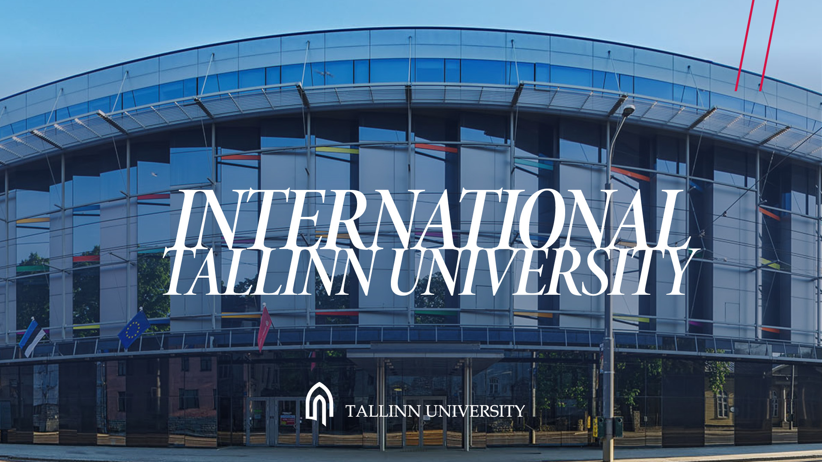

Slide 3
Notes:
Estonia is an e-society with electronic ID cards, e-government, e-health, e-school, e-parcing etc. We take pride of our innovations in education, e-governance, digital society and enterpreneurship. Estonia is the first e-government in the world. Bassically we have eliminatedˇall physical paper documents from government processes. There are plenty of start ups since registering a business is just one of the thousand of e-services that can be done quickly and easily. The Organization for Economic Cooperation and Development

Slide 5
Notes:
TÜ goal is to introduce the principles of suistainability to all our students.. TÜ takes steps in order to be sustainable itself. In and outside of classrooms, we are debating over the ways of solving complex environmental issues.

Slide 6
Notes:
We have a long and rich history. Starting as a Teacher’s seminary in 1919. In 2005 Tallinn University was founded by the Parliament. A number of higher education and academic institutions were consolidated into a single institution. Our campus is right in the heart of Tallinn, where everything is nearby, city centre, old town (15 min), dormitory (3 min), harbour (7 min), airport 25 min, beach 15 min.

Slide 8
Notes:
For example we have a 4k SuperNova cinema hall, modern production centre and technology.

Slide 10
Notes:
We have taken our place among the world’stop universities in a very short time. We have been in top 5% (top 1 000 best) since 2019. Mostly standing out in research. And you can see here, ranked by subject.

Slide 11
Notes:
Our research is guided by 5 focus fields. 100 years of teachers training,
digital and media culture in the increasingly digitised multiplatform world, digital literacy.
We give knowledge and skills related to cultures and languages,
We have become increasingly international.

Slide 13
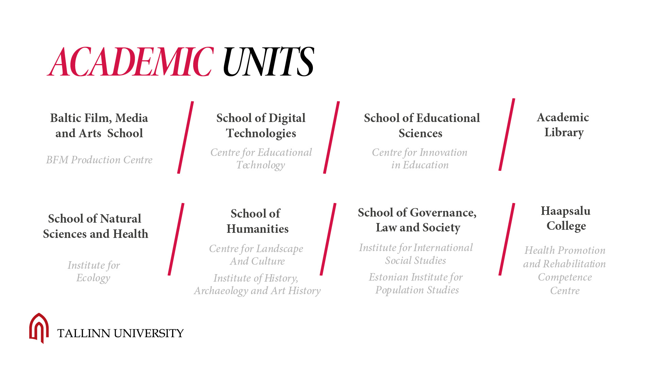

Slide 14
Notes:
Academic units are scattered allover the campus.

Slide 20
Notes:
It is a study course focused on project-and problem-based learning, where students from different areas collaborat with academics and partneers from outside university to carry out projects with interdiciplinary problems.

Slide 28
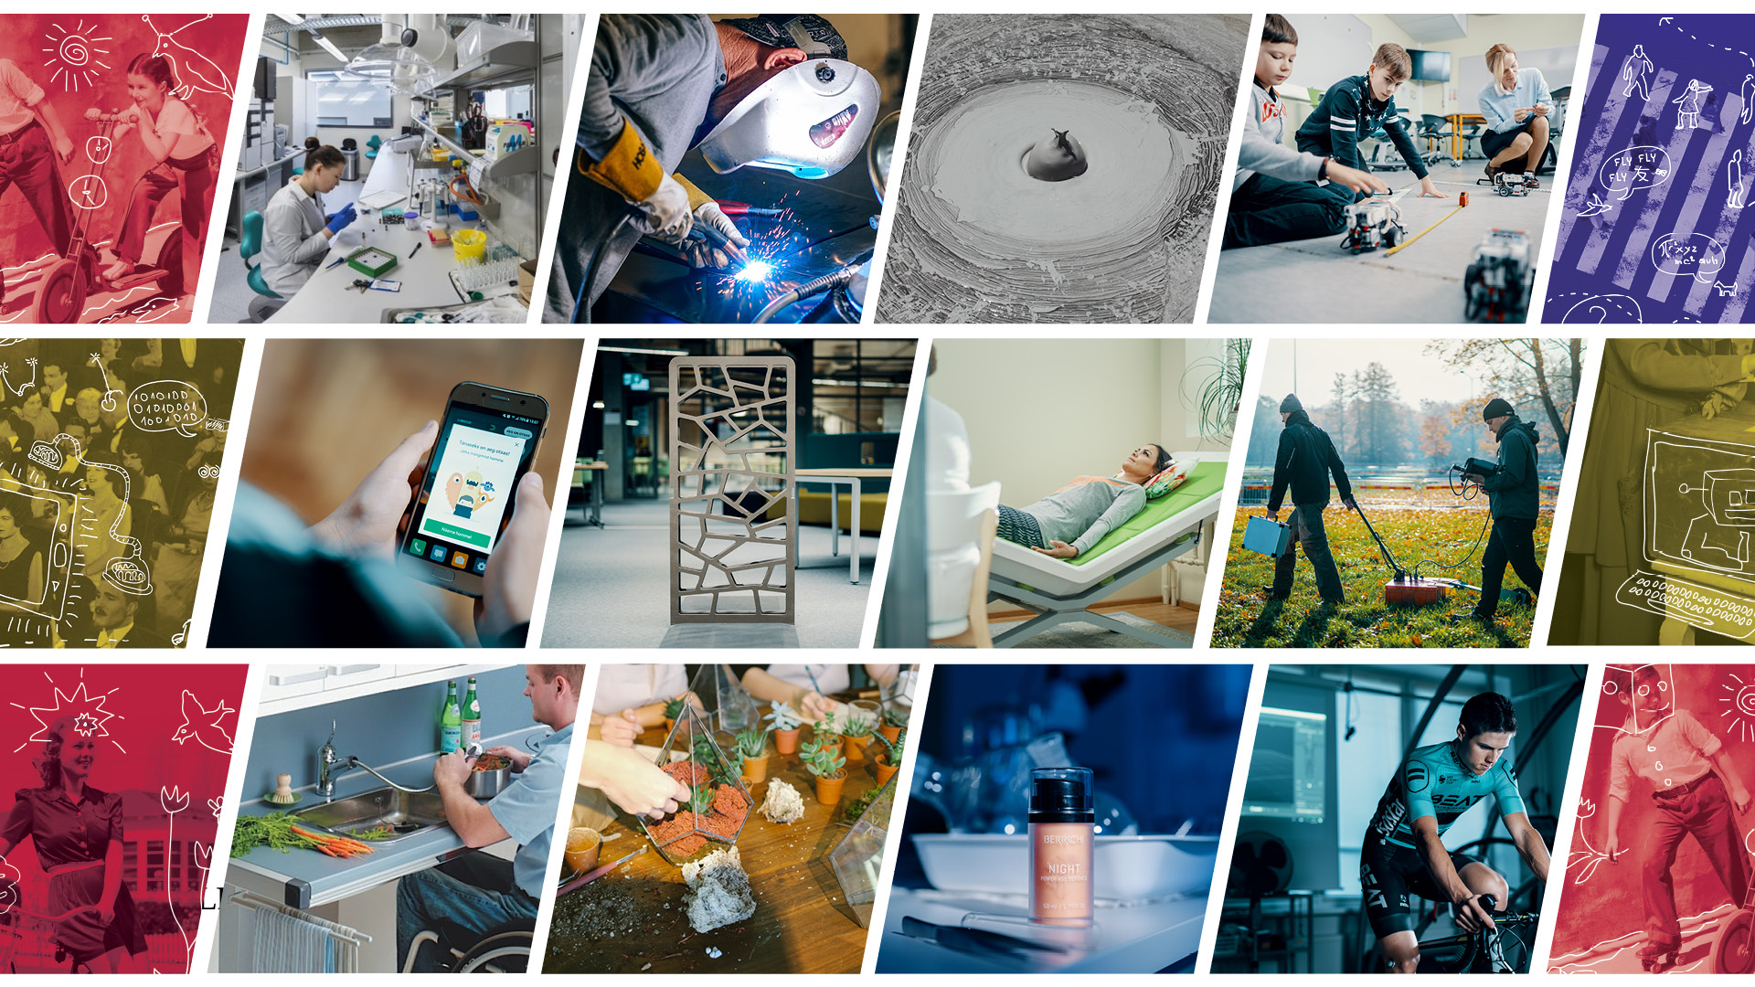

Slide 29
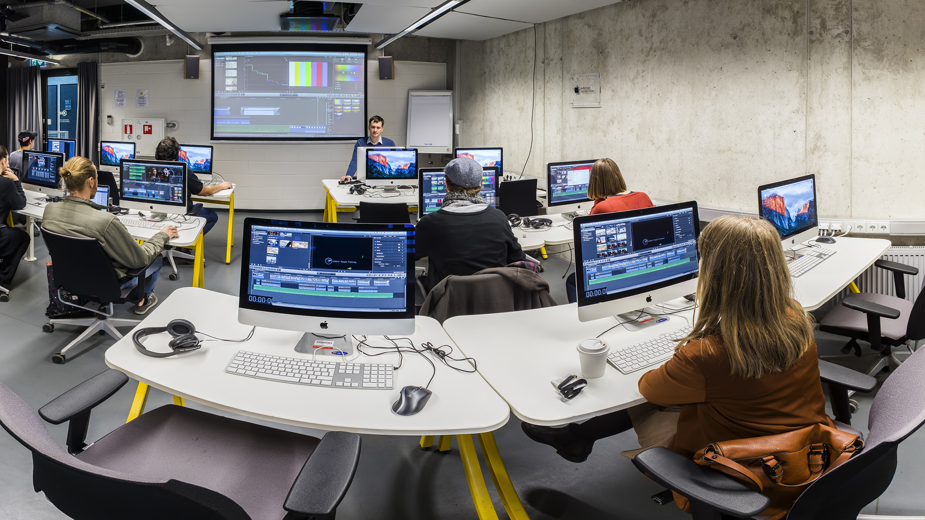

Slide 33
Notes:
We are working together with scools, kindergartens, teachers, students, other universities, governmental institutions, and anyone invested in education.

Slide 45
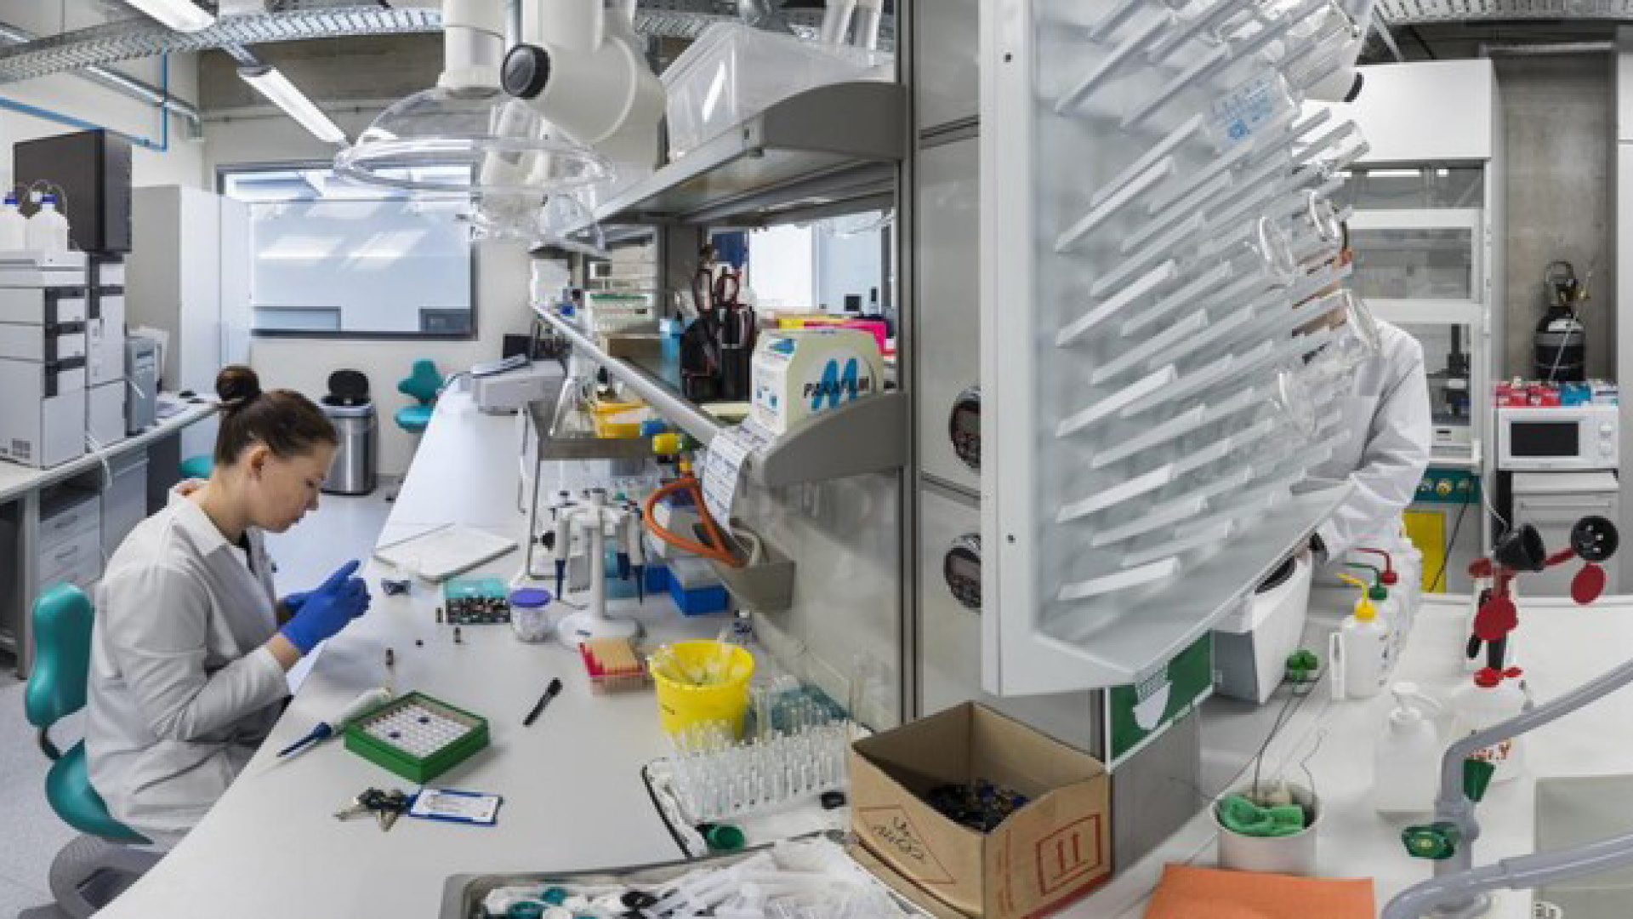

Slide 46
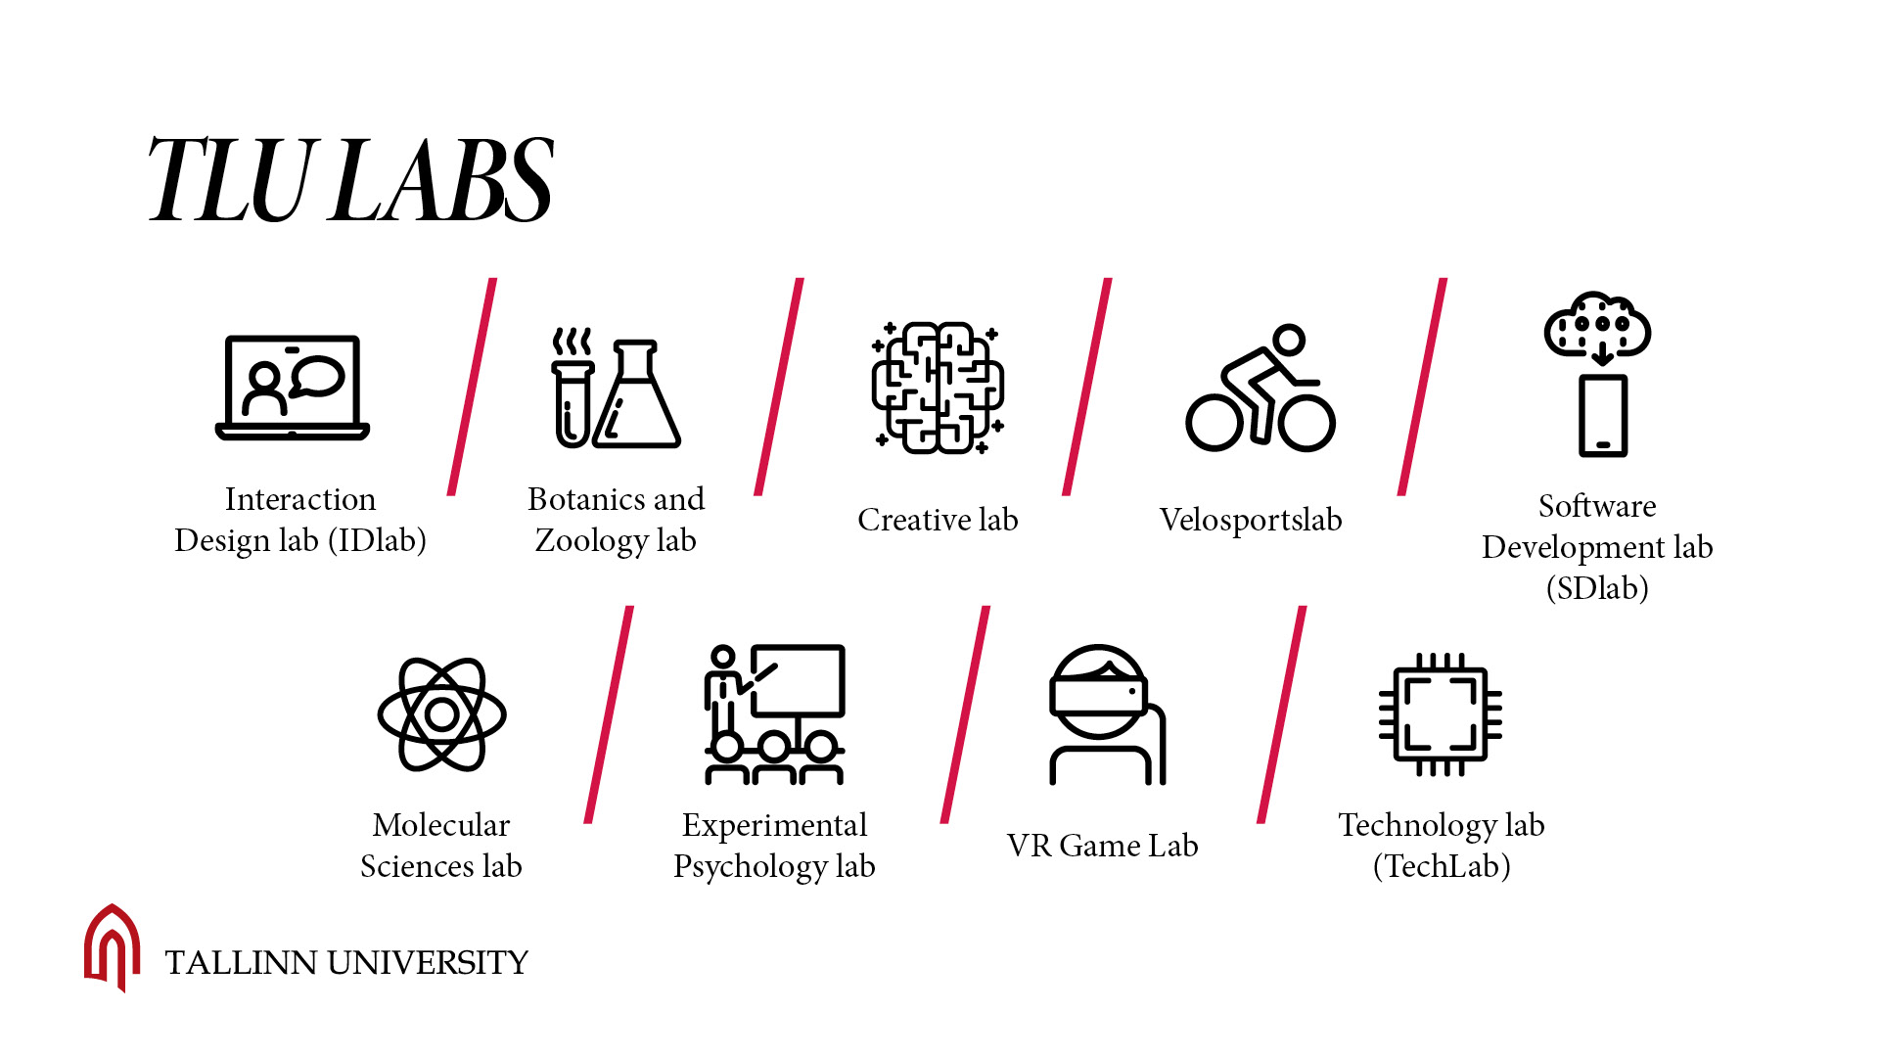

Slide 48
Notes:
We keep it local, yet international.. We have academic collaborations with various international institutions all over the world., agreements with 43 partner universities worldwide, and over 400 Erasmus + partnerships.

Slide 49
Notes:
Since 2006. 3 week program each July. Summer program includes talks by acclaimed academics, opinion leaders and intellectuals from other universities. There are 97 countries represented throughout the years, 90% are international students
Winter School- since 2010. In january.

Slide 50
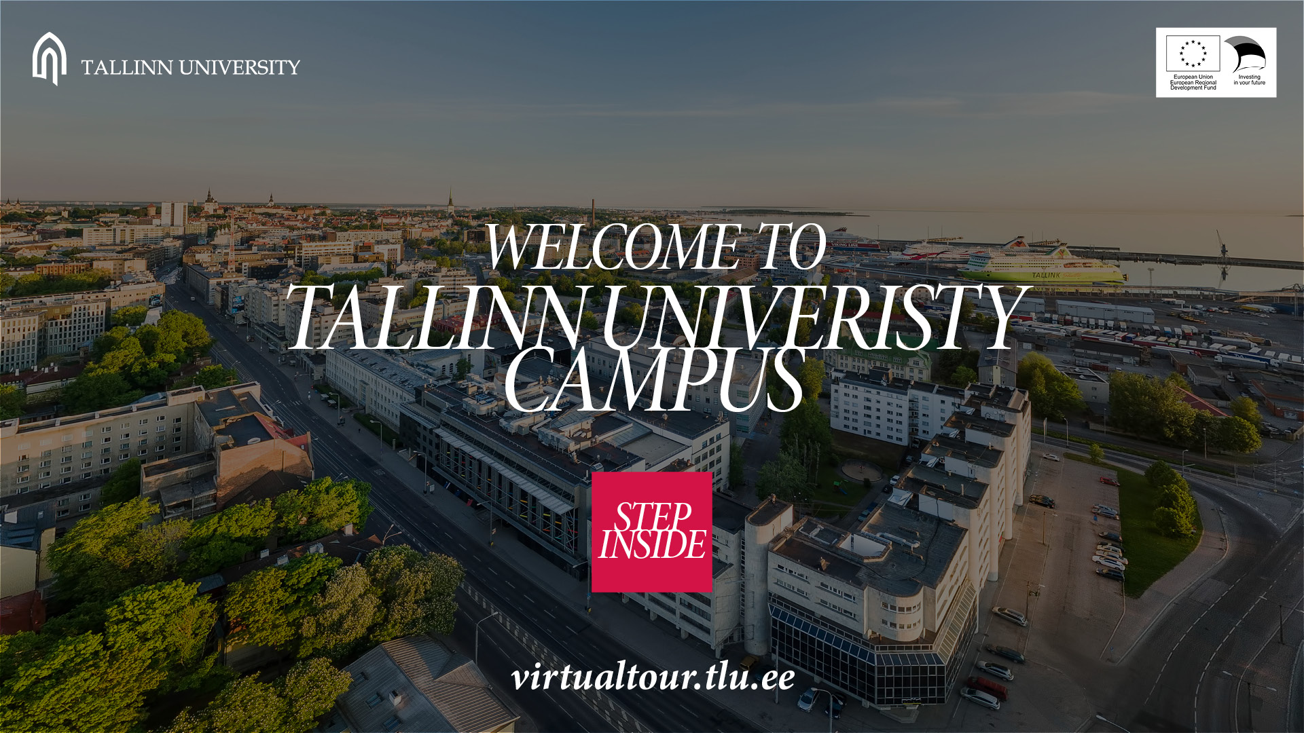
Notes:
Campus is in 6 parts. Each part built in different time. Our oldest builiding Terra built in 1940, in January 2020 we opened the new creative house called Vita(latin: Life), there you find art studios, dance halls, a black box, music classes, and a sound syudio, as well as ball games hall and a gym. Virtual tour on our web site.
Our student life is active. There are many possibilities for students to be acitvely involved in cultural, social, intellectual, sporting and recreational activities all year round.

