Slide 1
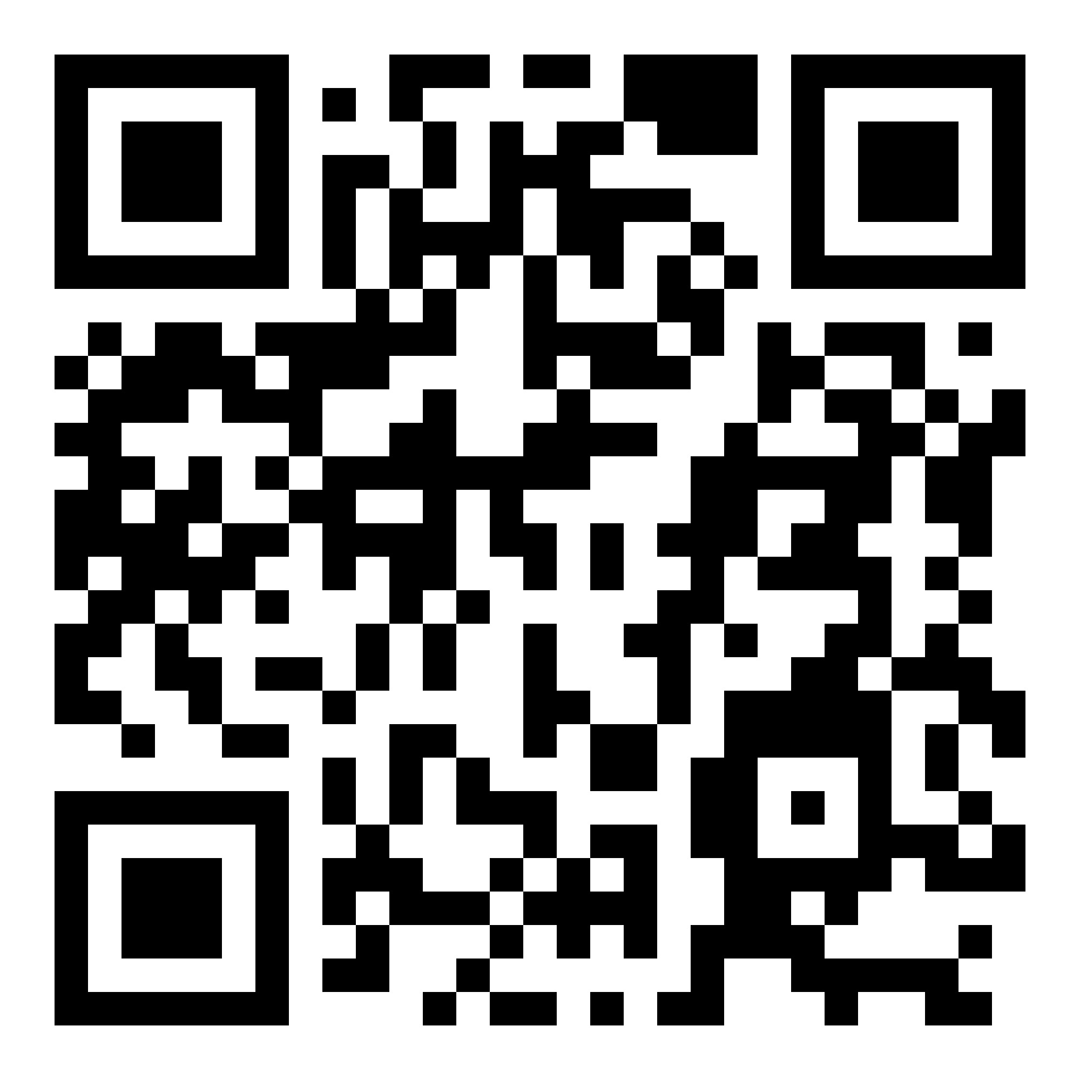
TERE TULEMAST! Orientation
www.tlu.ee/orientation

Slide 2
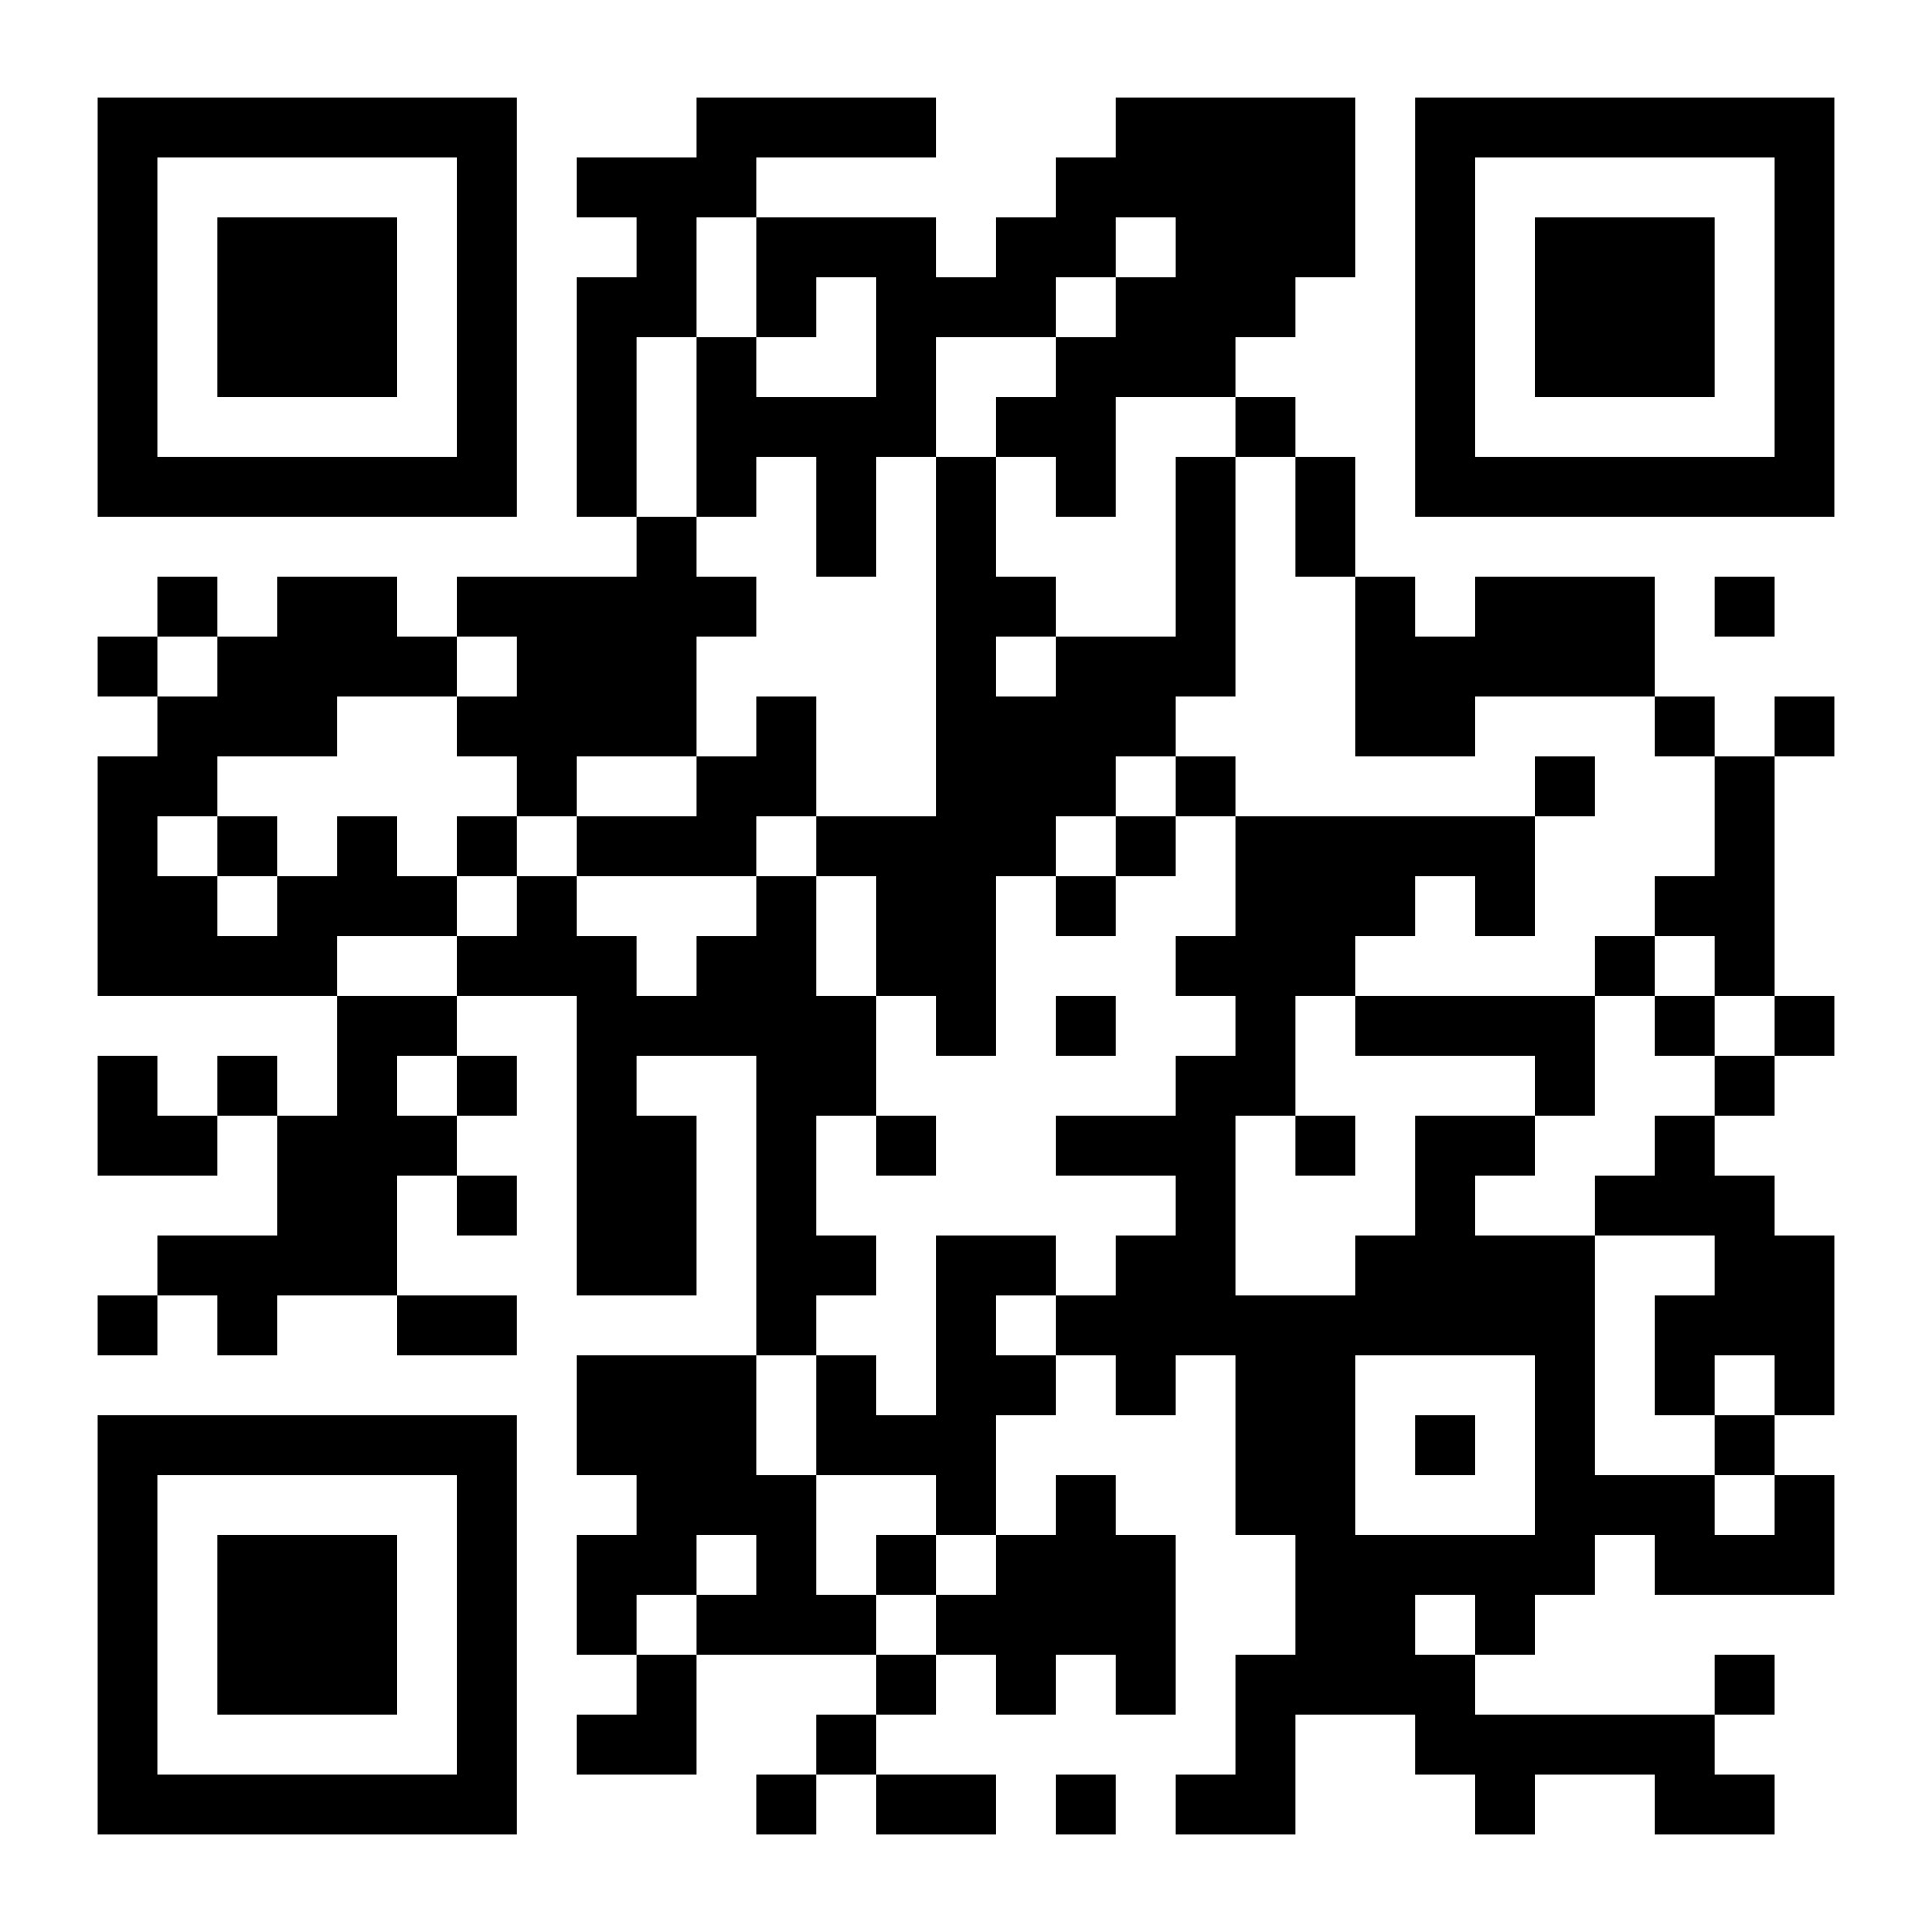
Agenda www.tlu.ee/orientation
29 January
10.00 Welcome and agenda – Student Union and Ingrid Hinojosa, TLU
10.15 Tallinn University – Cristel Kiilstrom, TLU
10.30 ÕIS and Emails - Merli Laurson, Henni-Maria Johanson, TLU
10.40 Accommodation, student cards, printing - Ingrid Hinojosa, TLU
10.50 Tallinn University Library – Carolina Schultz, TLU
11.00 Break
12.00 Health Care in Estonia – Marko Tähnas, Health Insurance Fund
12.30 Safety Tips from the police
12.50 Residence (EU), D-visa (non-EU); Transport – Ingrid Hinojosa
13.00 International Club – Ruth Karu, TLU IC
13.00-16.00 – Opening TLU user account (S-203)
Registration for Library Tours (Doodle)
20.00 Karaoke night (Gruuv)

Slide 3
Agenda www.tlu.ee/orientation
30 January
10.00 Culture morning
10.40 International House of Estonia – Sandra Rebane
11.00 ESN Tallinn – Maret Luud, ESN Partnership Manager
11.20 Student Support Centre – Kadri Pakaste, TLU
11.40 System of Studies, tips for survival at TLU – Ingrid Hinojosa, TLU
12.30 Meeting departmental coordinators
13.00-16.00 – Opening TLU user account (S-203)
19.00 Movie night (N-406)

Slide 4
Agenda www.tlu.ee/orientation
31 January
10.00 Library Tours (meet at A-205)
13.00-16.00 – Opening TLU user account (S-203)
16.00 – Old Town Tour (Vabaduse väljak)
01 February
10.00 Library Tours (meet at A-205)
20.00 Speed Friending (Guuv)
02 February
12.00 Russian Intensive Course info session (A-121)
17.00 Culture Evening (Mare Building, 3rd floor)

Slide 5
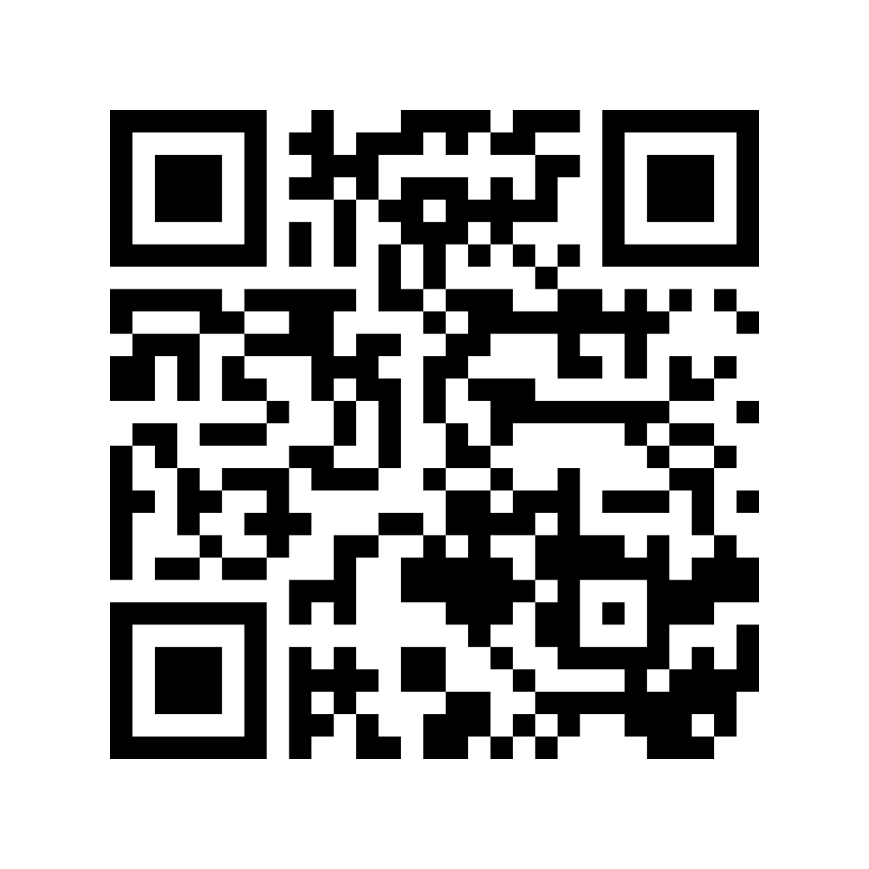
Announcements
Book an appointment to register and get
your welcome bag
Check that you have the Estonian time settings in your Calendar
Staff emails normally follow the pattern firstname.lastname@tlu.ee
Sim cards – get in T-222
New course, starts 29.01 16.15-17.45, A-325
BA - HIL6212.HT Special Course in Asian Studies
MA – HIL7254.HT Southeast Asian Societies and Policies

Slide 6
Announcements
Still looking for accommodation? Email: exchange@tlu.ee
Gym is cheaper if you register before 31.01
More information: https://sport.tlu.ee/en/

