Slide 1
Tallinn University International Club ESN TLU IC

Slide 3
Our section was created in 2006 as part of the Student Union Official section of ESN since 2009 4 - Board Members
~20 - Members

Slide 4
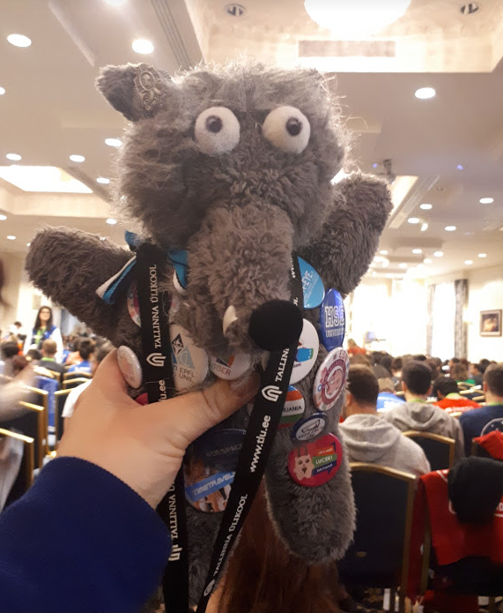
The Board
PRESIDENT
COMMUNICATIONS MANAGER
RUTH KARU
?
VICE-PRESIDENT
EVENT MANAGER
TASNEEM HAQUE
?
MASCOT

Slide 5
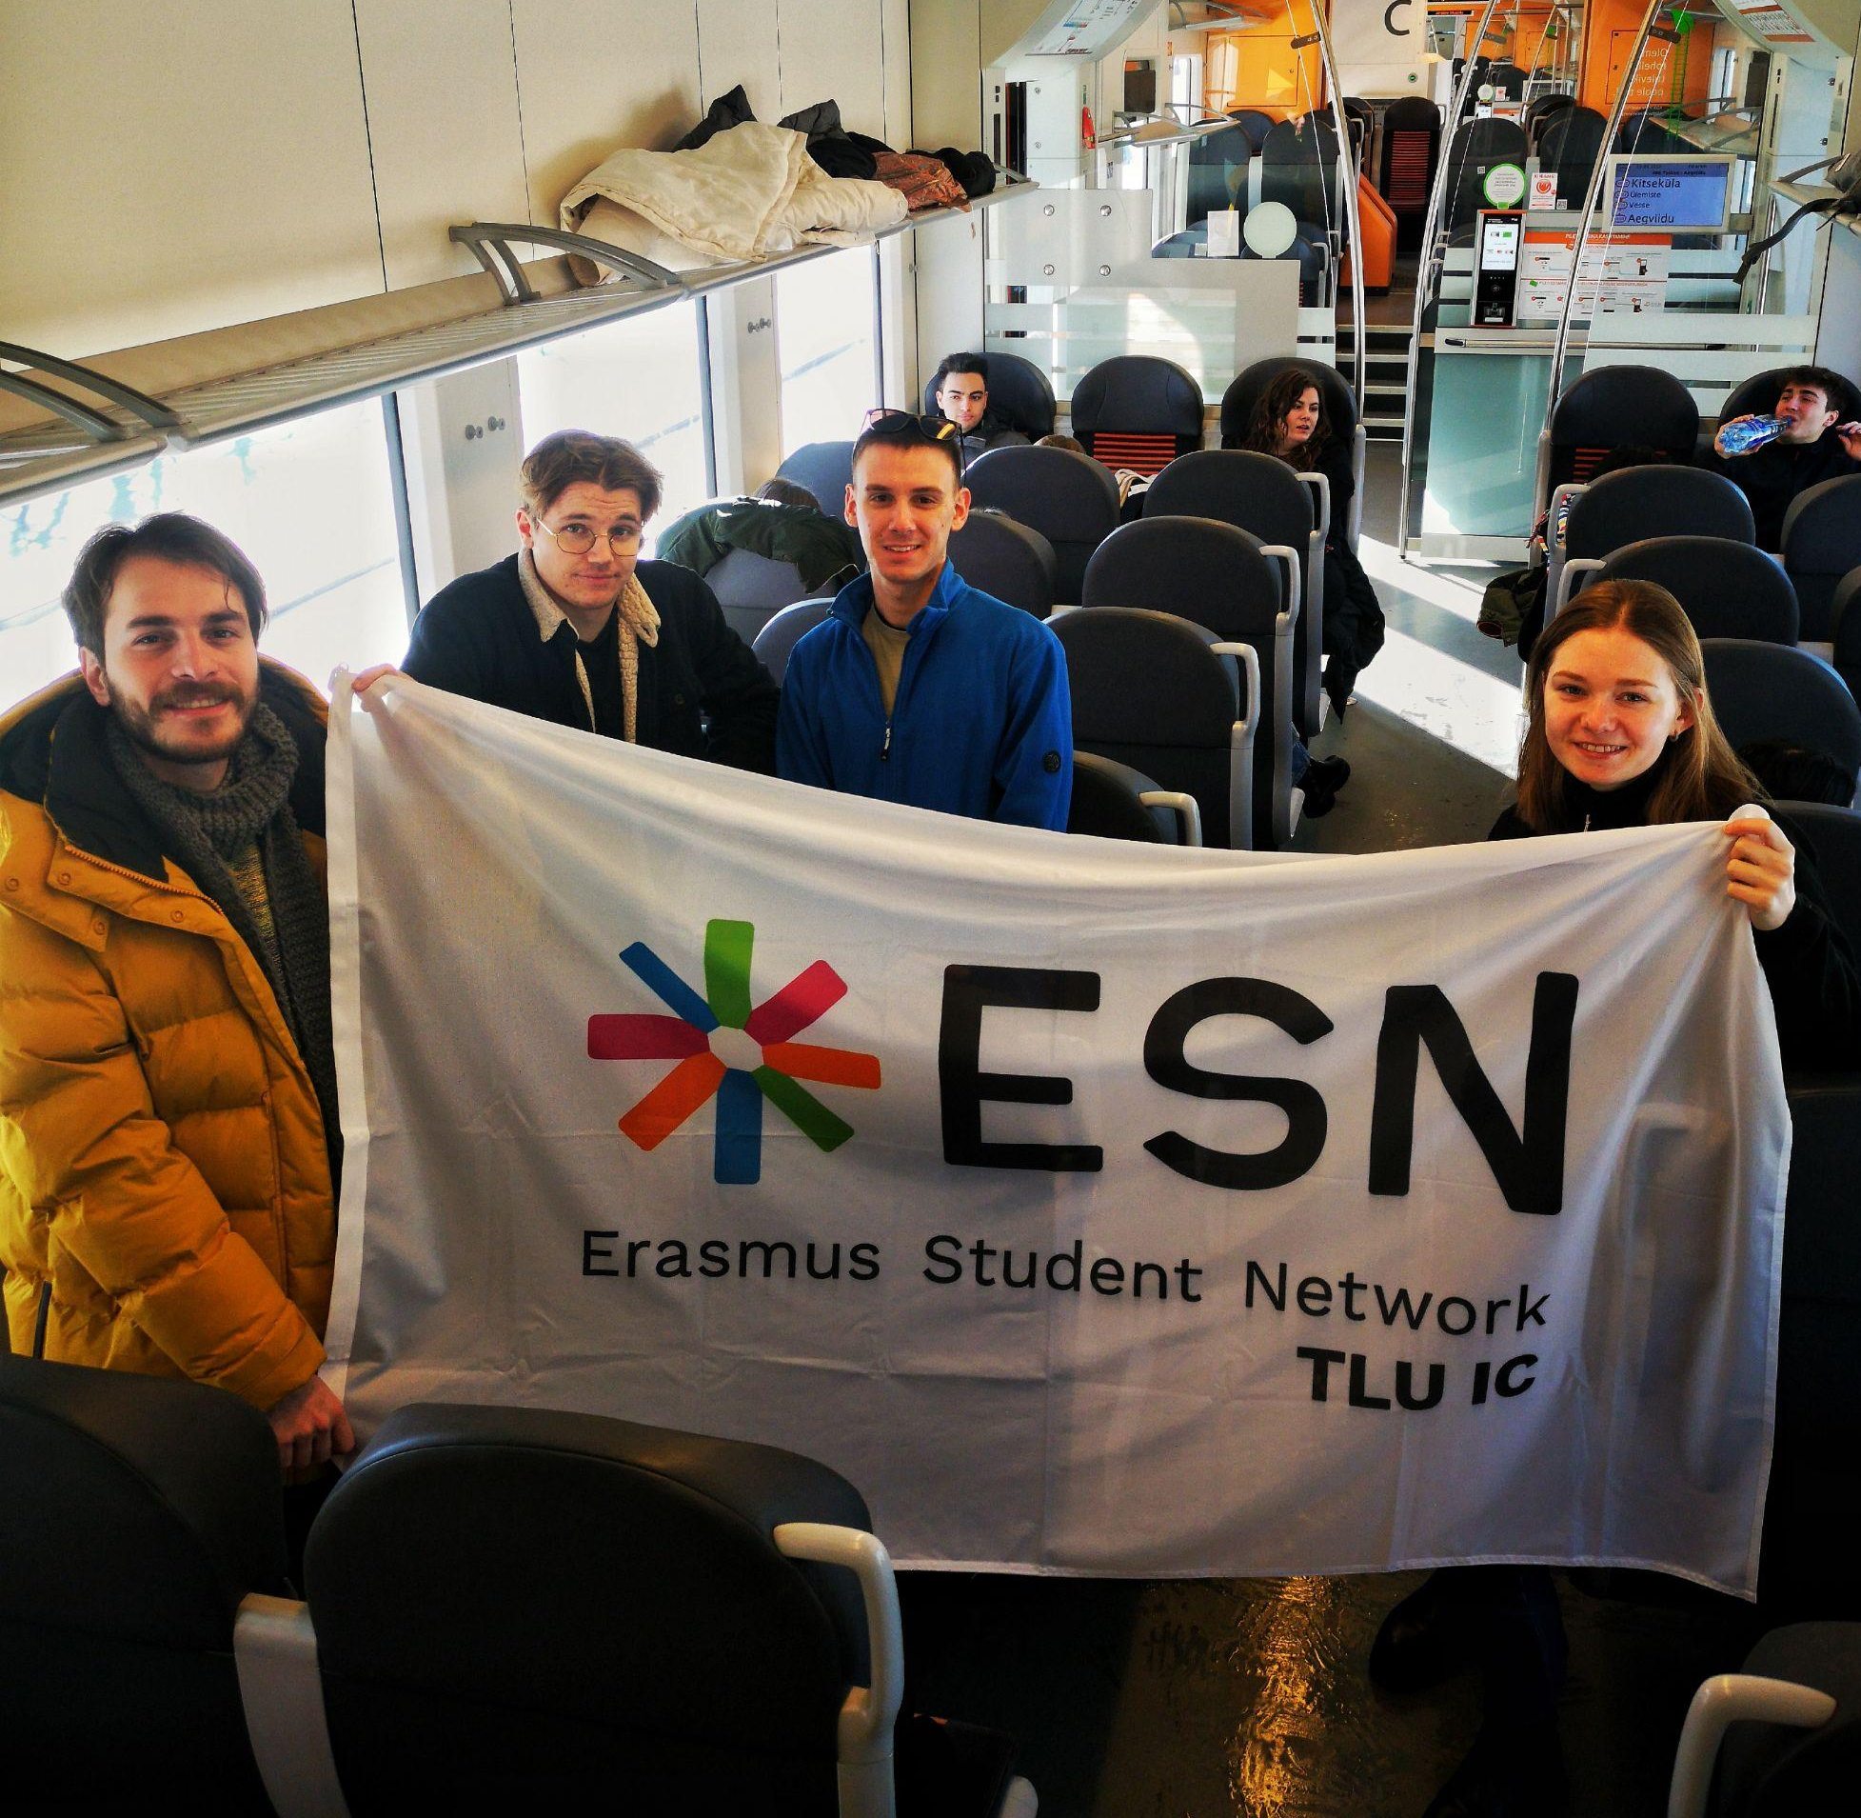
What We Do....
Work in the interest of international students with the help of international and local students
Work to improve the social and practical integration of international students
Motivate local students to study abroad
Contribute to the improvement and accessibility of student mobility
Value volunteering and active citizenship

Slide 6
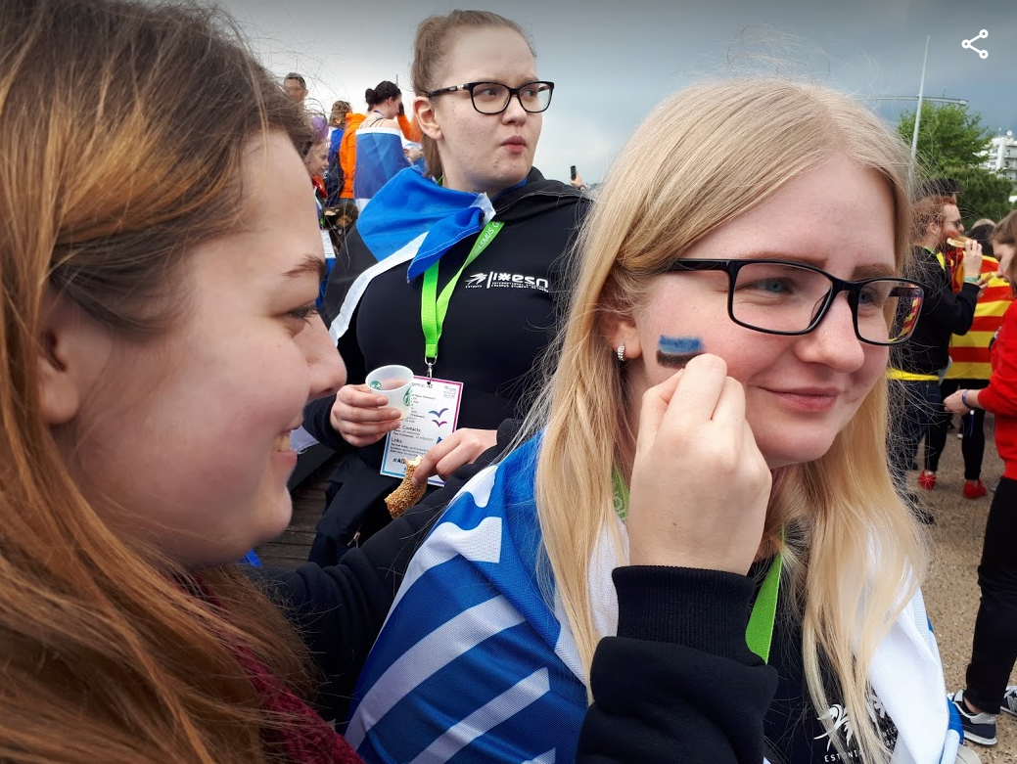
Our Values
Friendship
Support
Openness
Respect
Diversity
Professionalism

Slide 8
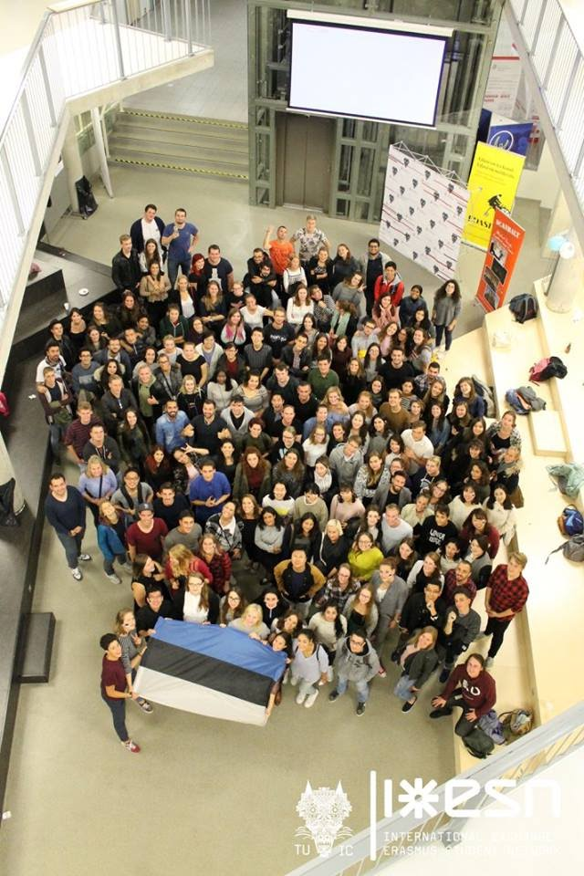
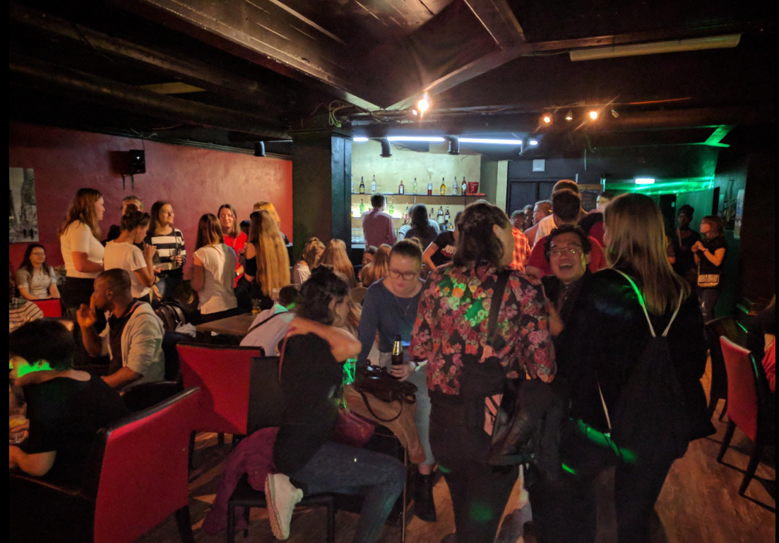
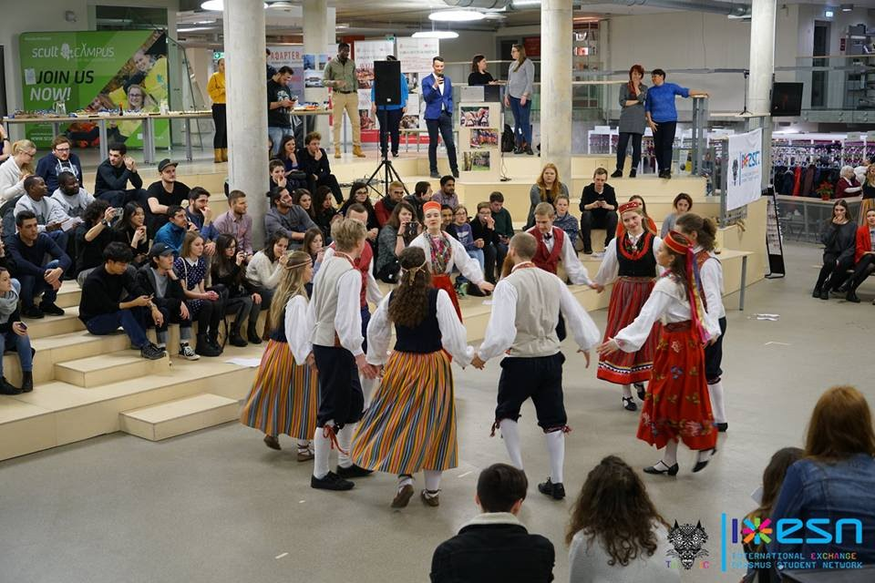
Events
Speed - Friending
@Gruuv
Estonian Evening

Slide 9
Upcoming events
Dates | Events
29/01 at 20:00 | Karaoke Night
30/01 at 19:00 | Movie Night
31/01 at 16:00 | Old Town Tour
1/02 at 20:00 | Speed Friending
02/02 at 17:00 | Estonian Evening

Slide 10
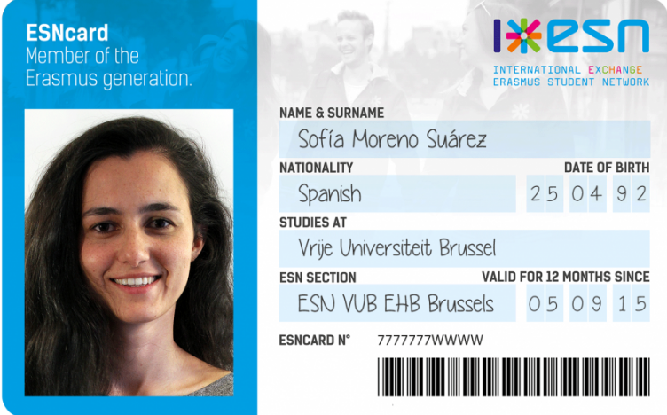
ESNcard
Discounts with our events and also with many other partners within Estonia throughout Europe.
ESN TLU IC office in room S-141 (11:00-17:00).
15€ (only in cash) and bring a document photo (3x4 cm).
Notes:
Partners: Flixbus, Ryanair, Timetravels, Gruuv

Slide 11
International Partners

Slide 12
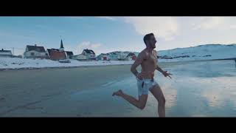

Slide 13
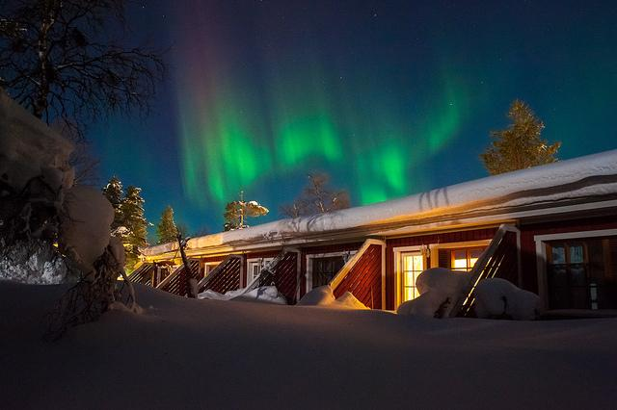
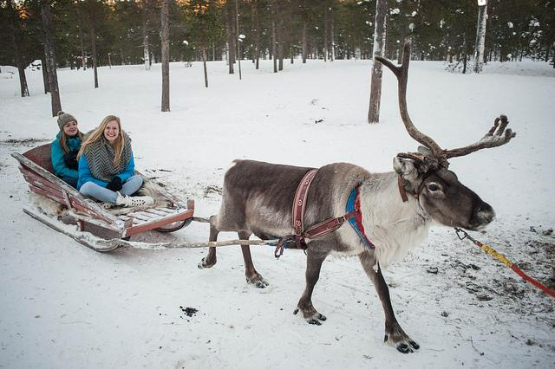
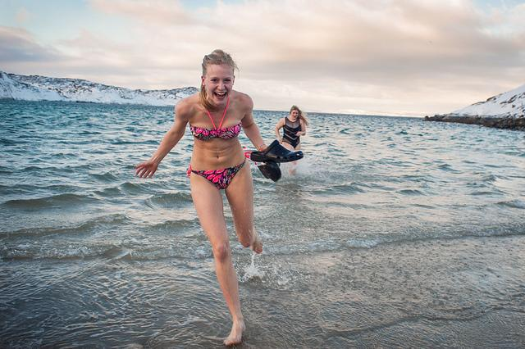
Planned Trips!
Lapland- SAARISELKÄ
Saaremaa trip

Slide 14
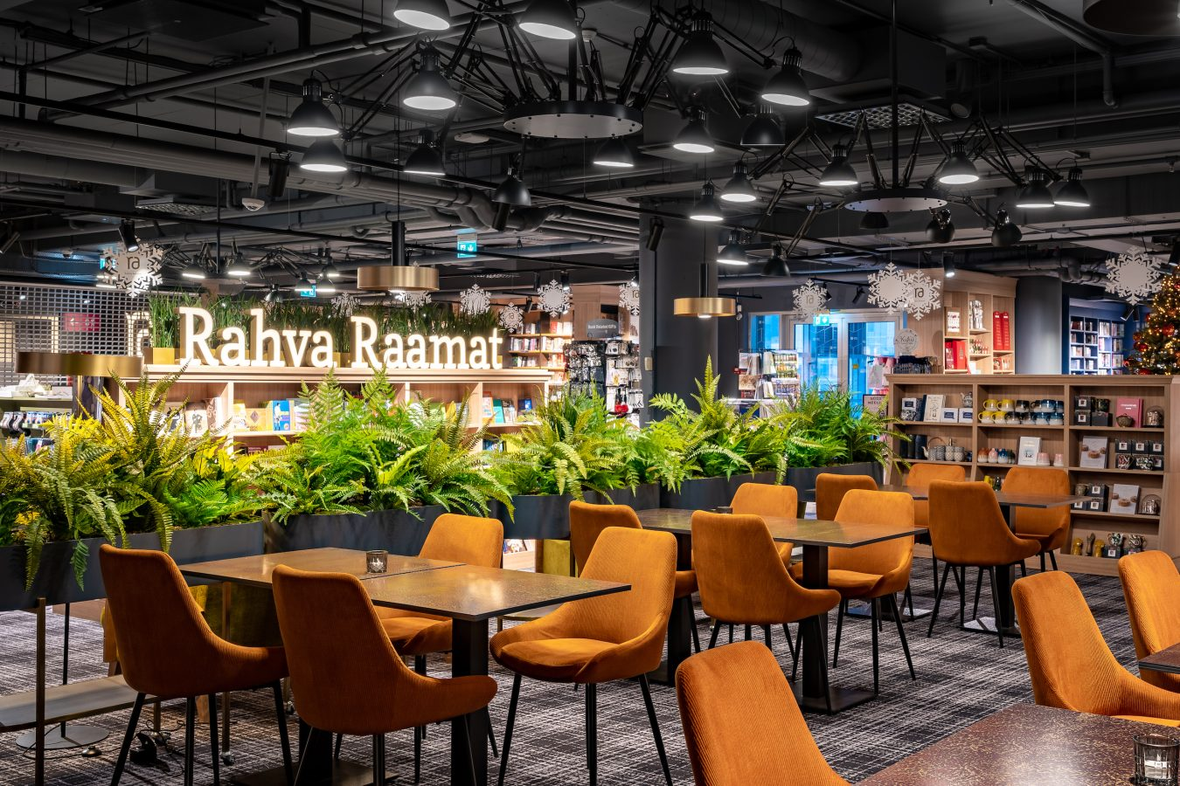
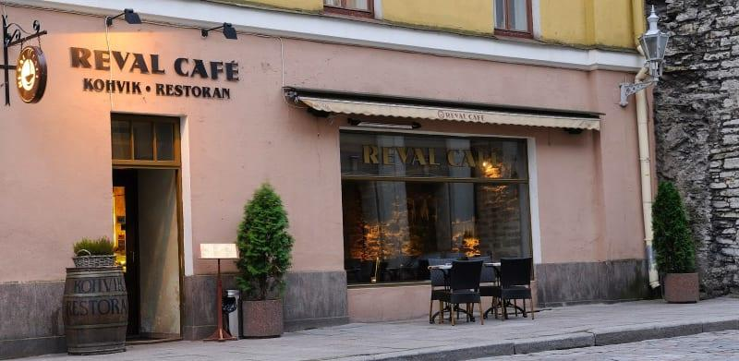
Discover Tallinn

Slide 15
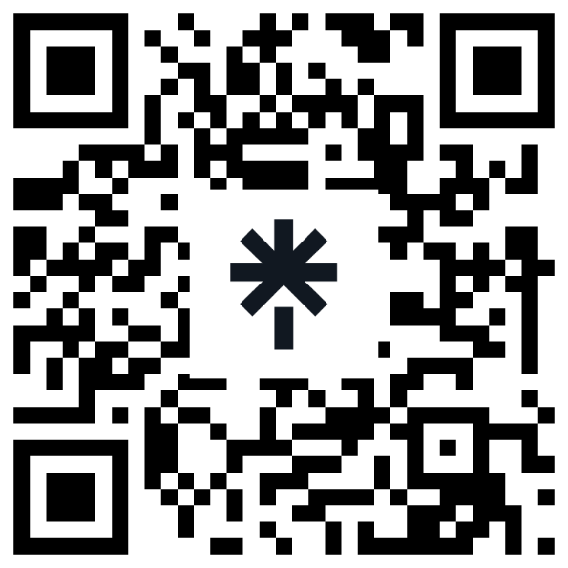
Find us!
linktr.ee/esn_tluic

Slide 16
