Slide 1
POLICE AND BORDER GUARD BOARD
Tips for the foreign students in Tallinn

Slide 2
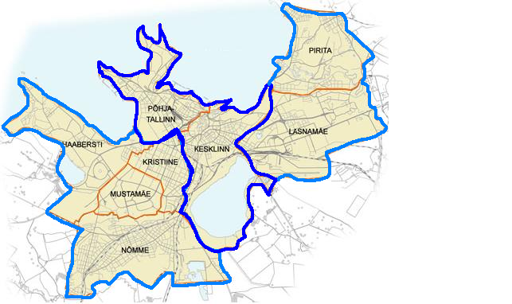
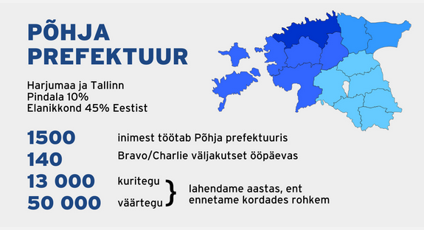
Police departments in Tallinn
East Police Department – P. Pinna 4
South Police Department – Rahumäe tee - 6/1
Information – 1247 (24/7)
East Police
Department
South Police
Department

Slide 3
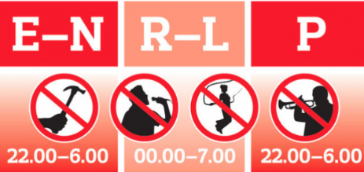
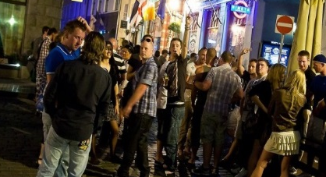
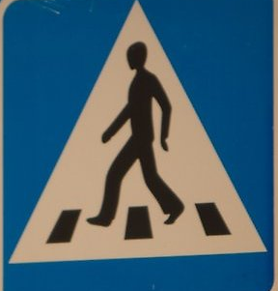
Not allowed
ALCOHOL
to drink alcohol in public places (like: parks, bus station and so on) – i’ts not nice to see, but not agaist the law
to yell, to urinate, to spit, to throw around garbage, to lie on the ground, to sleep in public places
________________________________________________
NIGHT PEACE
to disturb others peace at night with loud music
Sunday to Thursday – 22-06
Friday to Saturday – 00-07
________________________________________________
TRAFFIC
to cross a roadway in places not suitable for crossing (cross the roadway by traffic lights or crosswalk - “zebra”)

Slide 4
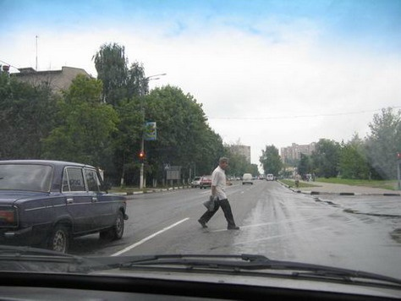



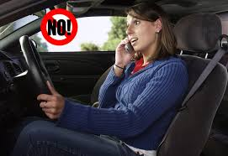

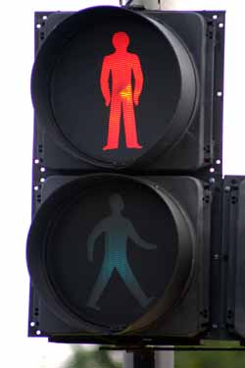



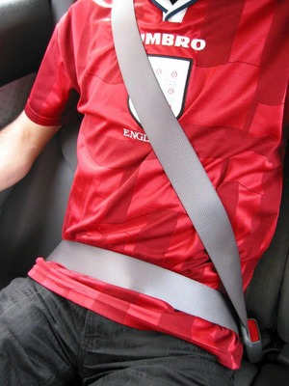
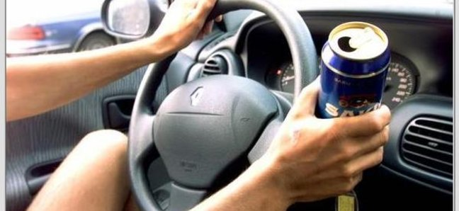
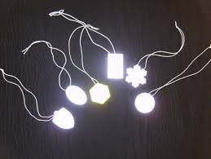


Slide 5
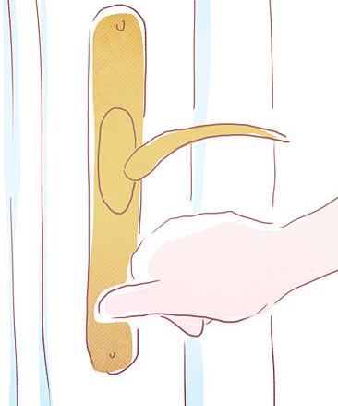
Safety at home
Do not give your keys to other people.
Close curtains when you leave home.
Do not let strangers enter your home.
Take your property (e.g. scooter, bicycle) home.
Police, Emergency, Fire department workers wear uniform and introduce themselves by showing official ID.

Slide 6
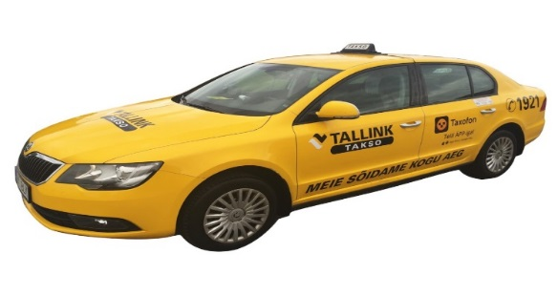
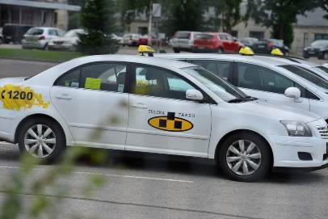
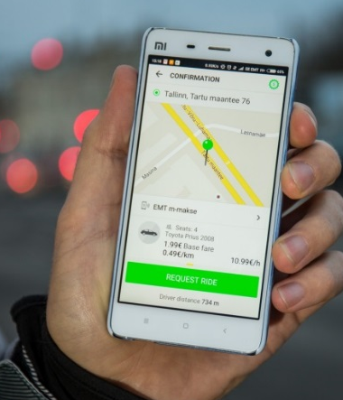
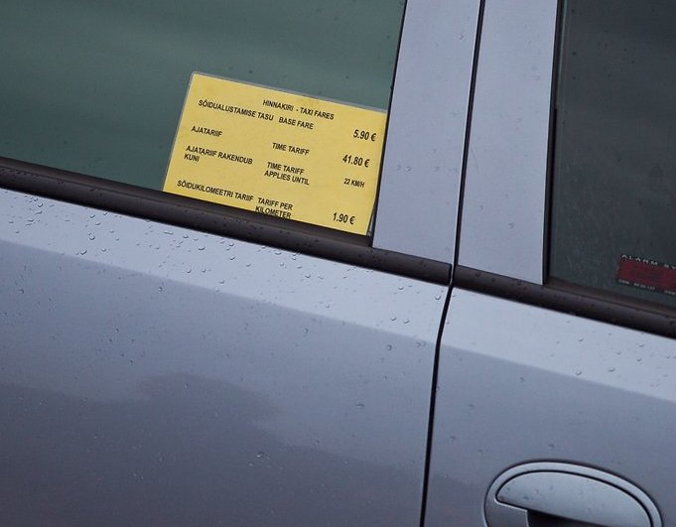
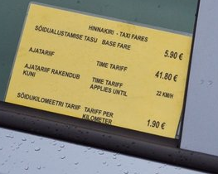
Taking a taxi
There are many respectful taxi companies, use them.
Avoid taxis that stop and offer their services.
Before taking a seat, verify the tariff schedule!
In suspicious cases do not enter.
FORUS +372 612 0000
Tallink Takso +372 640 8921

Slide 7
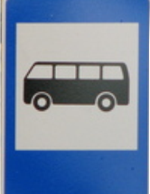
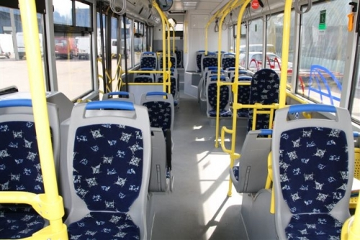
Public transport
Avoid bus stops that are not well lit.
Make sure that your valuables are safe, use inside pockets.
In empty bus, sit near the driver.

Slide 8
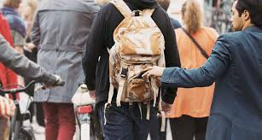
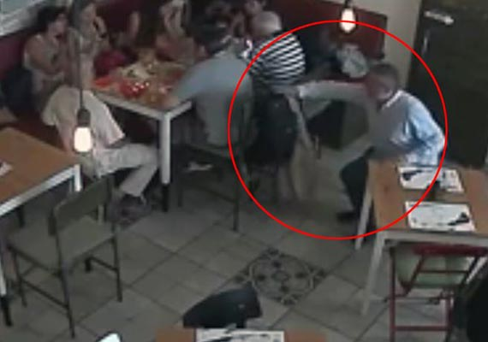
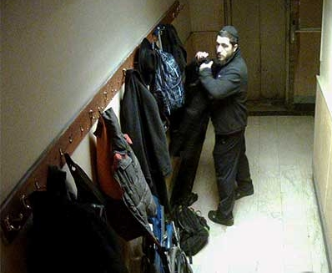
Public places
Avoid being alone at nighttime. Especially when you are under the influence of alcohol.
If somebody grabs your bag, let it go. Your safety is more important.
Pay attention to your surroundings.
Always choose well lit routes.
Do not leave Your things in Your car.
Hide your valuables.
Lock your bicycle and car.

Slide 9
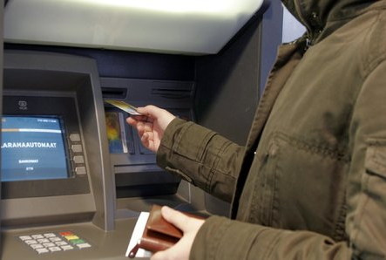
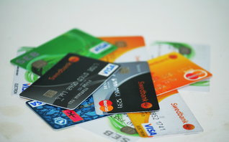
Cards
Keep your debit and credit cards near you, don´t tell others your PIN codes. (cases have taken place in night clubs, where young guys while being drunk give their card to someone else to use and in the morning find out their bank card is missing).

Slide 10
Internet
Do not publish personal information.
Keep passwords for yourself.
Do not open weird messages and invitations, do not klick the suspicious links.
Log off when you finish your activity on your computer.
Think before click on different sites.
Use secure and different passwords on your accounts.
There is no anonymity on the internet
Web police officers ON FACEBOOK
https://www.facebook.com/people/Anna-Liisa-Kreitsman/100077757520419/
https://www.facebook.com/vladlen.jakovlev
https://www.politsei.ee/et/veebipolitseinikud

Slide 11
Offences against Equality
§ 151. Incitement of hatred
Activities which publicly incite to hatred, violence or discrimination on the basis of nationality, race, colour, sex, language, origin, religion, sexual orientation, political opinion, or financial or social status if this results in danger to the life, health or property of a person.
In this case the result has to be a real threat to the life, health or property.
Message has to be such that also cause hatred or violence in other persons, so that community accepted it.
Insult (race, skin color, etc. ) – civil court case
https://humanrights.ee/en
E-mail: info@humanrights.ee
Facebook: @humanrightscentre
Telephone: (+372) 644 5148

Slide 12


If You do not know the law, ask for help
Not knowing the law is not an excuse
for breaking the law. Follow the law!

Slide 13
PUNISHMENTS
Violation of law | Fine
Drinking in a public area | 400 euros or 30 days in jail
Using or owning a small amount of drugs | 800 euros or 30 days in jail
Crossing the road in a wrong place / not wearing a reflector | 20 euros
Stealing a thing what costs less that 200 € | 1200 euros
Hurting someone / violating public order in a group | criminal punishment
Racial violence if the person’s life or property is under danger - The result has to be a real risk to a person's life, health or property. | 1200 euros or 30 days in jail
NB: these are maximum punishments. There is usually a warning before the fine! Depends on the case

Slide 14
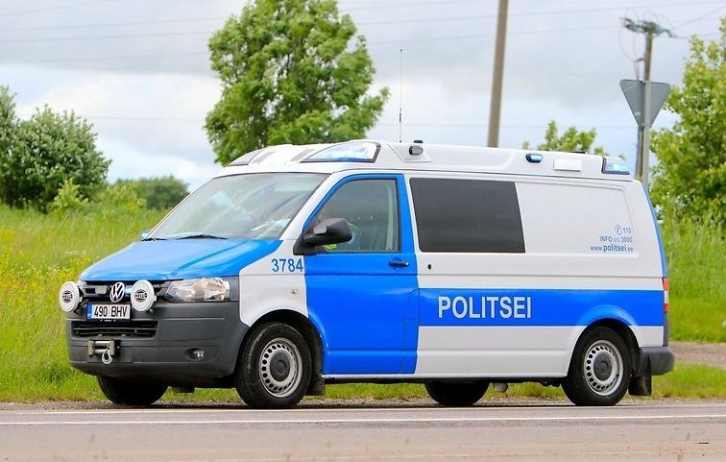
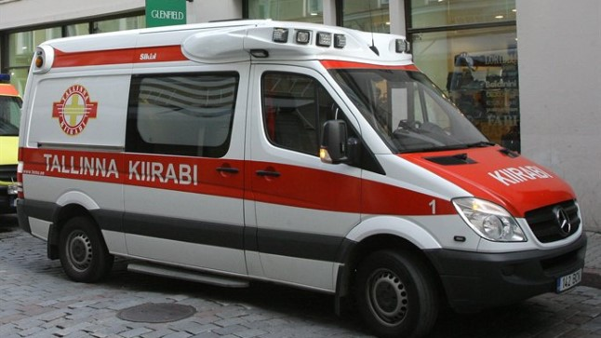
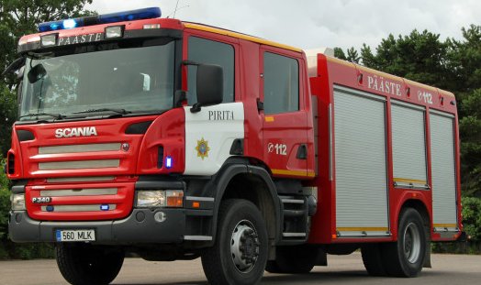
112 Emergency number (Police, Medical assistance, Fire department)
Information – 1247 (24/7)

Slide 15
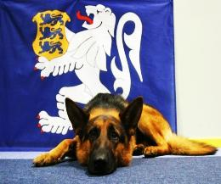
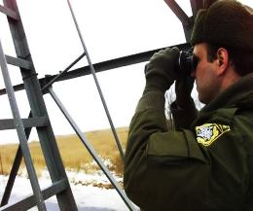
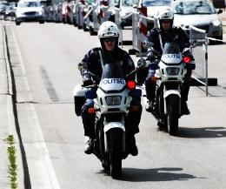
Thank you for your attention!
Questions?

