Slide 1
Tips about Academic Communication and Conduct
Ingrid Hinojosa

Slide 2
Cheating and plagiarism (Study Regulations)
In a case of disregard for academic practice, depending on the seriousness of the violation, the Director of the academic unit has the right to issue a letter of reprimand to the student or make a proposal to delete the student from the matriculation register. The following is considered a violation of academic practice:
1) Using additional materials; 2) Unauthorized exchange of knowledge during an examination
3) Participating in an examination or pass-fail assessment on behalf of another student or enabling it; 4) Submission of someone else ́s written work under one ́s own name or submitting previously submitted work;
5) Plagiarism, i.e. using somebody else ́s written work or ideas (also your own previous work) without providing proper academic reference; 6) Knowingly giving untrue data in papers and applications.

Slide 3
What will happen?
If the student is detected as having violated good academic practice, a note will be added to the Transcript of Records and the course is marked as F.
Read more about plagiarism at https://www.tlu.ee/en/students-about-ethics-and-plagiarism
Good Practice in Learning: https://www.tlu.ee/en/application-good-academic-practice-studies

Slide 4
Emails
Be polite
Include as much relevant information as possible (field of studies)
Save the email conversation
Don’t forget your name
Read and reply to emails
University staff does not have to respond instantly to your emails. Response time is three (at busy times five) working days. So, please be patient – it does not make it faster if you send an email every hour.

Slide 5
Going to the office
Respect the office hours
If necessary, make an appointment
Prefill your documents
Introduce yourself
Keep the volume down...
One student at a time
Please see the webpage first, usually all the information you need is there.

Slide 6
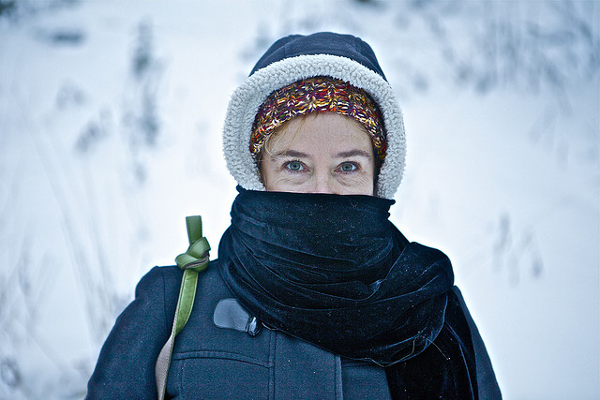
What to wear?
Ceremonies – to be on the safe side wear black and white
Appropriate attire for the occasion
Appropriate to weather conditions

Slide 7
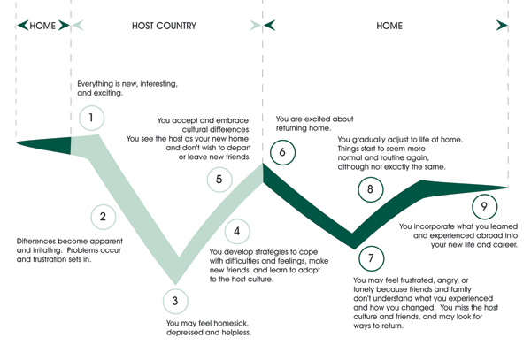
The W-curve of culture shock
Notes:
Not just one time low and high – waves.

Slide 8
Symptoms of culture shock
Boredom, loneliness
Allergies, pain
Obsession with own health
Sleeplessness, excessive need of sleep
Mood changes, depression, powerlessness
Anger, animosity against other people
Identification and idealisation of home culture
Trying to absorb everything within the new culture too fast
Not capable of solving even the most simple problems
Loss of self confidence and insecurity
Development of stereotypes in the new culture
Strong longing for family and friends back home
Feeling overlooked
Notes:
Have you noticed any symptoms when tutoring?

Slide 9
Ideas for coping
Accept that you cannot know everything
Keep an open mind
Try to do things that you did at home
Stay in touch with family and friends at home – it is OK to miss them
Get to know someone from the new culture
Talk to a friend or somebody else
Stay active – physical activity often helps
Learn from experience – but be patient, learning new things takes time
Remember the good things as well
Knowing about culture shock helps

Slide 10
General things to keep in mind
Being late is considered rude
We don’t normally eat at lectures
People are treated equal – no matter what their gender or age is
Respect agreements. Let the other person know if there has been a change of plans
Students are expected to be independent. University staff normally communicates directly with students, not with their parents or friends

Slide 11
Cultural tips
Remove your shoes when visiting someones’s home
Don’t take it personally when people seem too serious to you – this is just the nature of people here
Estonians can get very sensitive when someone makes a critical remark about their culture
Greetings are rather formal (handshake)
Notes:
Talk about nuditiy and sauna, going to the doctor

Slide 12
Legal considerations
Drinking and smoking are illegal if you are under 18
All drugs are illegal!
Drinking and smoking are not allowed in public places
Wearing a reflector in the dark is required by law
HELKUR

Slide 13
Case study
An exchange student from Southern Europe came to Estonia and he was very happy with his choice – everything was very well-organized and he felt welcomed. After some time he started to realize that people aren’t very friendly– they didn’t greet him in the corridor and turned the head away.
Once he was invited to an Estonian wedding. He learned Estonian songs and dances and got to know many Estonian students. Next week his new friends acted as nothing had happened, they only said ‘Hi!’ in the corridor and walked on. The exchange student felt guilty and was wondering what he was doing wrong.
Why did this situation occur?

Slide 14
Case study
An exchange student from Asia went shopping in Estonia and was very surprised. She wanted to buy boots and it took time before she got the attention from the shop assistants. The assistants helped her but were quiet and reserved, didn’t smile nor asked her if she needed extra assistance. It seemed to the student that the assistants were impolite and blamed herself for not acting ‘correctly.’
The exchange student went to the adviser and asked what she had done wrong. What could she do differently next time when she goes shopping.
Why did this situation occur?

Slide 15
Have a safe and enjoyable stay here!
Visitestonia.com

