Slide 1
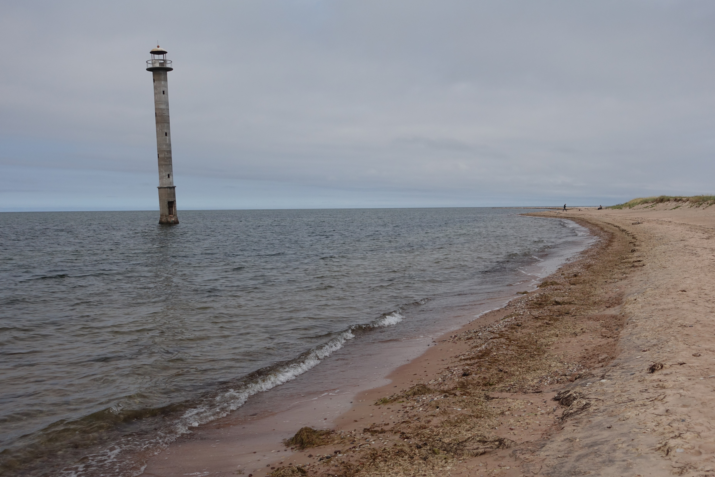
Ancient coastal formations as an archive of past storminess-related climate fluctuations on uplifting coasts of Estonia
Hannes Tõnisson, Ülo Suursaar
Tallinn, 2022

Slide 2
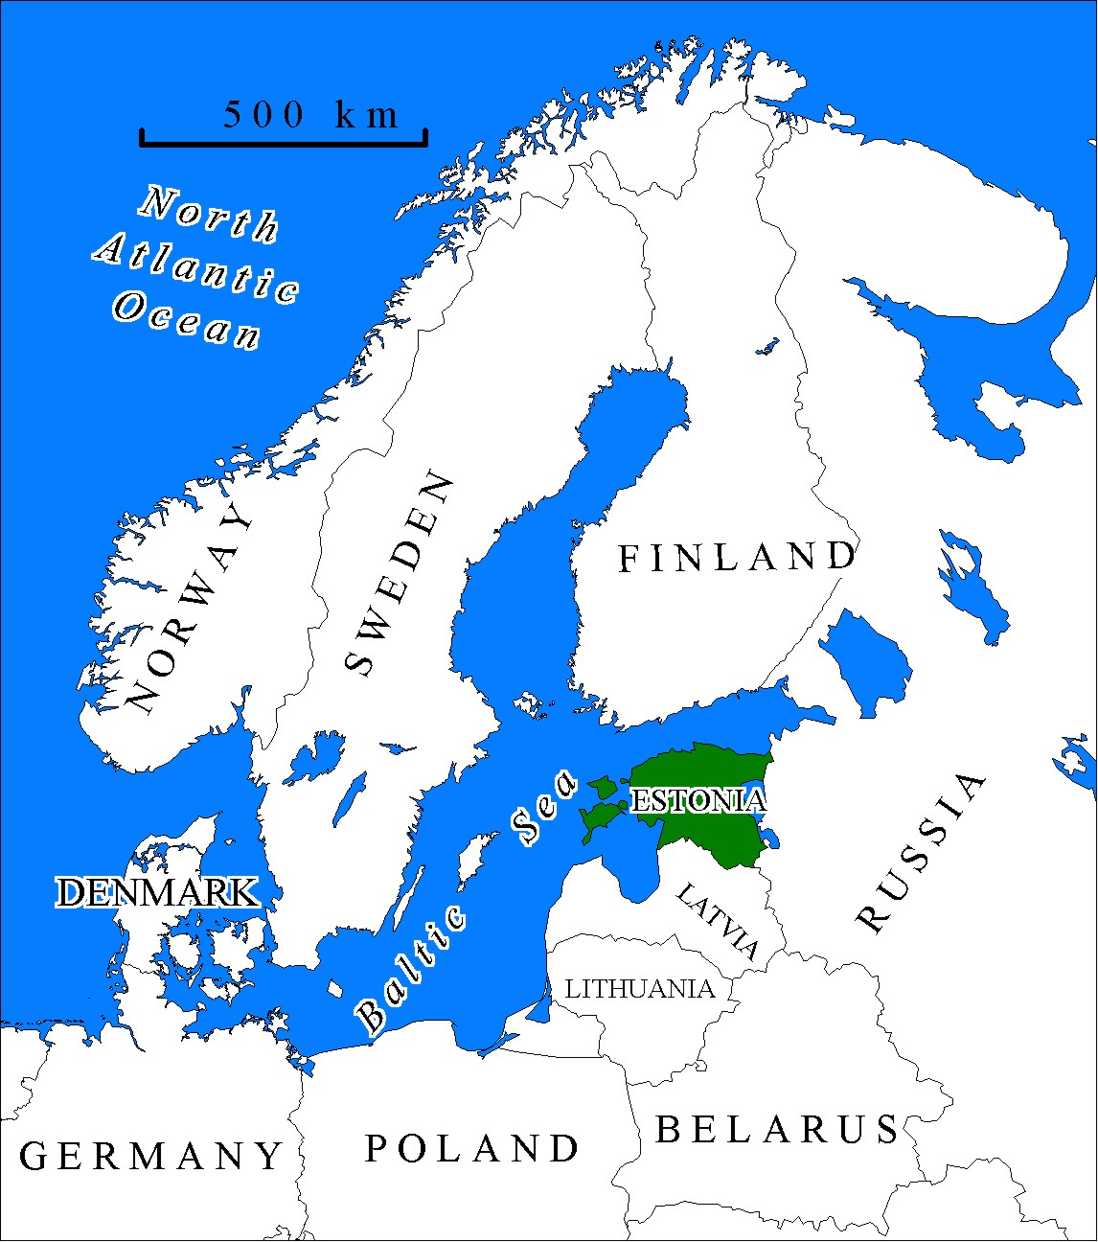
Background data:
Postglacial land uplift (up to 3.5 mm/y);
tidal range is less than 5 cm (can be neglected);
range of sea level fluctuation (-1.2...+2.8 m);
as a result of continuous land uplift and deficit of movable sediment there are no active dunes only foredunes and embryo dunes in the active shore zone occur;
many shore-parallel ridges can be found in the coastal area, sometimes many kilometers from todays shoreline;
sea level has dropped almost constantly during last 6000-7000 years.

Slide 3
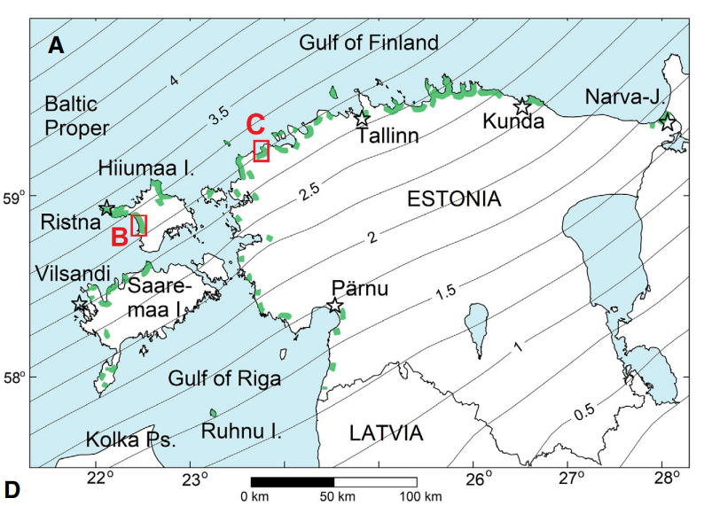
Map of Estonia with relative-to-geoid land uplift isobases (mm/yr) and locations of shore-parallel ridges (Suursaar et al., 2019; Boreas).

Slide 4
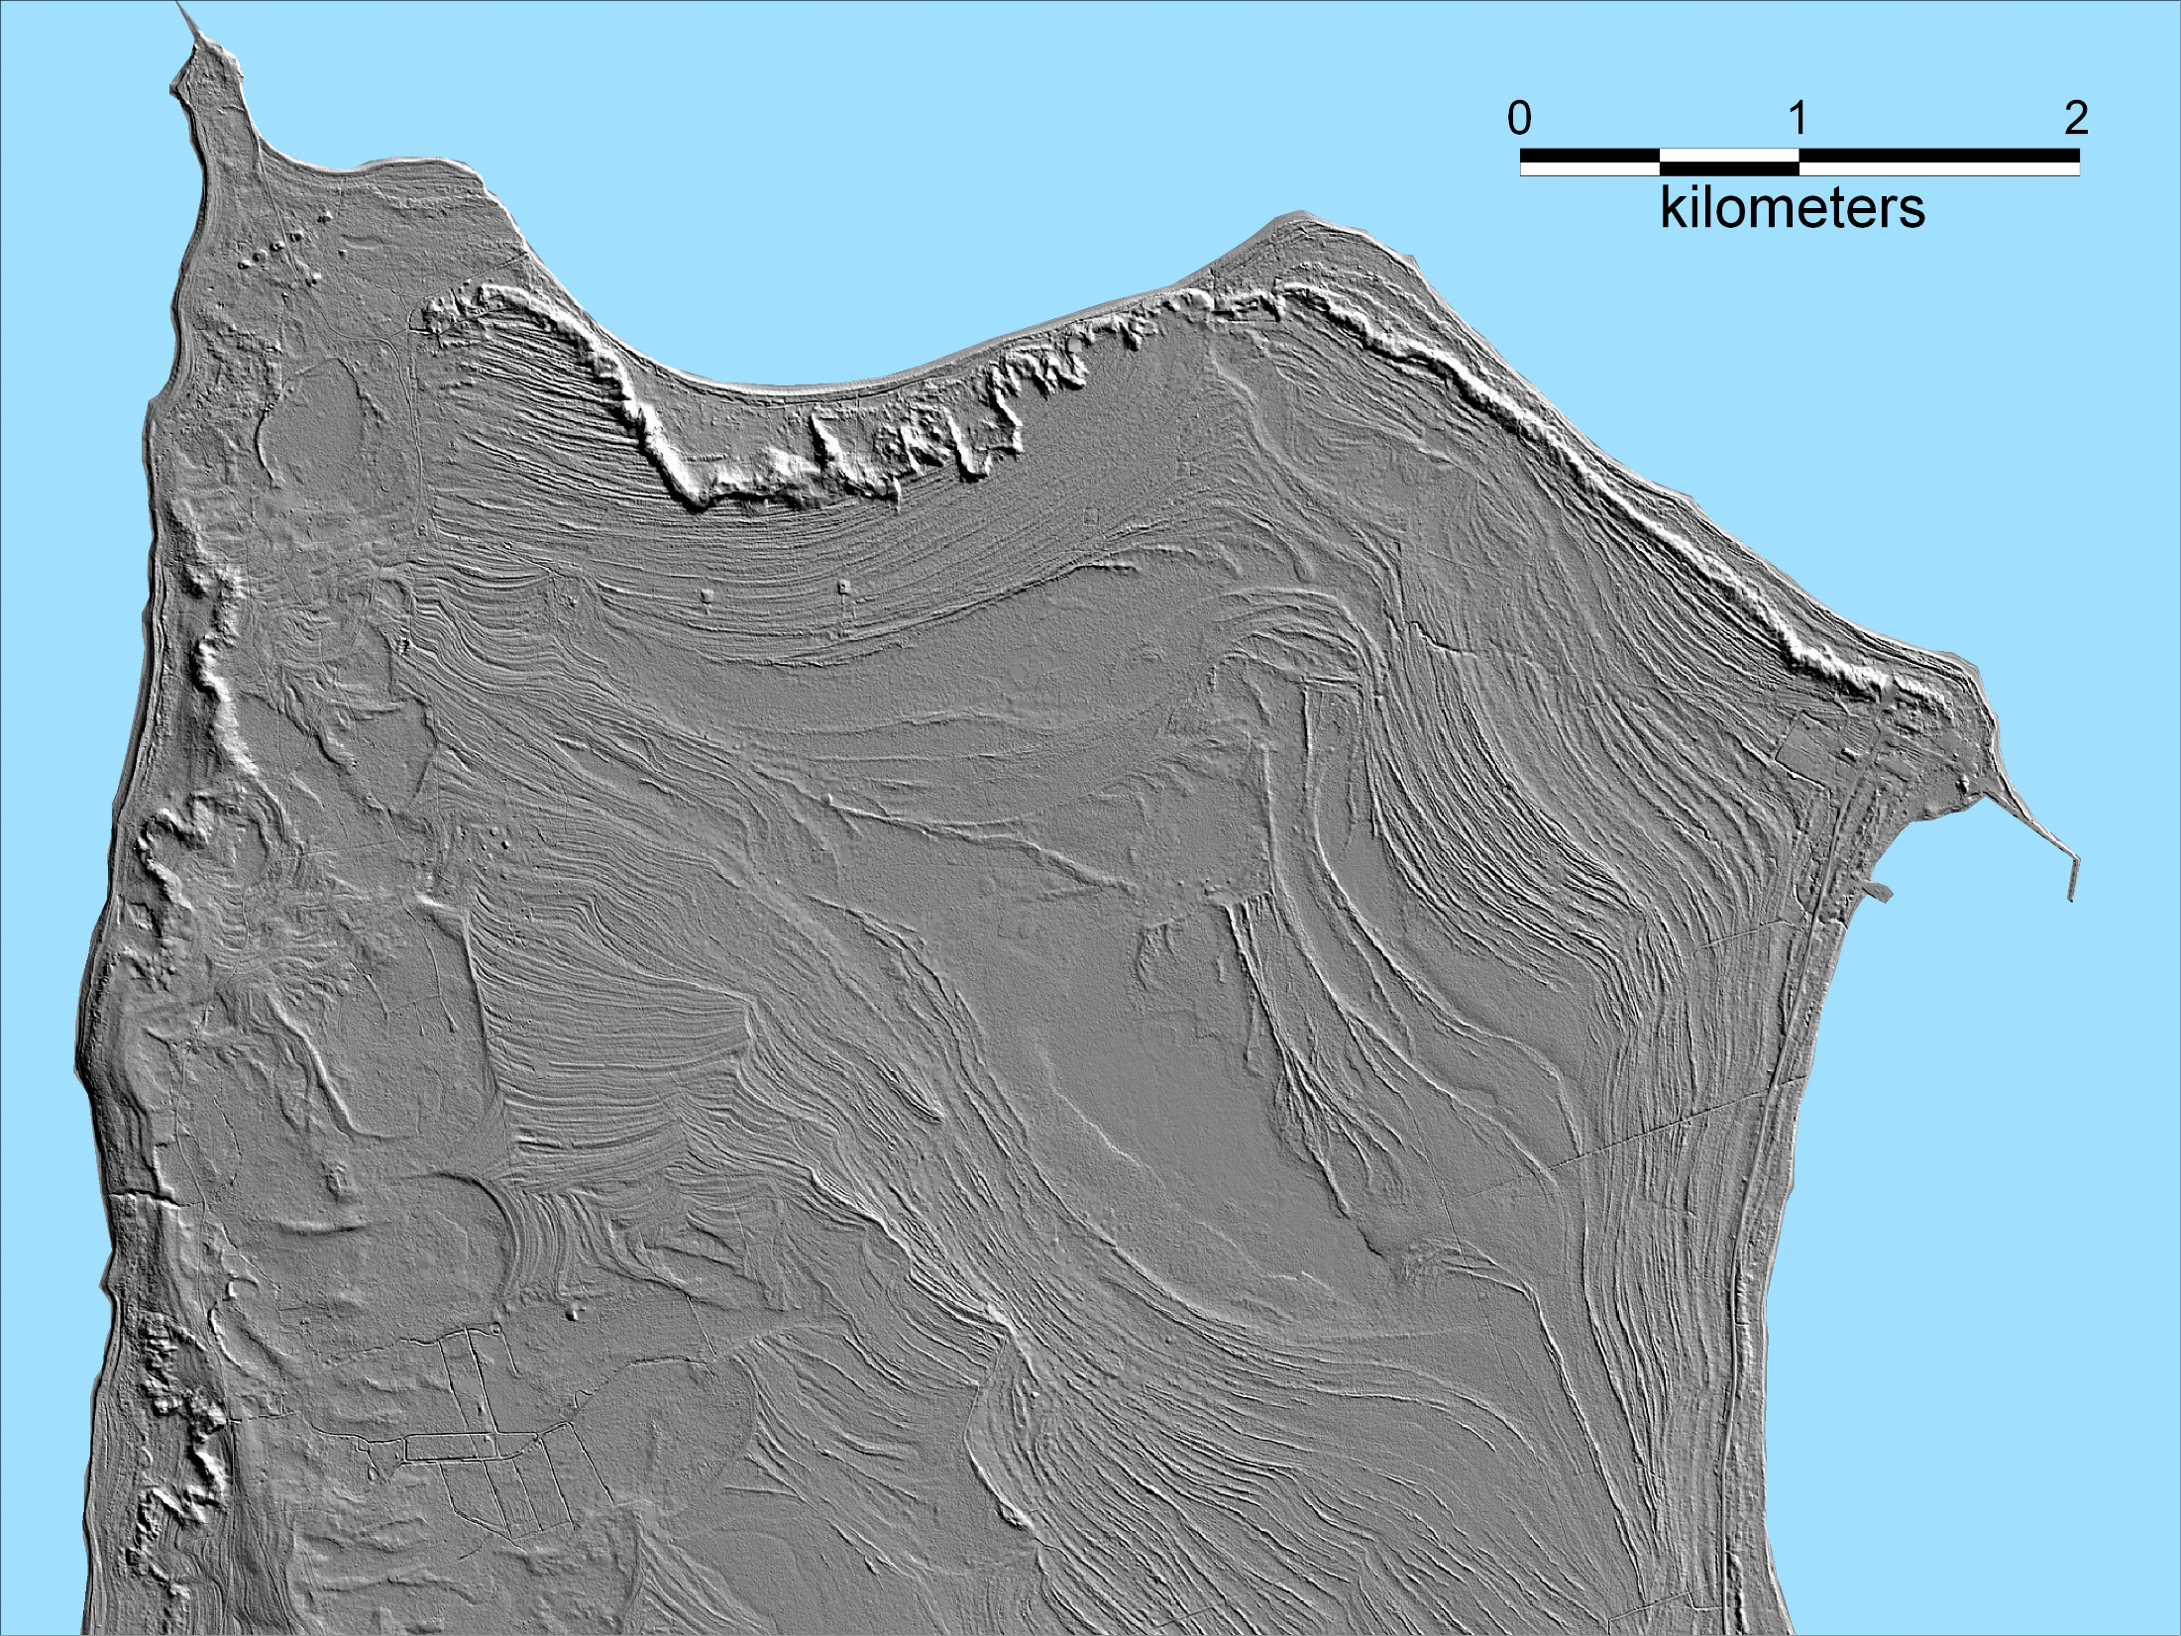
Closer look: we can see quite regular “stripes” - ancient shore parallel coastal formations, sometimes many kilometers from todays shoreline;
a few hundred meters from contemporary shore, there is clearly visible dune belt from LiDAR images;
signs of past fluctuations in regional climate are all recorded in ancient coastal formations.
Baltic Sea
D u n e b e l t
D u n e b e l t
Shore parallel ancient
beach ridges
Tahkuna Penisnsula
Estonian Landboard map

Slide 5
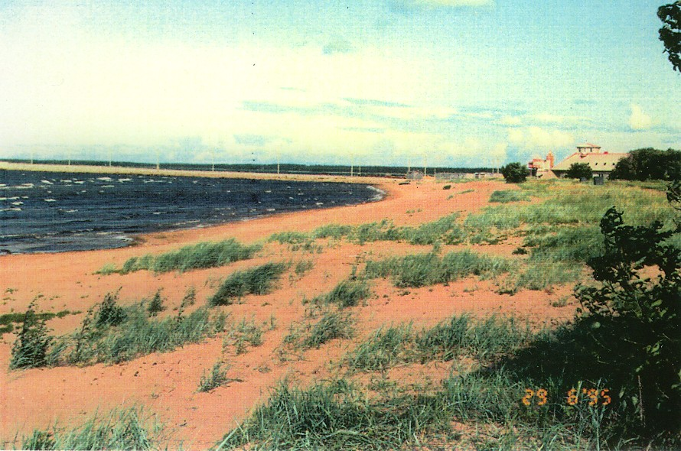
What is the mechanism behind the formation of these ridges:
Kunda 1995 (K. Orviku photo)

Slide 6
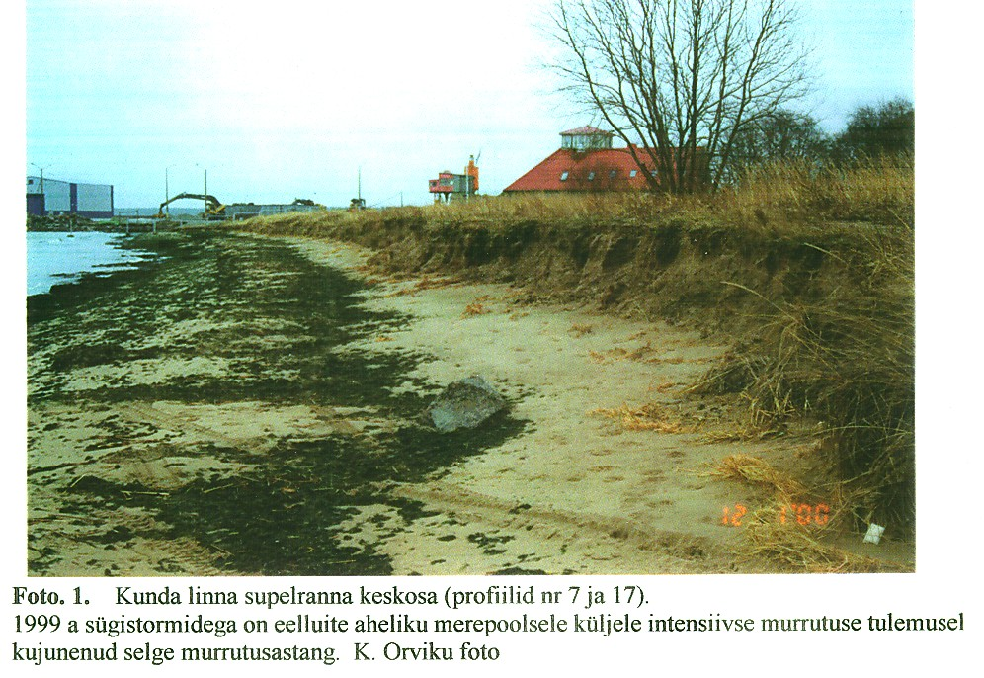
Rapid erosion as a result of 1999 storm – shore-parallel scarp has formed (K. Orviku photo).

Slide 7
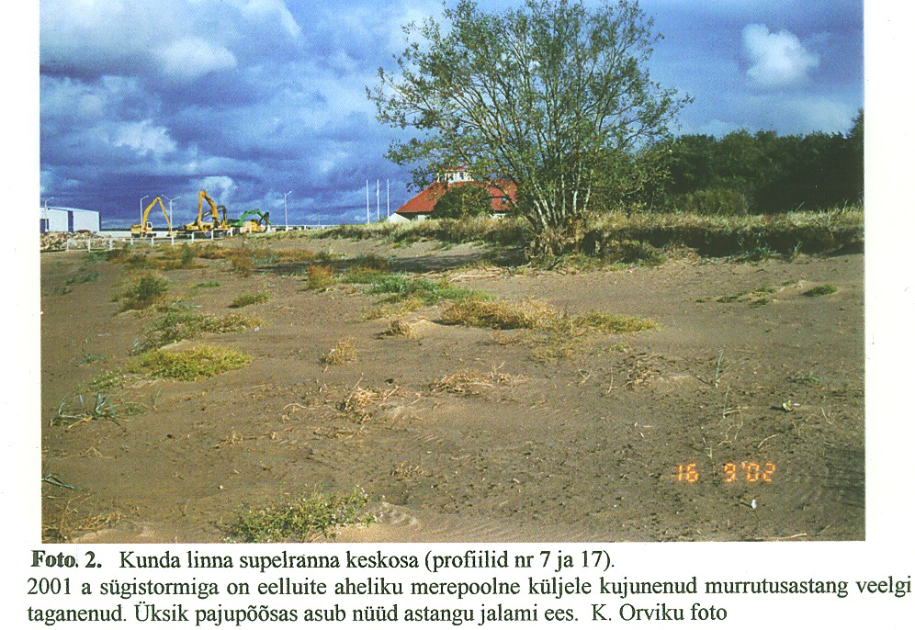
The same scarp receded even further during extreme storm in 2001, new foredunes have already formed by 2002 autumn (K. Orviku photo)

Slide 8
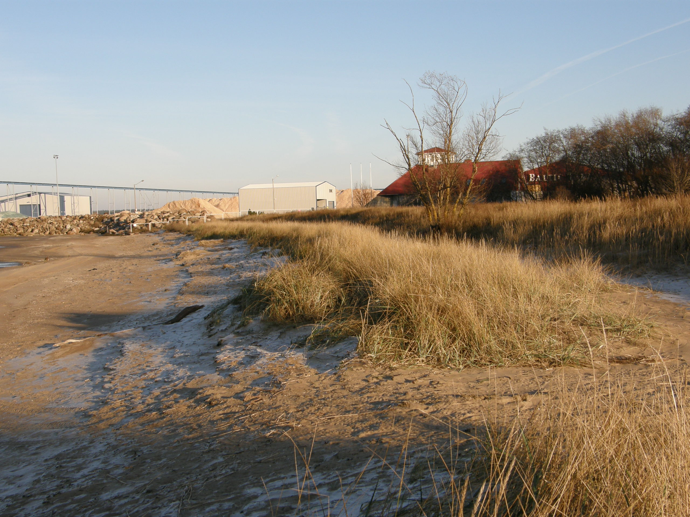
We can see that the scarp has collapsed, by November 2009, some wind-blown sand has accumulated as well, new foredune ridge-zone has started to form.

Slide 9
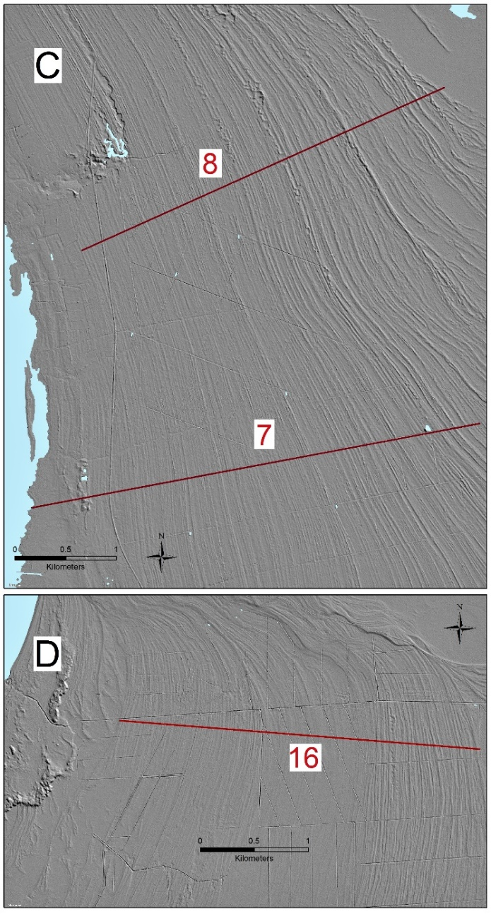
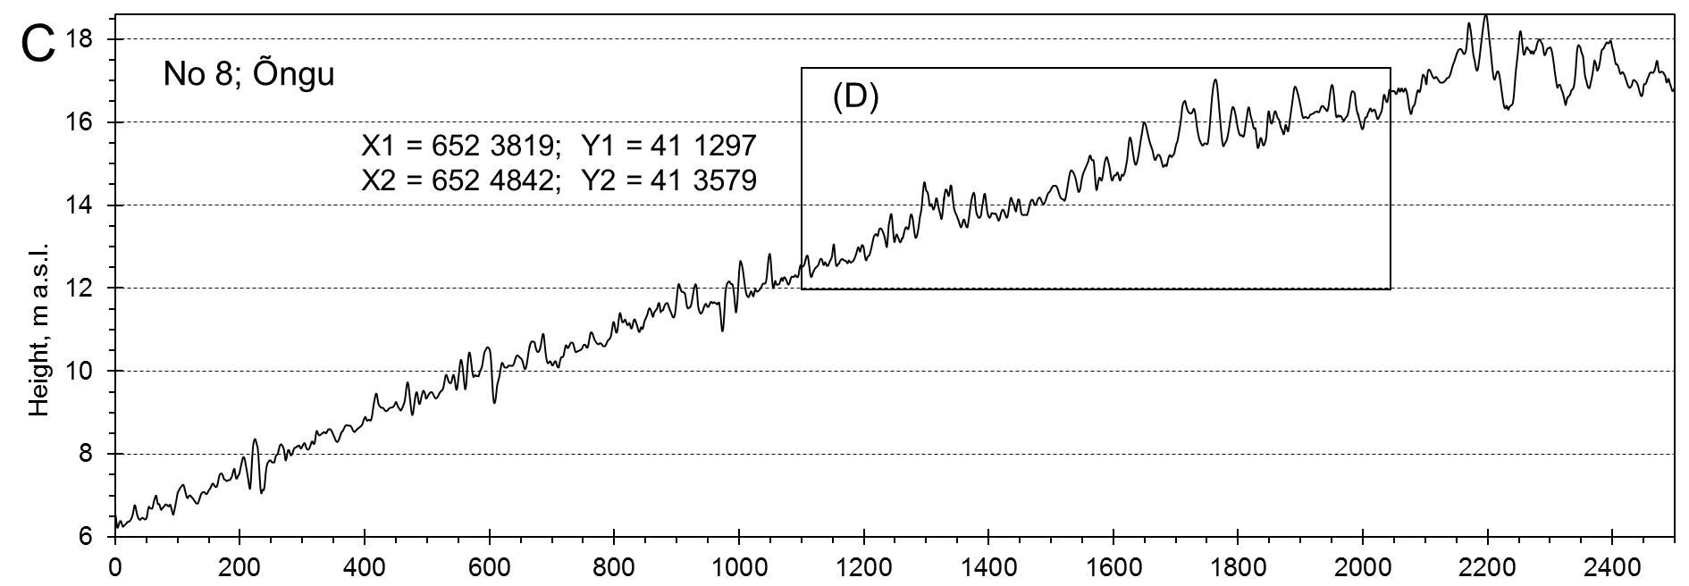
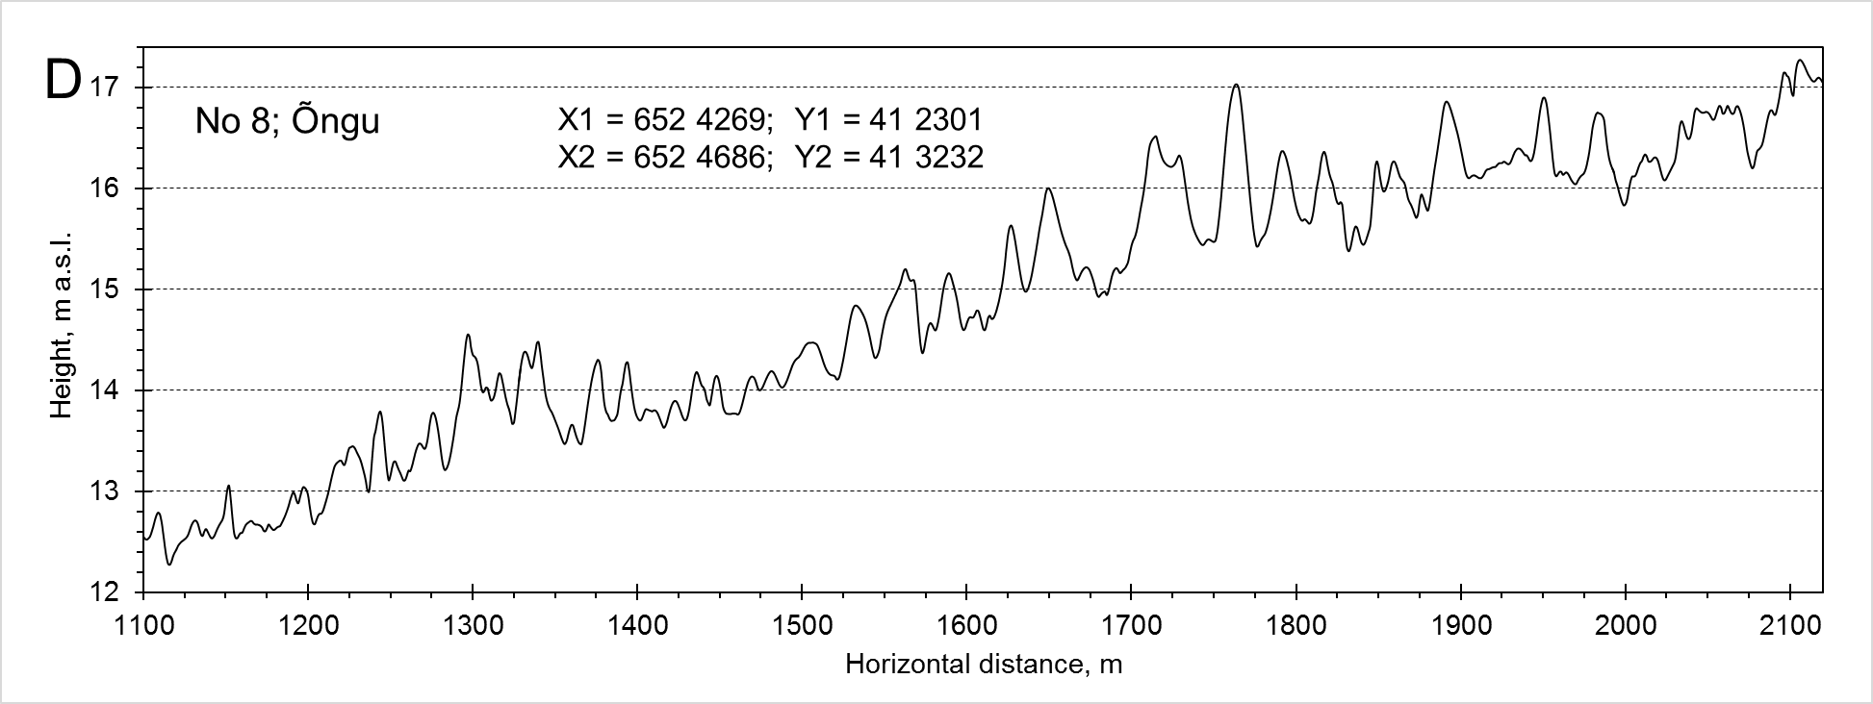
Examples of LiDAR profile sections at Õngu, Hiiumaa.
Uplifting coast with adequate sediment supply and forcing. Uplift and vegetation preserves the old patterns.
Example of the topography of such foredune-ridge complex, seems quite regular?

Slide 10
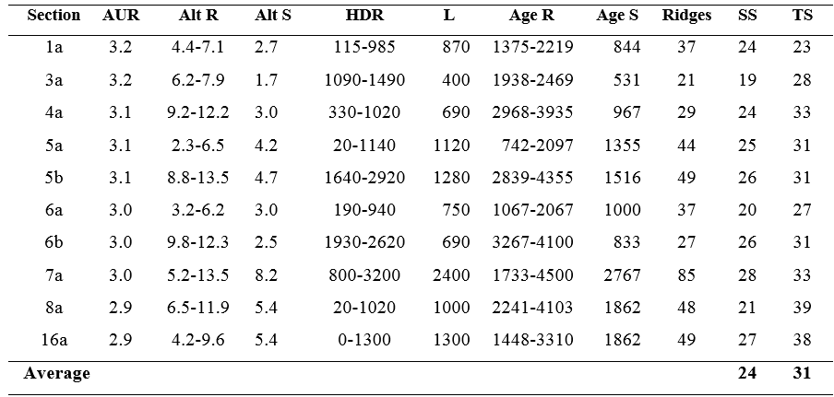
Detailed description of the patterns along some specific profile sections in Hiiumaa island NW-Estonia. Red triangle is indicating the formation time (yr) for one ridge.

Slide 11
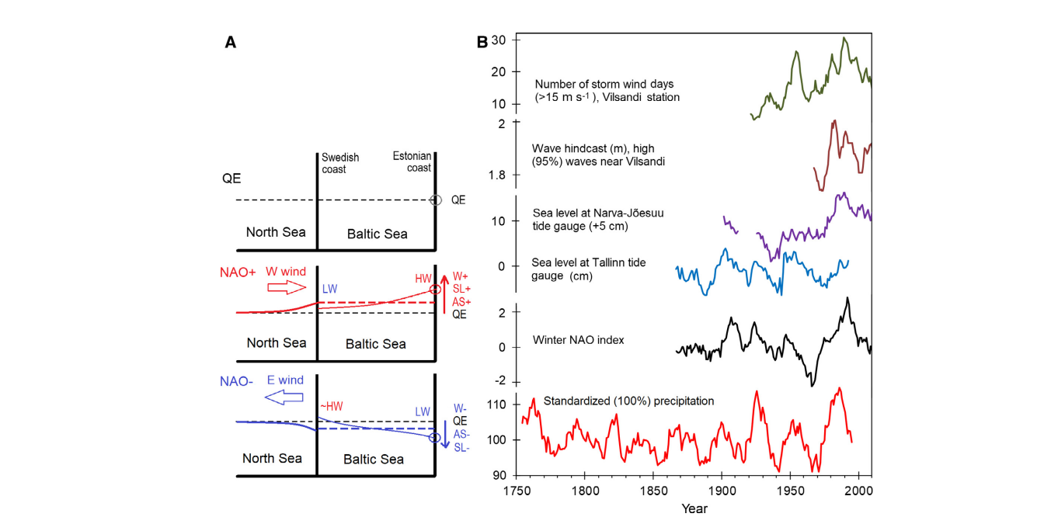
Scheme of Baltic sea level and direct geomorphic agents in different climatological regimes. QE, quasi-equilibrium SL. High (NAO+) phase with prevailing westerly and high storminess = positive average water level, positive SL slope (SL+) towards the eastern coast, high wave conditions (HW), longer fetches and stronger winds (W+). Low (NAO) phase and prevailing easterly = negative surplus (AS), west directed slope (SL), low waves (LW), short fetches and weak onshore winds (W). (Suursaar et al., 2019; Boreas)
Patterns in forcing

Slide 12
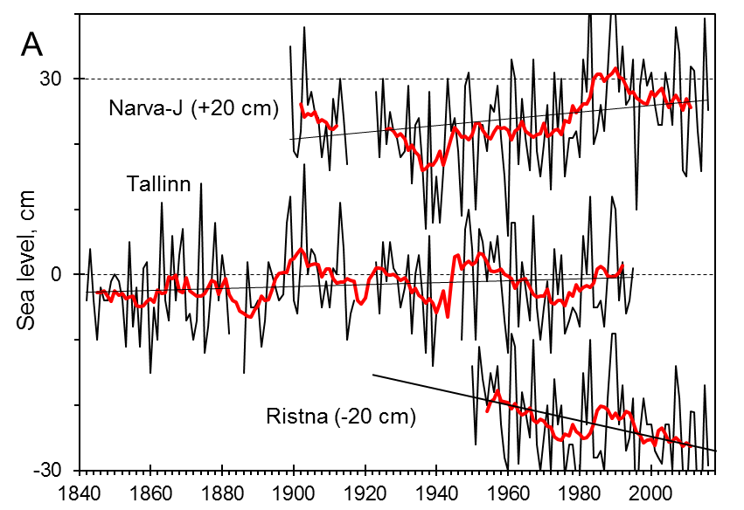
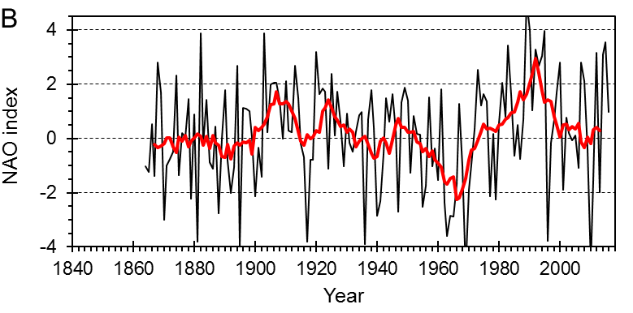
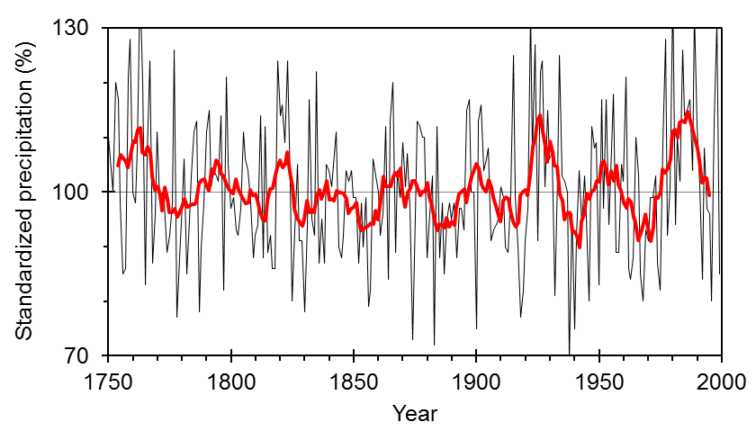
Temporal spacing over a large number of studied ridge patterns varied
20-40 years, average 30 ± 5 years.
25-40 year (weak) periodicity in forcing is also present in the Baltic Sea!
Relative sea level variations at three tide gauges (A). Hurrel station-based (DJFM) NAO-indices (B).
Reconstruction of annual sums of relative precipitation amounts with
9-year running averages in Estonia
(C, data by Tarand et al. 2013).
9 cycles since 1750 -- 30 yr average.
Patterns in forcing

Slide 13
Lower uplift rates – more 30-years periods needed to form one ridge (Suursaar et al., 2019; Boreas).

Slide 14
Results: What is the ridge formation time?
Why it is differing?
Time
spacing
Nr ridges
-Elevation
-Age span
Site | Z | ZOSL | AS | NR | TS | Uplift
Hiiumaa | 7.5-7.0 | 6.7-5.95 | 3.0-2.1 | 27 | 33 | 3.3
Hiiumaa | 7.0-4.5 | 6.7-3.5 | 2.1-0.79 | 38 | 34 | 3.3
Hiiumaa | 4.5-0.0 | 3.5-n/a | 0.79-0.0 | 0 | n/a | 3.3
Järve | 17.9-8.7 | 16.7-7.1 | 6.4-2.8 | 62 | 58 | 2.3
Järve | 8.7-4.2 | 7.1-2.8 | 2.8-1.5 | 25 | 52 | 2.3
Järve | 4.2-0.0 | 2.8-n/a | 1.5-0.0 | 13 | 115 | 2.3
Juminda* | 4.2-2.5 | 2.8-n/a | 1.5-0.77 | 13 | 56 | 2.7
Juminda* | 2.5-0.0 | n/a-n/a | 0.77-0.0 | 0 | n/a | 2.7
NarvaJ | 10.9-7.0 | 9.5-5.7 | 6.0-3.0 | 39 | 77 | 1.7
NarvaJ | 7.0-0.0 | 5.7-0.0 | 3.0-0.0 | 19 | 158 | 1.7
NarvaJ* | 7.0-5.1 | 5.7-n/a | 3.0-1.54 | 19 | 77 | 1.7
NarvaJ* | 5.1-0.0 | n/a-n/a | 1.54-0.0 | 0 | n/a | 1.7
Ruhnu | 12.6-4.0 | 10.9-4.0 | 6.21-2.54 | 37 | 99 | 1.5
Ruhnu | 4.0-0.0 | 2.75-n/a | 2.54-0.0 | 0 | n/a | 1.5

Slide 15
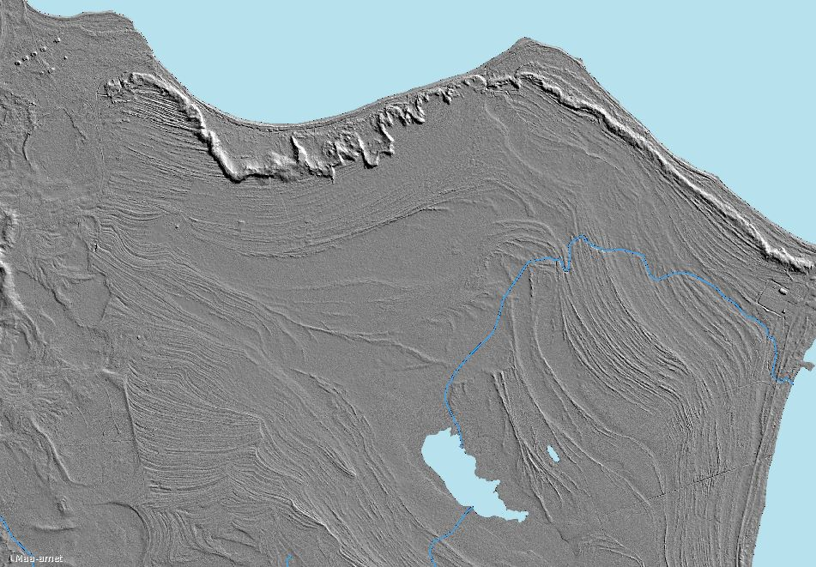
Seems that their formation is regular, but some of the ridges are smaller, some larger.

Slide 16
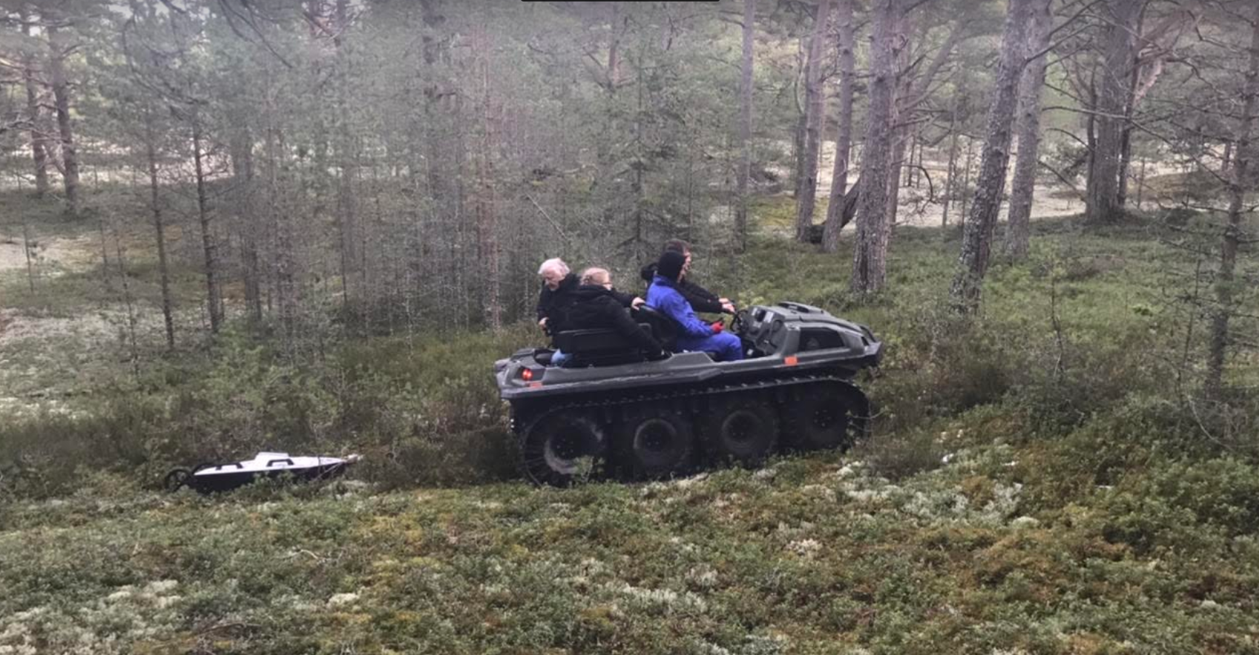
What is inside the ridges? What it tells us?
Geophysical methods to study changes in the past – Ground Penetrating Radar
70/300 Mhz antennas were used.

Slide 17
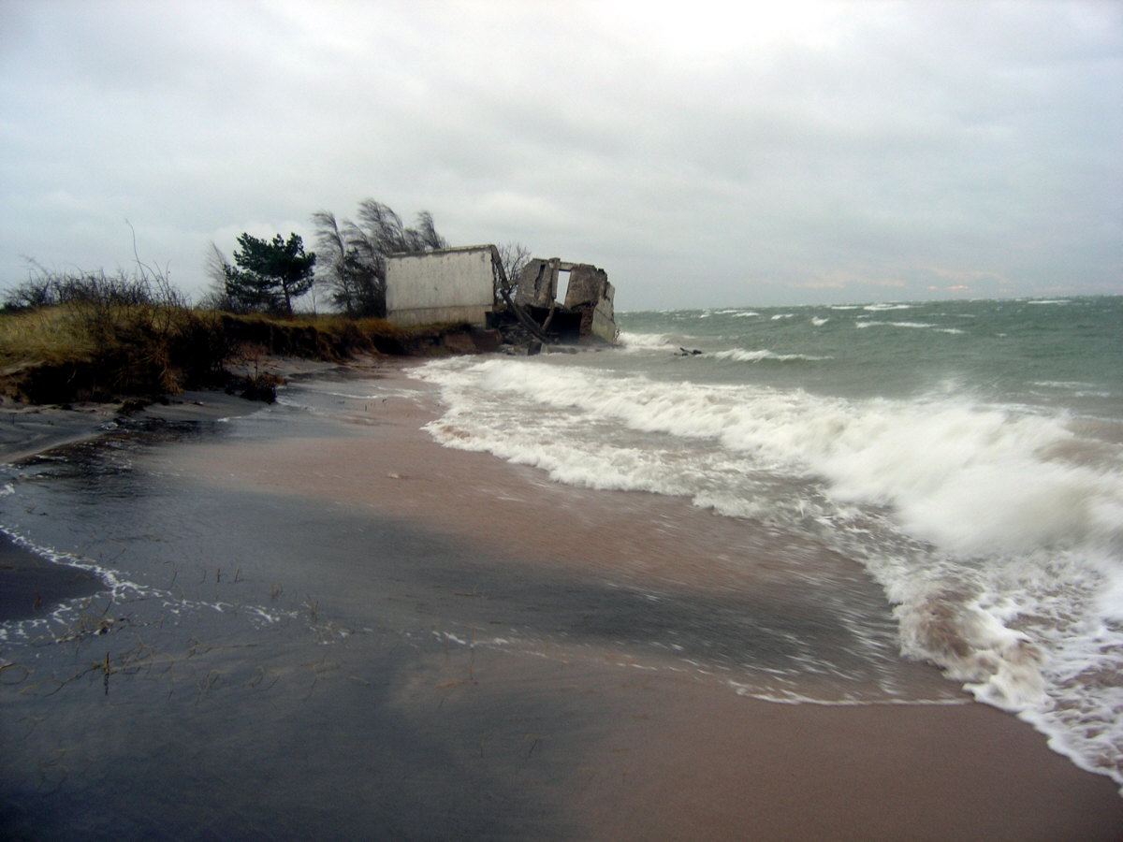
Background (how it all forms):
Storm signs on the sandy beach
Heavier minerals (dark colour) on the shore after the storms, lighter minerals washed away.

Slide 18
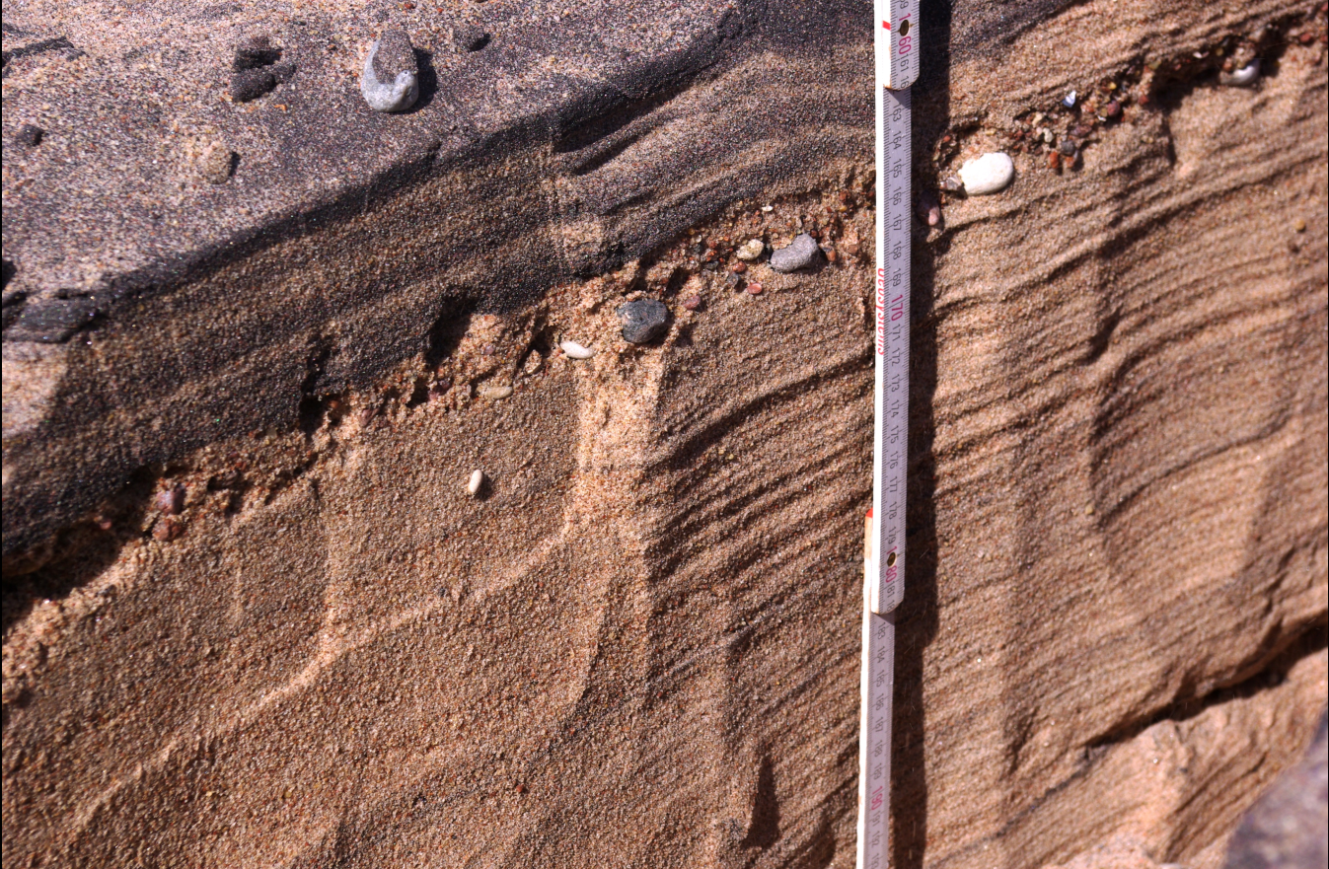
Layer of heavy minerals and coarser sediments:

Slide 19
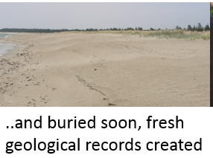
Soon after the storm, sediments accumulate again and “layer” will be buried

Slide 20
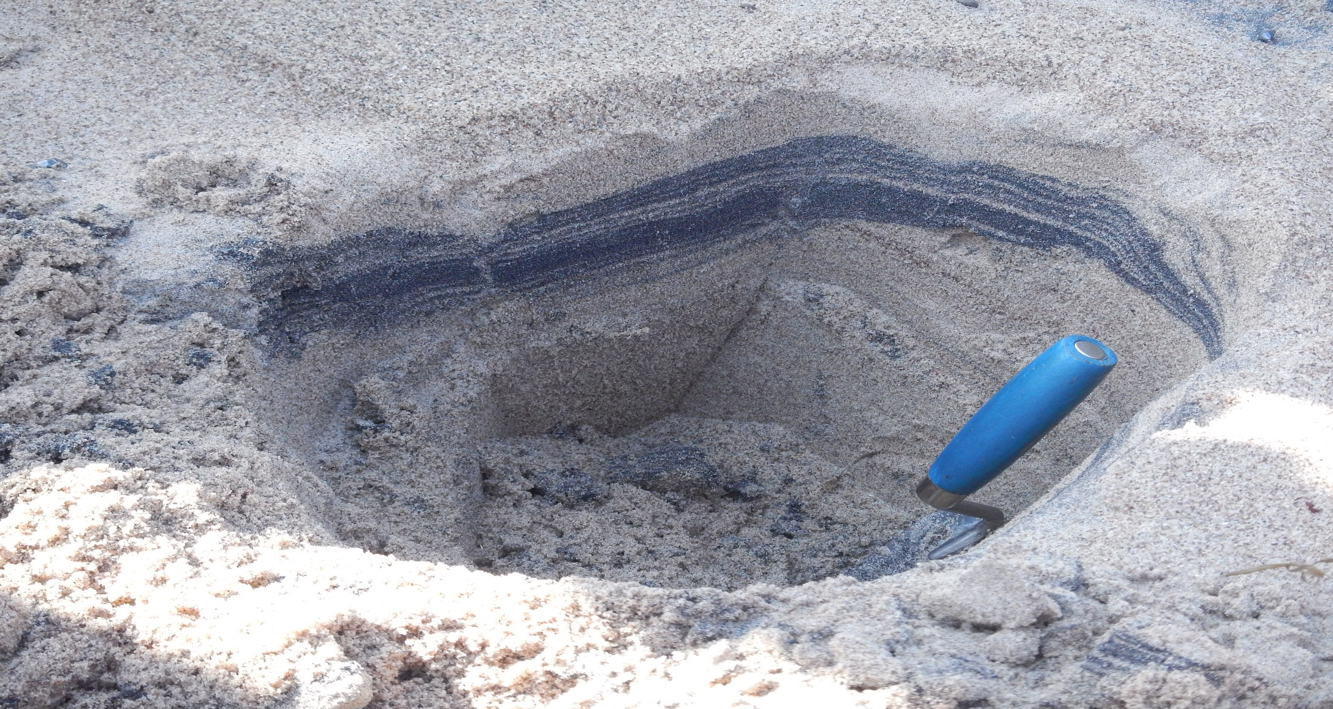
…we can dig it out if we want:

Slide 21
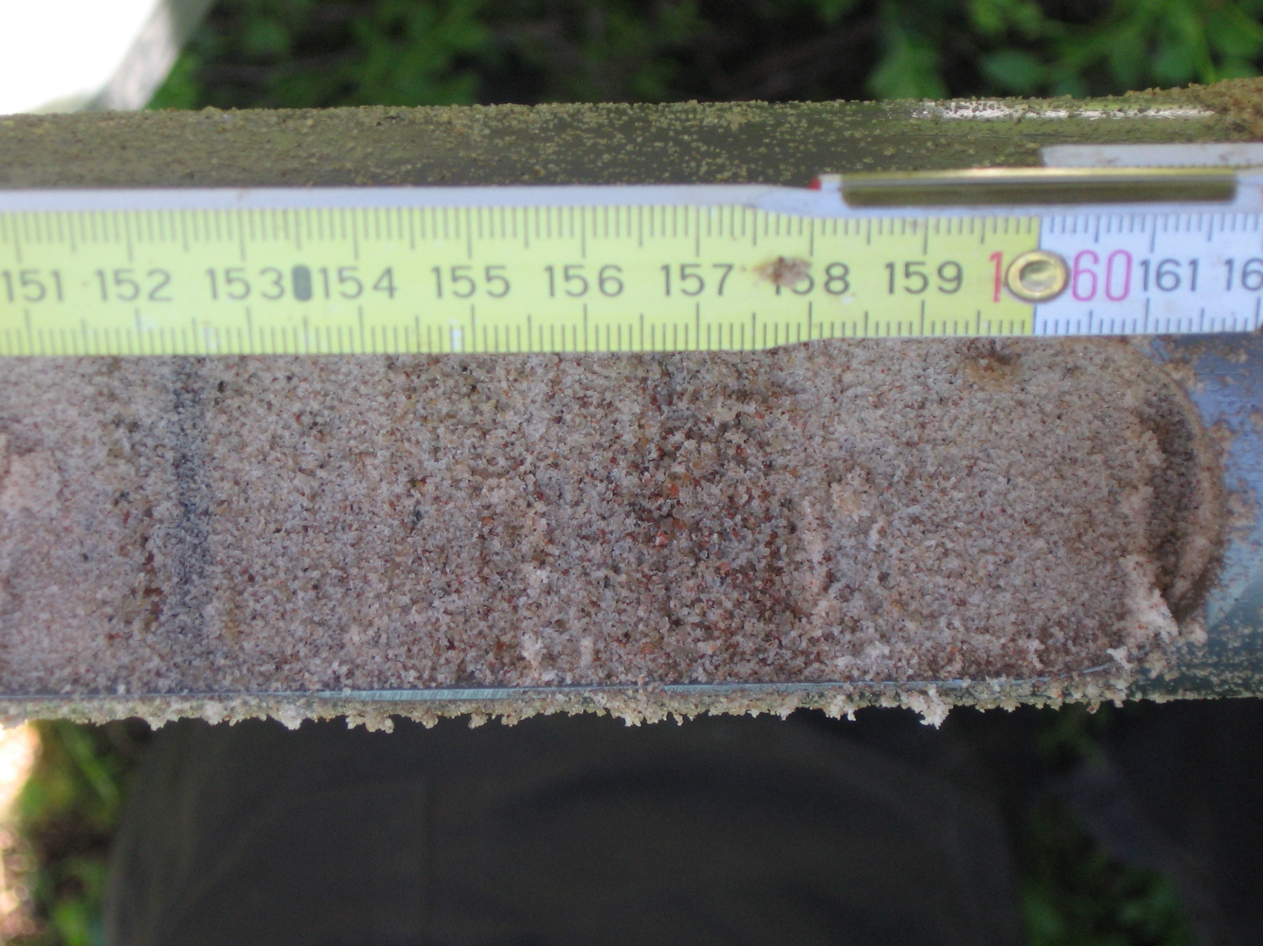
..or take a sediment core:
Layers in the window sampler (sediment core), signs of storms

Slide 22
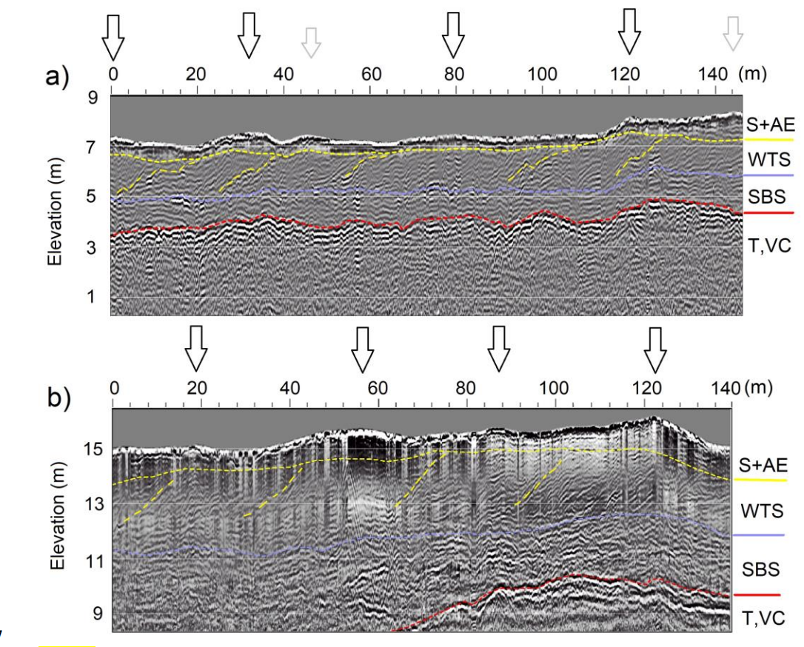
… or we can look inside by using ground penetrating radar
Small ridges, minor seaward tilting layers, likely calmer period
Larger ridges, long seaward tilting layers, likely stormier period
Figure (Suursaar et al., 2022; Geomorphology in press)

Slide 23
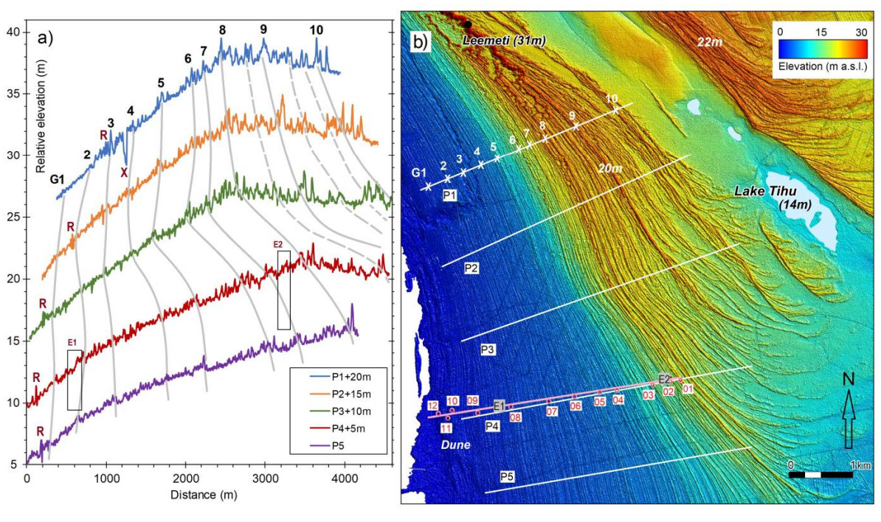
a) Elevation profiles P1–P5, offset upward by 5 m for better visualization, with grey lines indicating the high ridge sets (numbers 1–10 marked on P1), R – road dam, X – river; E1 and E2 – locations of GPR profile excerpts. b) Location of the profiles P1–P5 (Suursaar et al., 2022; Geomorphology in press)
Large ridges or ridge groups can be easily traced along the shore. Seems that larger ridges have more aeolian sand and more extensive tilting layers inside.

Slide 24
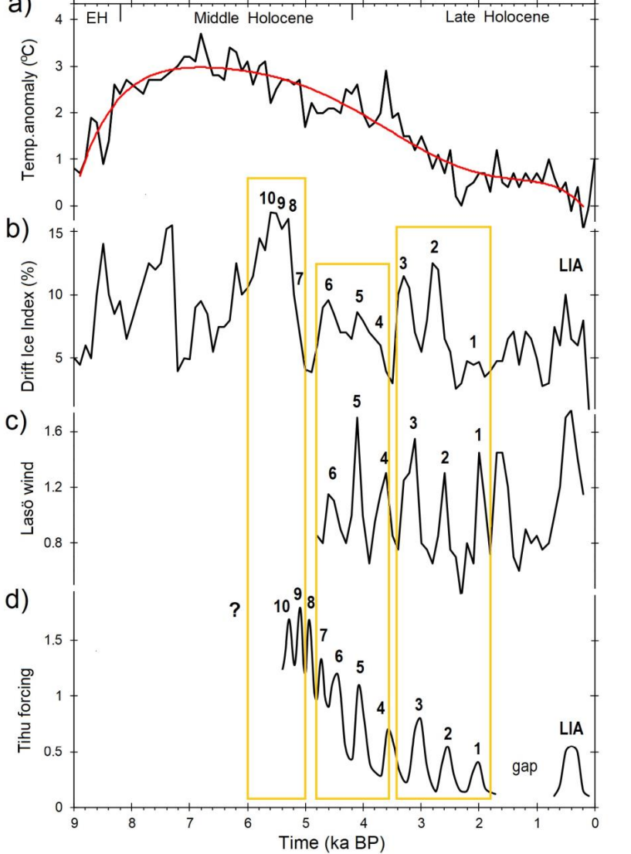
a) Reconstructed summer air temperature anomalies relative to modern era in Latvia; b) drift ice index (%) according to Bond et al. (2001; 2008); c) wind forcing reconstruction based on coastal ridges on Læsø Island, Denmark (Hansen, 2017); d) hydrodynamic and wind forcing cycles at Tihu Spit;
Yellow rectangles are for aiding the visual comparison of the groups. The numbers (1-10) on b, c, and d mark high ridge sets; LIA – Little Ice Age (a dune near Õngu); gap – a break in coastal ridges on the Estonian coasts.
Formation of the larger ridge groups is quite well correlated with number of forcing factors.

Slide 25
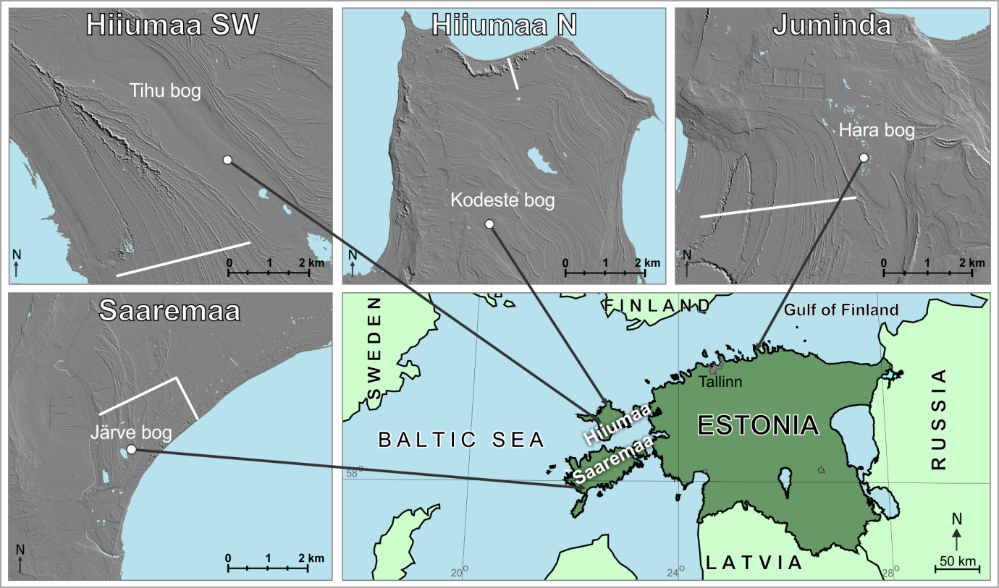
Alternative study in four peatbogs was investigate the influx of sand grains into the organic matter - also indicator of past storminess.

Slide 26
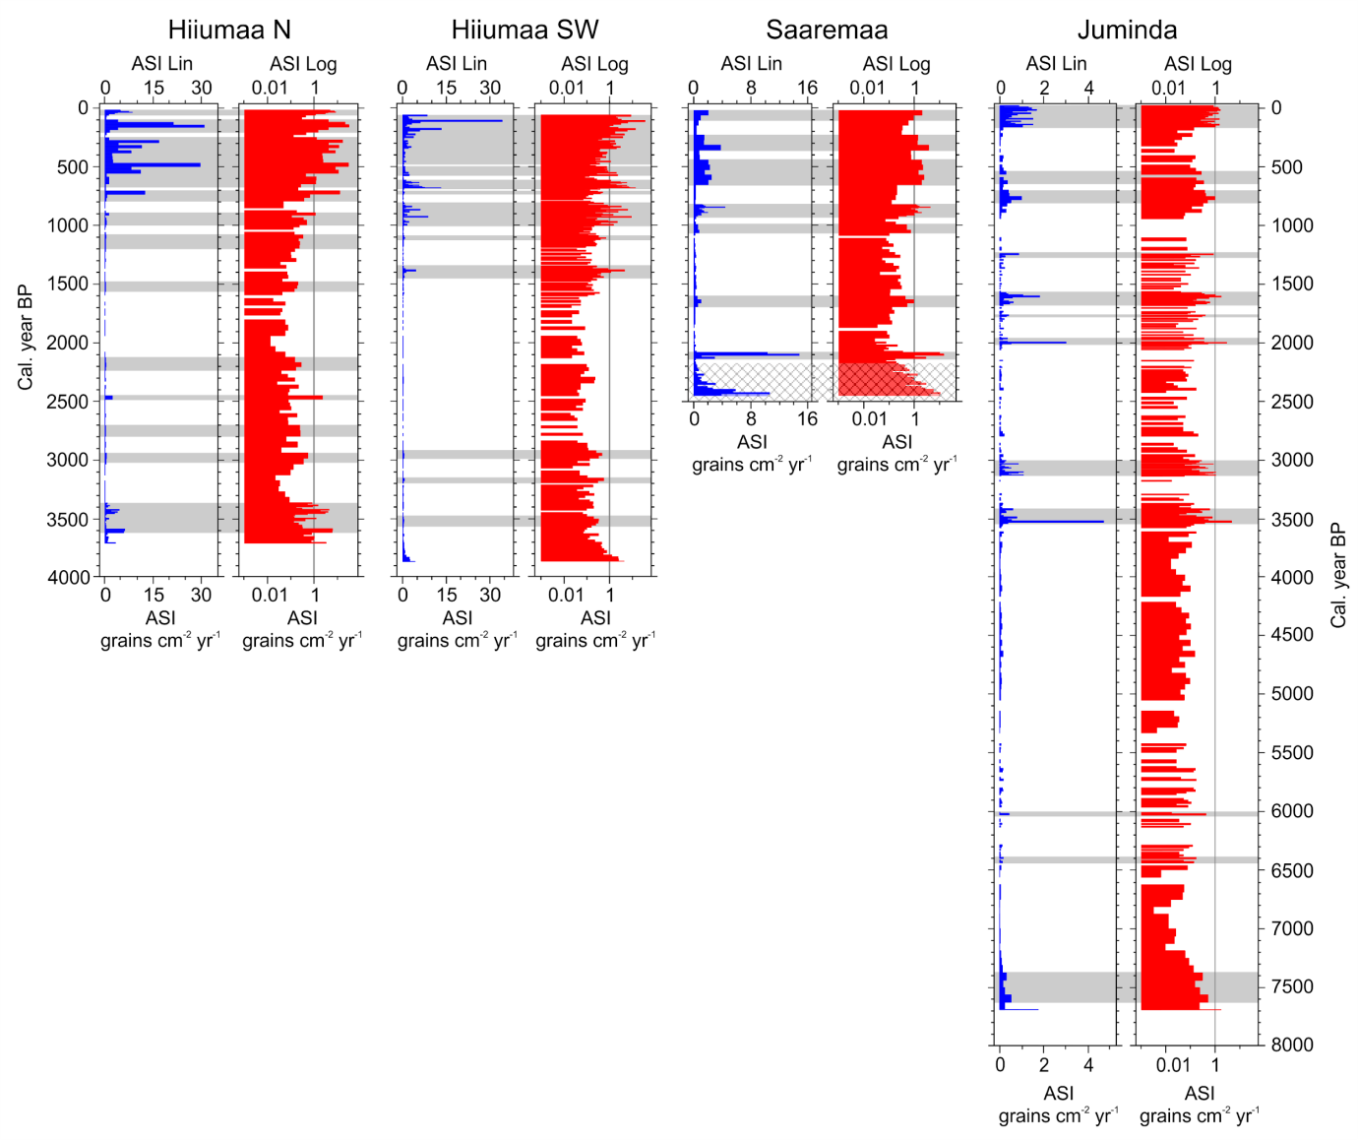
In the influx of the sand grains to the peatbogs we can also see an increased around 2000 and 3000-3500 years ago.

Slide 27
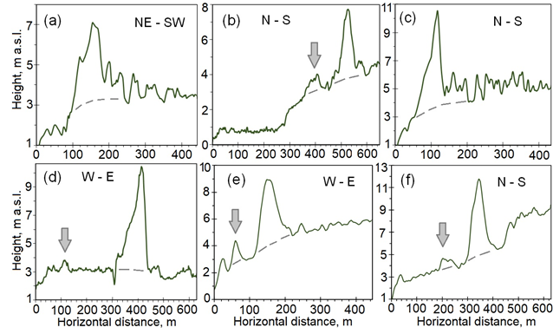
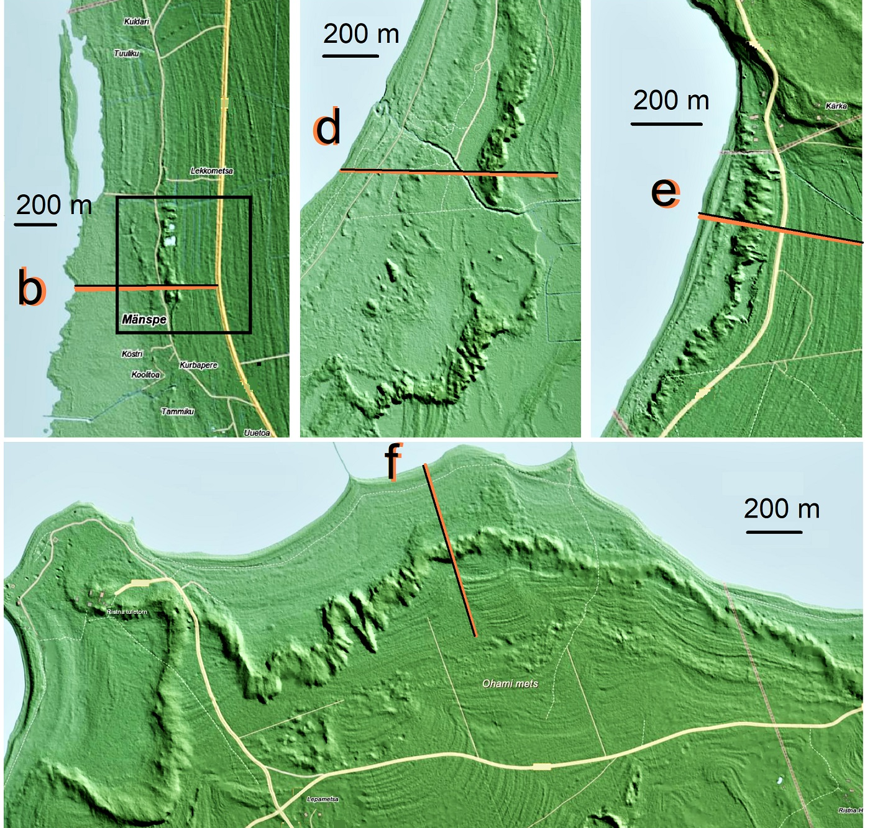
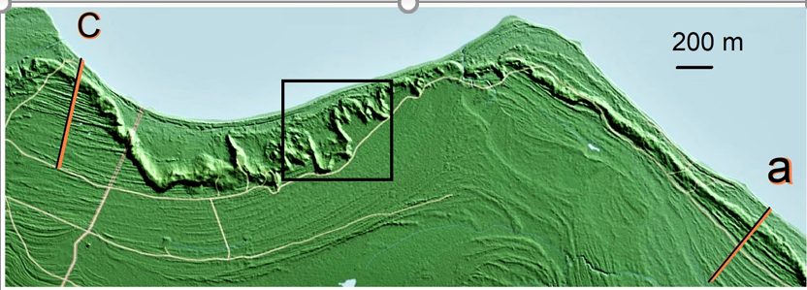
Dune ridge is up to 10 meters high, we have found 33 such locations along Estonian coast, base level of such dune is 2.5-3 m a.s.l.
Arrows indicate the “basements” (present-day foredunes) from where the reblows likely originated

Slide 28
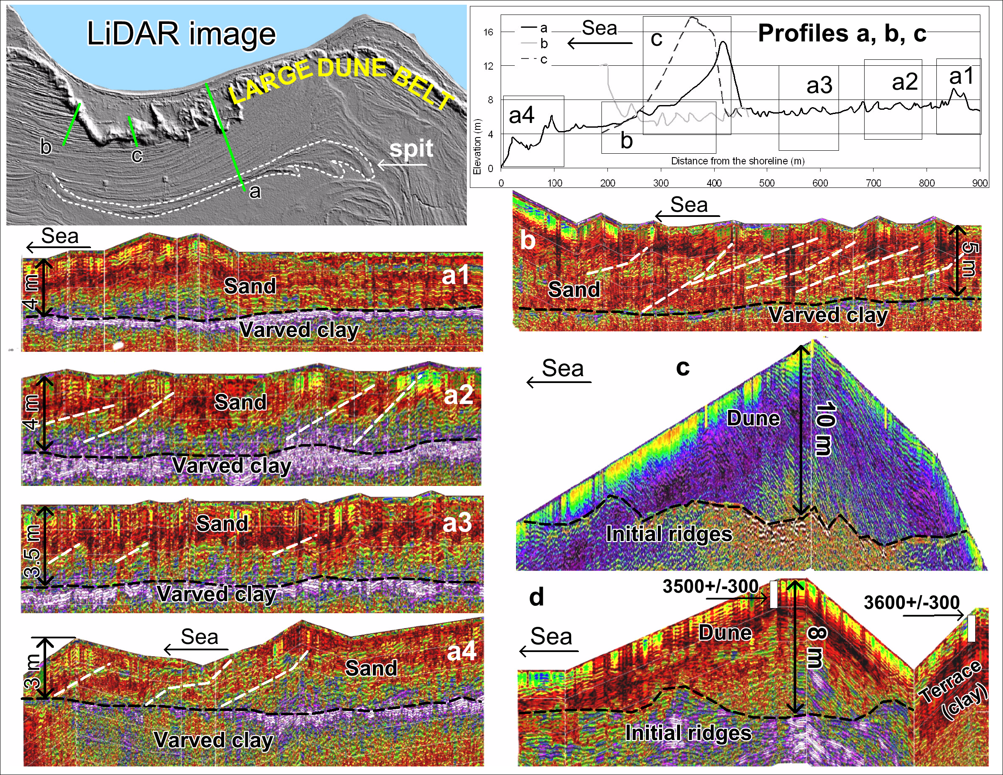
The old “basement” of the original dune and initial beach ridges are still visible (GPR profile).
10 m
sand

Slide 29
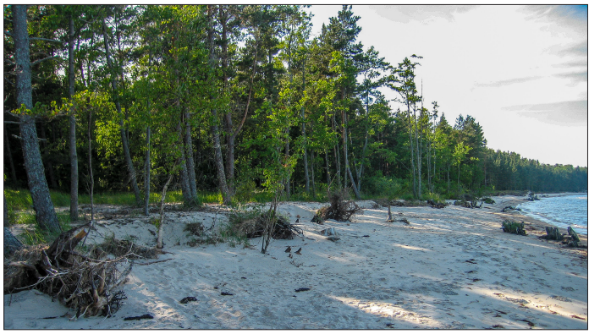
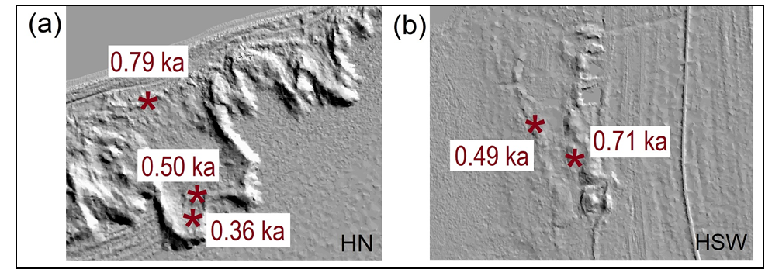
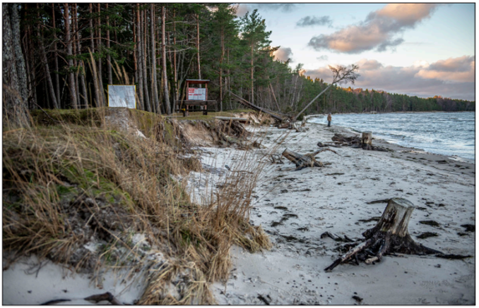
When and how did the dune belt formed?
In Estonia, forests often grow directly landward the sandy beaches leaving the treeless area very narrow. The old dune ridges are covered mainly by pine forest –there is not enough movable sand for rapid build-up of a large dune in Estonia.
Using the land uplift and base height we can calculate that this dune belt started to form most probably ca 700 yr-s ago. This roughly concurs the OSL ages we have obtained. We also see that final reblown events stopped around 350 years ago.
OSL ages of dune formations
Narrow beaches

Slide 30
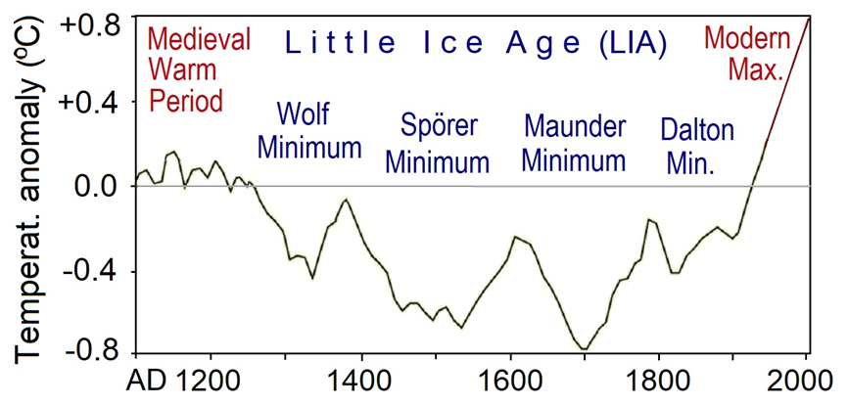
Good explanation is the so-called Little Ice Age (LIA). The extent of LIA is mostly put between AD 1350–1900. With minimal temperatures around AD 1280–1350, AD 1450–1550, and AD 1645–1715. These cold sub-periods had 1–2° lower temperatures than today. Cold and windy conditions inhibited vegetation growth and favored dune build up and reblown events.
Large sand movement and dune formation in Sweden were also reported between AD 1460 and AD 1870.
A climate reconstruction for the Northern Hemisphere in AD 1100-2016 (modified from: McCracken and Beer, 2014; IPCC, 2013).

Slide 31
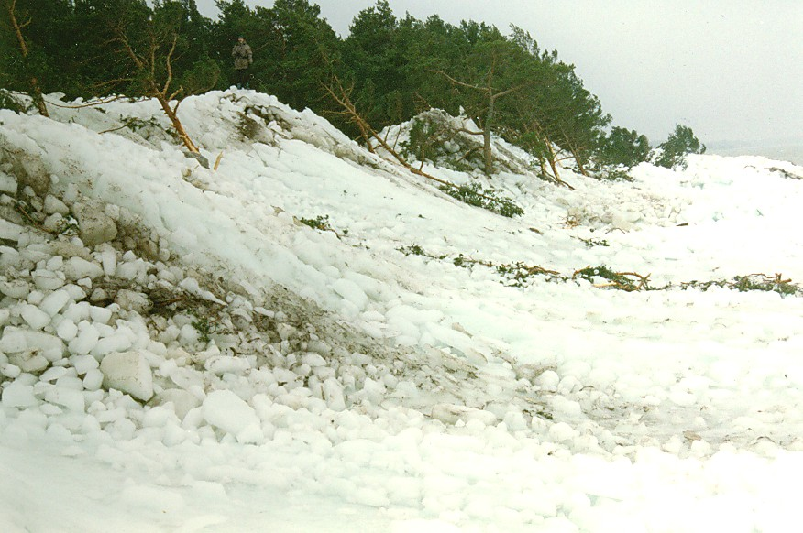
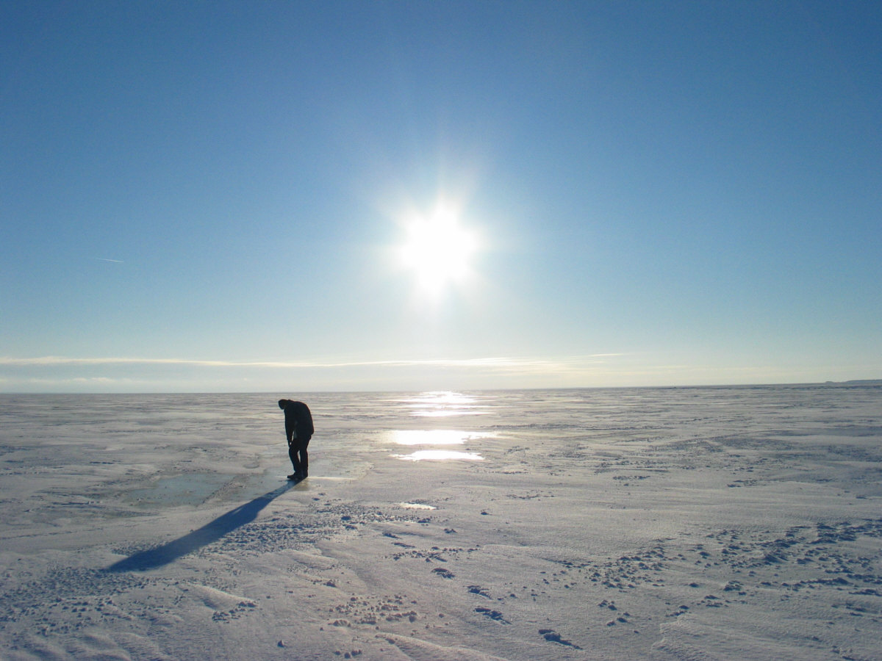
The influence of sea ice can be substantial besides the cold and dry climate. The entire Baltic Sea was frequently covered with seasonal sea ice during the LIA. In spring, driven by winds, ice ridges usually bulldoze the coast and destroy coastal vegetation – helping to trigger dune formation.

Slide 32
We can see notable increase in the influx of the sand grains to the peatbogs during the last ca 800 years on all selected sites – probably the sign of active dune formation period.

Slide 33
Conclusions:
Regular ancient coastal formation along Estonian coast have been formed during last 6000-7000 years due to the constant land uplift and resulting relative sea level drop;
formation of the ridges has been regular, probably related to NAO+ and NAO- cycles;
larger ridges or ridge groups are often characterized by more extensive tilting layers (signs of ancient strong storms) in their cores. These are most likely signs of intense storm periods in the past;
stormy periods around 1900-2200 years ago and at around 2900-3200 years ago have been detected in number of studies carried out along Estonian coast. However, recent study indicates that more such periods can be detected;
around AD 1300, dune belt started to form in many locations along Estonian coast. The dune belt formed during LIA, when cold and windy conditions inhibited vegetation growth and favored dune formation. Subsequent reblow events occurred during the coldest phases of the LIA, probably from AD 1450 to 1750.
after the end of LIA, climate gradually turned more humid and warmer and the dune was fixed again by vegetation. The dune belt also explains why so few shore-parallel ridges have been formed over the last 1,000 years. Most of the available sediment was used for building up the dune belt, and some of the older ridges were eroded and incorporated into it.

