Slide 1



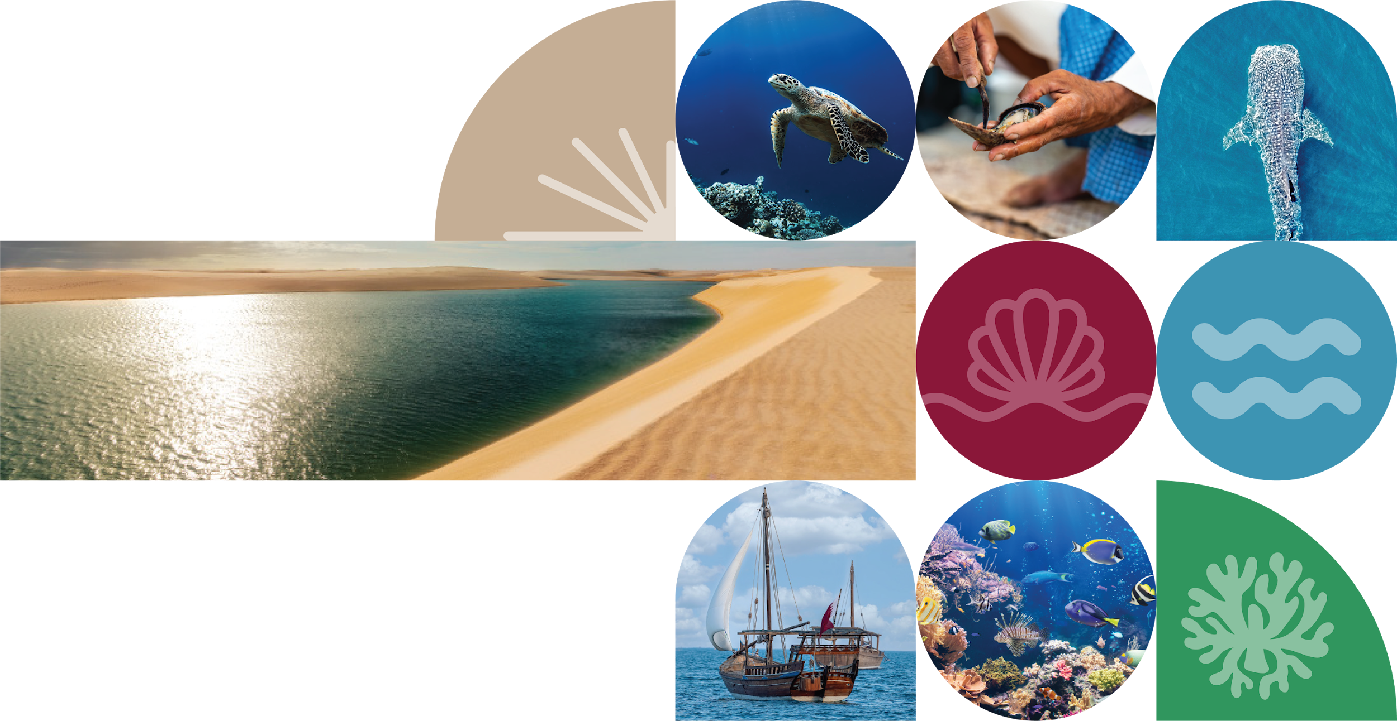
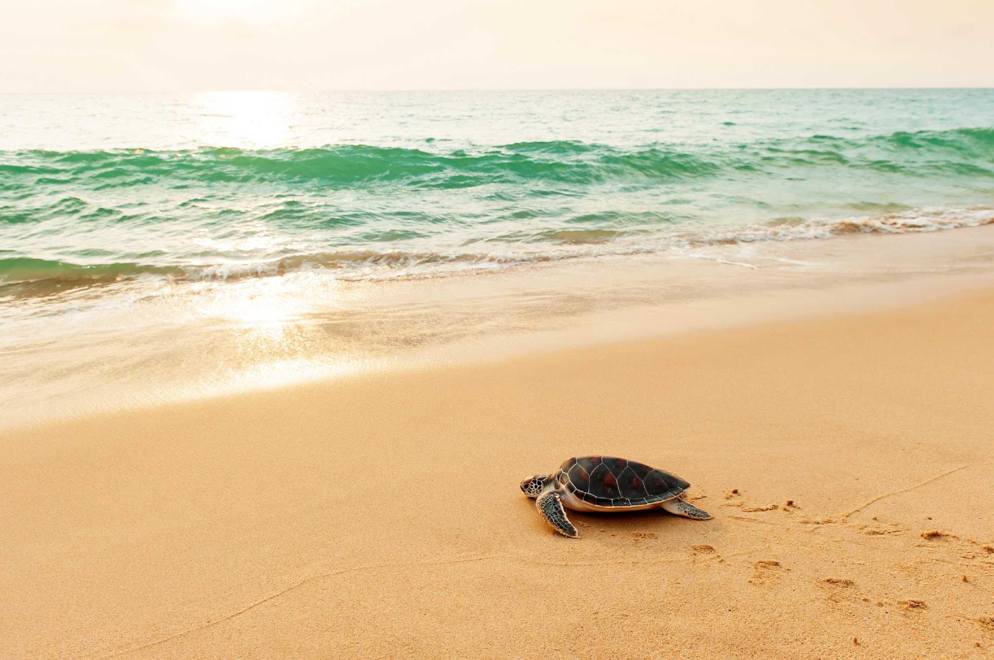


Rapidly transforming Holocene strandplain, affected by port jetty and hydroclimatic shifts – natural laboratory of past and future shoreline behavior
H.Tõnisson, K.Luik, Ü.Suursaar, I.V. Buynevich, A.Kont,
R. Männikus, R.Rivis, Sten Suuroja, K.Vilumaa
Tallinn University, University of Tartu, Geological Survey of Estonia
Temple University

Slide 2
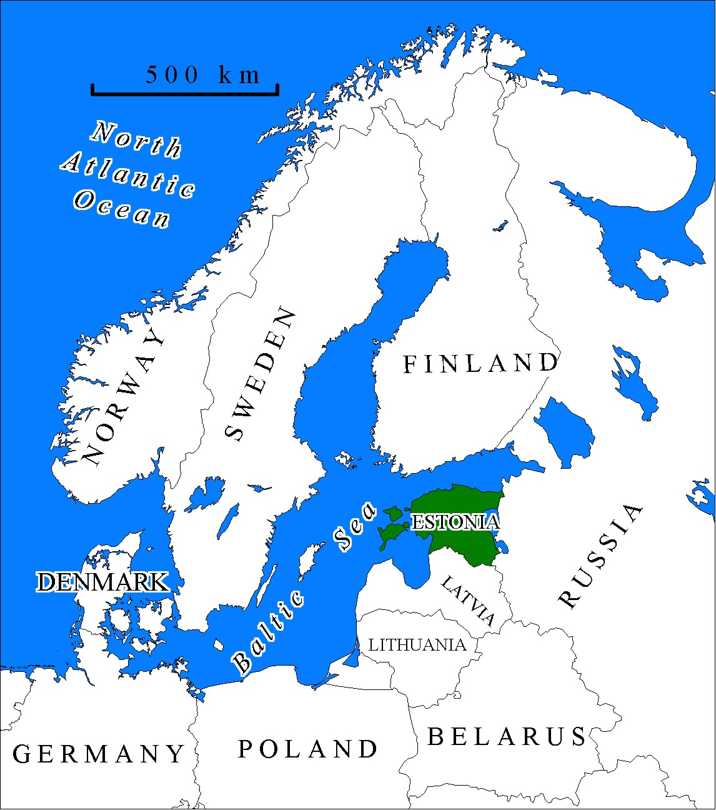
Postglacial land uplift (up to 3.5 mm/y);
tidal range is less than 5 cm (can be neglected);
range of sea level fluctuation (-1.2...+2.8 m);
as a result of continuous land uplift and deficit of movable sediment there are no active dunes only foredunes and embryo dunes in the active shore zone occur;
many shore-parallel ridges can be found in the coastal area, sometimes kilometers from today´s shoreline;
sea level has dropped almost constantly during last ca 7000 years.

Slide 3
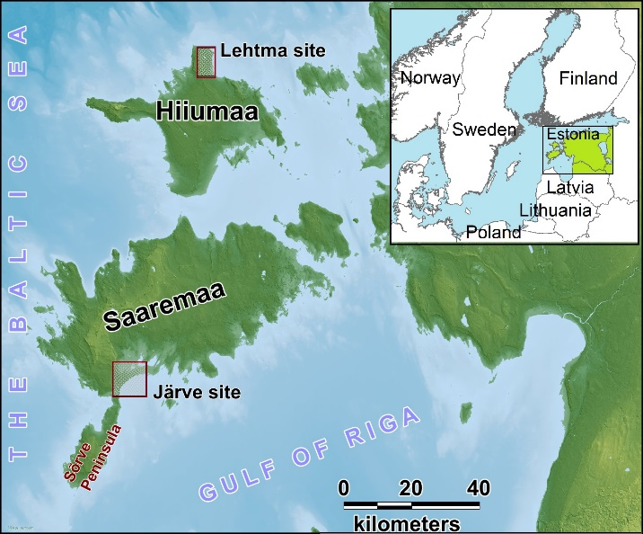
STUDY AERA
The study areas are located in the West-Estonian Archipelago in the eastern part of the Baltic Sea;
The Lehtma study site is located in the north-eastern part of Hiiumaa Island. This study area contains mostly shore-parallel ridges and some recent and ancient spits. Ridges are often covered with relatively thin aeolian cap. Larger dune ridge is likely related to Little Ice Age (LIA).
The Järve study site is located at the southern coast of Saaremaa Island. This study area is mostly characterized by number of ancient spits and their increments. Higher dune ridge can be found near coast and is currently eroding.

Slide 4
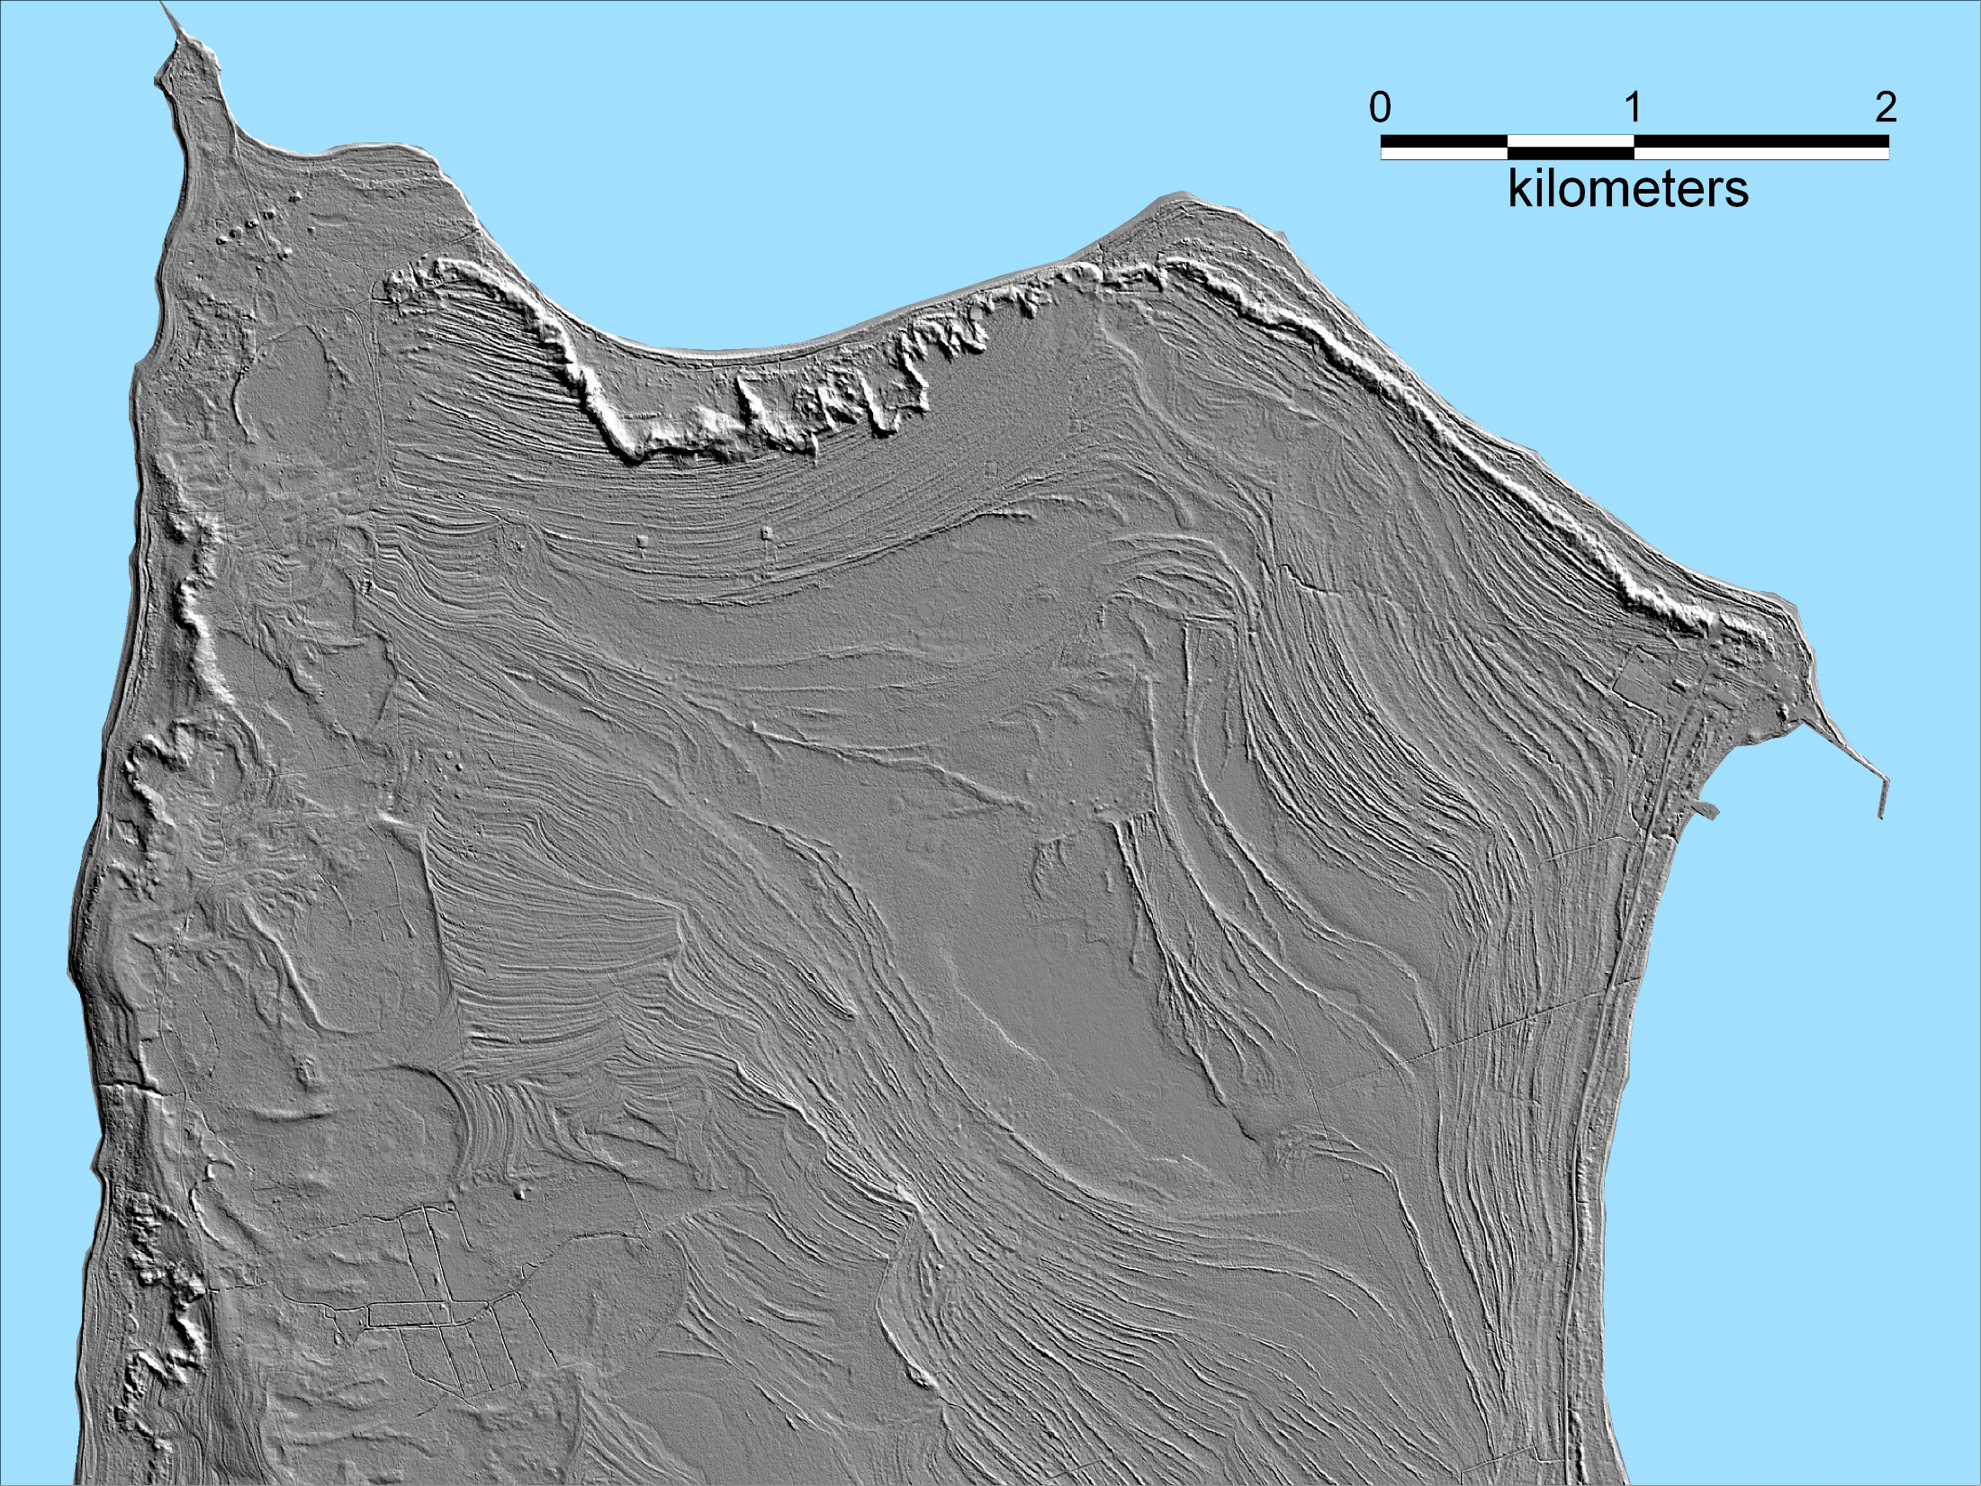
Lehtma site: High absolute uplift rates (>3 mm/yr), abundant sediment supply from marine and glacial depocenters has resulted in a wide strandplain. Beach/dune ridge plain stretching up to 4 km. The beaches vary from very narrow (central erosion area is less than 5 m) to > 50 m wide at Tareste Spit
This spit has formed during the past few decades. The prograded section consists of 1–2-m-high, mostly shore-parallel sandy ridges and intervening swales.
The highest feature at the study site is an ~ 10-m-high dune belt in the northern part of the peninsula, with a few dune fragments visible 100–200 m from current shoreline on the eastern coast as well. These dunes were likely formed during the Little Ice Age.
Baltic Sea
D u n e b e l t
D u n e b e l t
Shore parallel ancient
beach ridges
Tahkuna Penisnsula
Estonian Landboard map

Slide 5
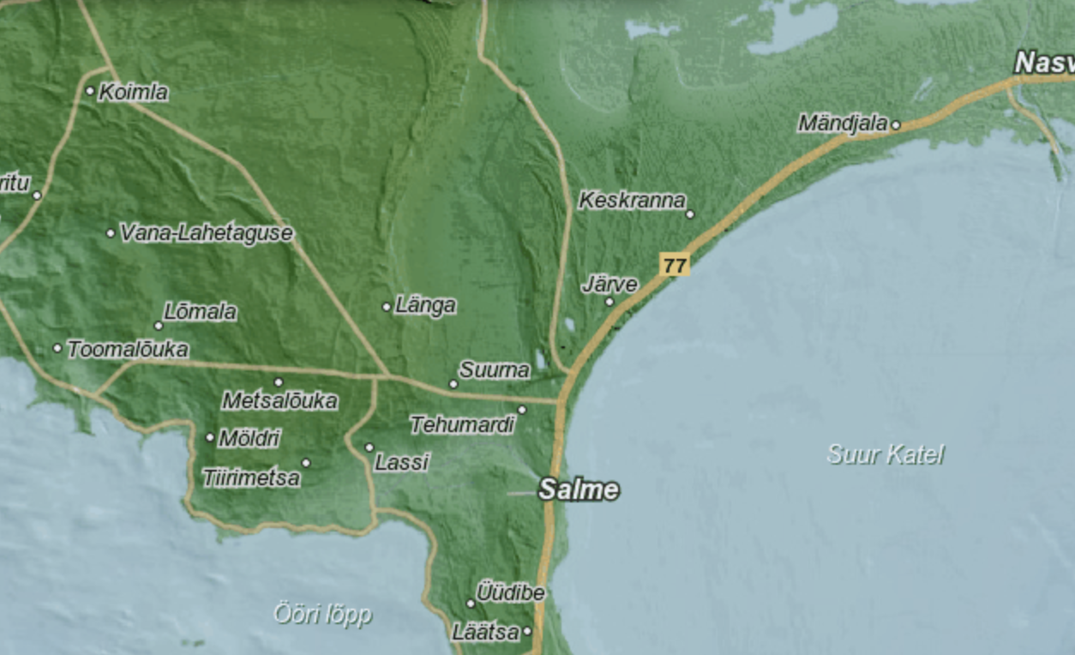
Järve site: The area currently experiences an absolute uplift of ~2.0–2.3 mm/yr.
a 20–30m wide sandy beach backed by dunes is characteristic here. Extending~8 km in length, the LIA dune ridge is mostly 4–5 m high, with the highest point of ~10 m above sea level.
Landward of the dunes, coastal strandplain consists mostly of ancient spits with relative heights of up to 2 m, mostly composed of sand and gravel layers. Small lakes and peaty swales infill gaps between the older spits. The younger seaward spits are smaller (<1 m high) and partly covered by dunes.
Recent erosion has resulted in a 2–4-m high dune scarp along the coast.

Slide 6
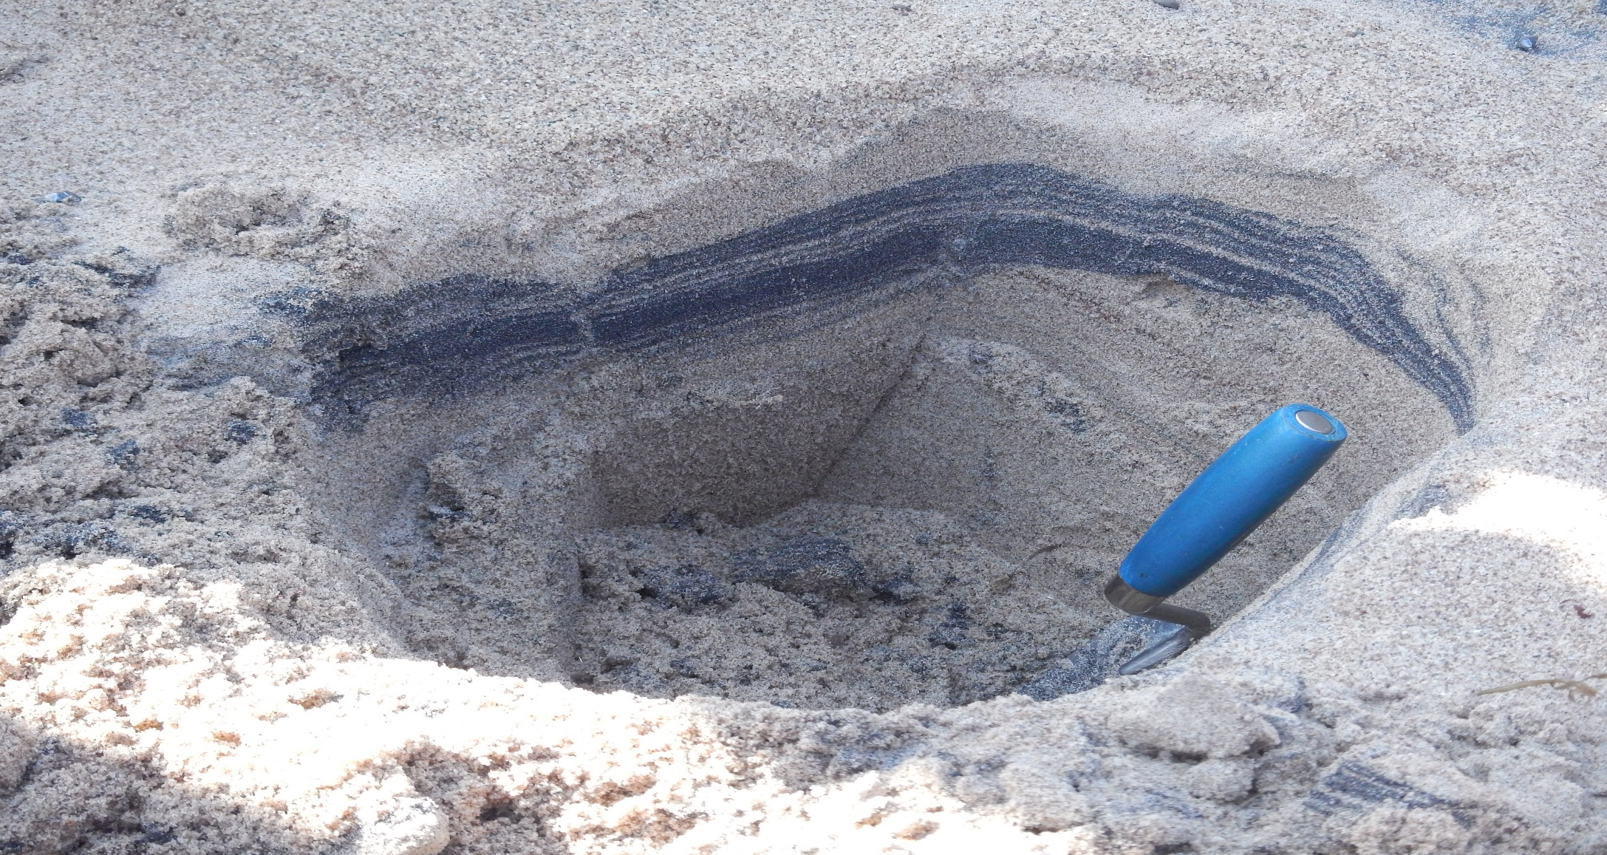
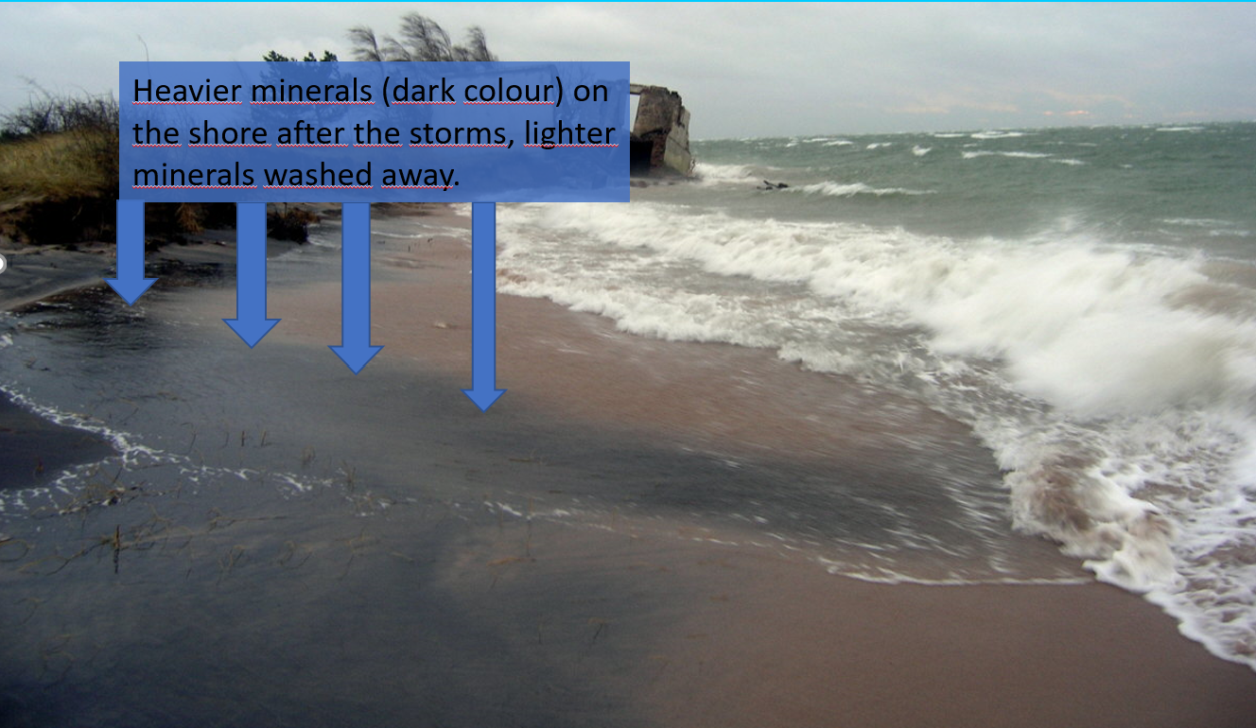
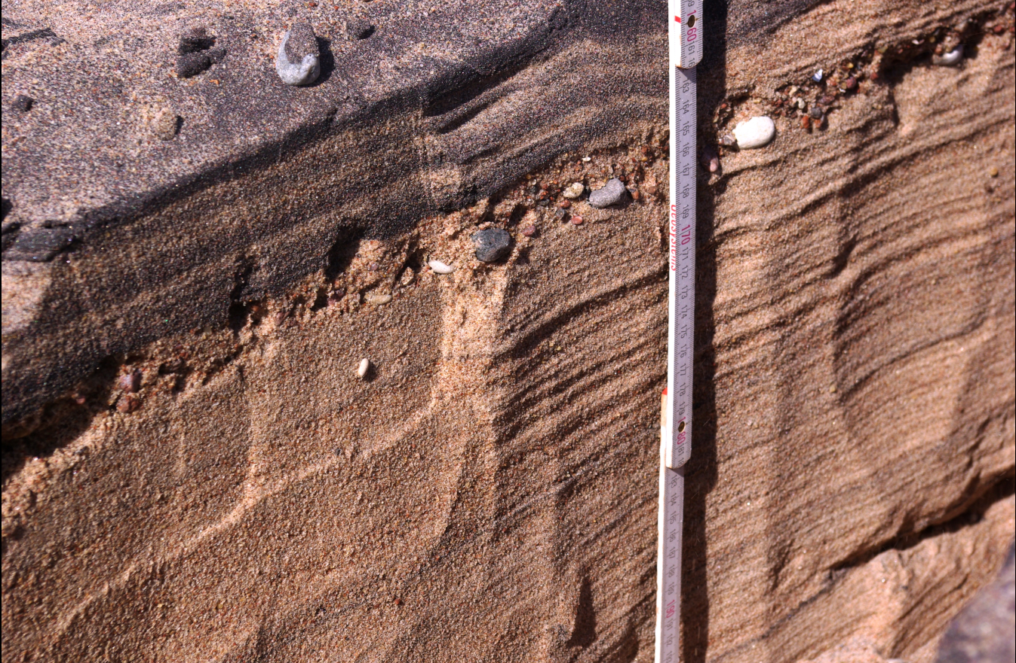
AIM
It is widely acknowledged that coastal strandplains may be entering into a new phase of erosion due to sea-level rise and changes in climate-related hydrodynamic conditions. However, rarely addressed issue is how the natural changes in shoreline configuration or combined with anthropogenically induced changes (e.g., engineering structures) can ultimately produce coastal erosion markers similar to those from extreme storms.

Slide 7
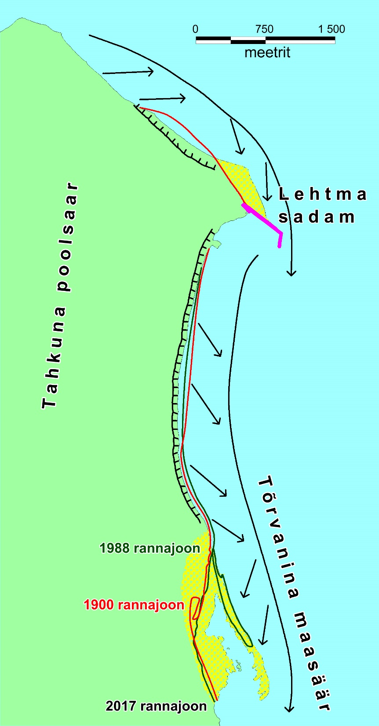
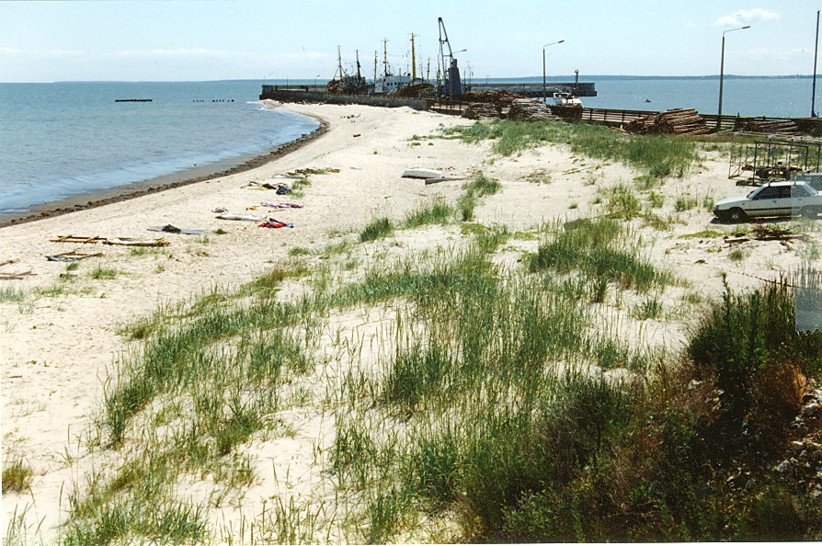
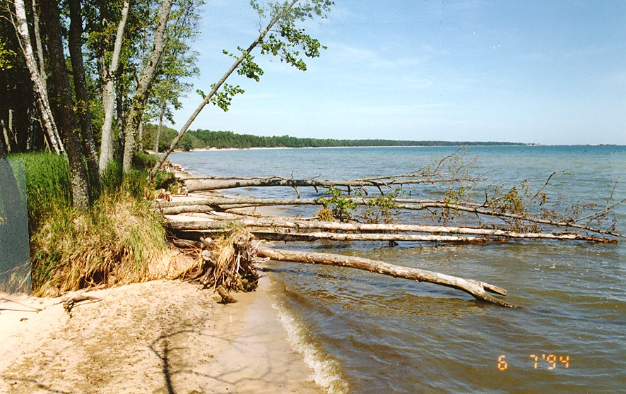
RESULTS
General coastal processes on the northern and eastern coast of Tahkuna Peninsula are characterized by longshore sediment (mainly fine to medium sand) transport from W to E and from N to S.
Construction of jetty has halted sediment bypassing, causing extensive erosion ca 3 km downdrift from port.
Port
TAHKUNA PENISULA
Number of increments of the spit and lagoons
T Õ R V A N I N A S P I T
T Õ R V A N I N A S P I T

Slide 8
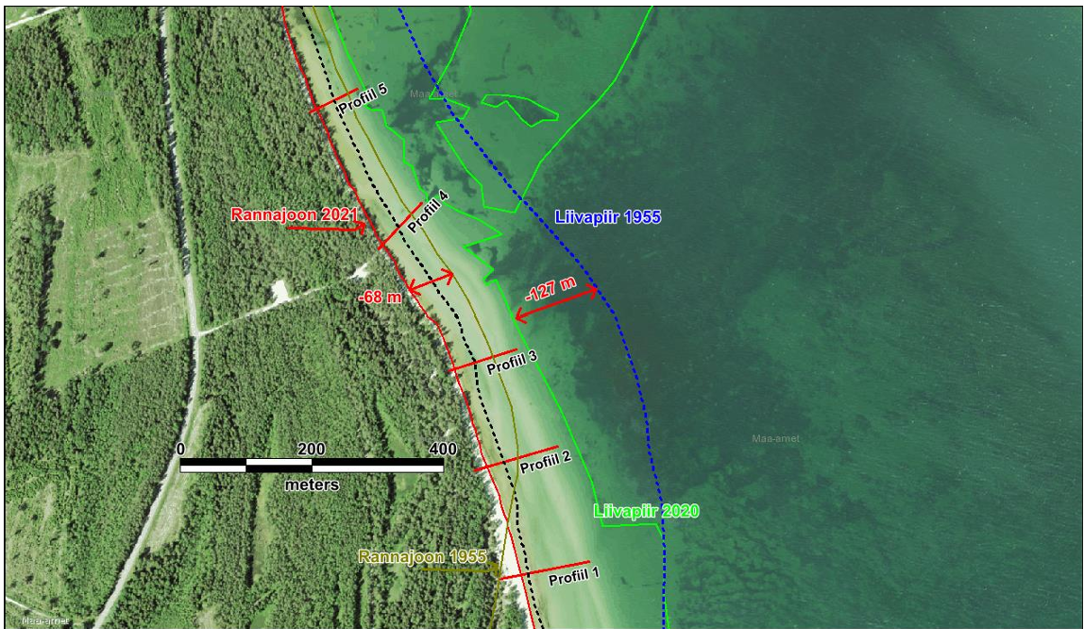
RESULTS
Since 1955, underwater sandbars have retreated >150 m, while the shoreline retreat reached nearly 70 m. Total loss of sand is estimated at ~165,000 m³ (2,500 m³/yr).
As a result of erosion, shoreline orientation has also changed by several degrees and a small cape (Tõrvanina) has formed. This, in turn, favoured a rapid (~25 m/yr) elongation of a sandy spit, which is currently 1,400 m long.
Normally, along the eroding strandplain margin, heavy mineral concentrations (HMC) provide evidence of intensified storminess. We have also detected very high HMCs on the eroding section of Lehtma study site. Here the high magnetic susceptibility anomalies and thick HMC layers indicate a cumulative long-term erosion (not individual extreme storms or stormy periods).
Shoreline 2021
Sand border 1955
Sand border 2020
Shoreline 1955

Slide 9
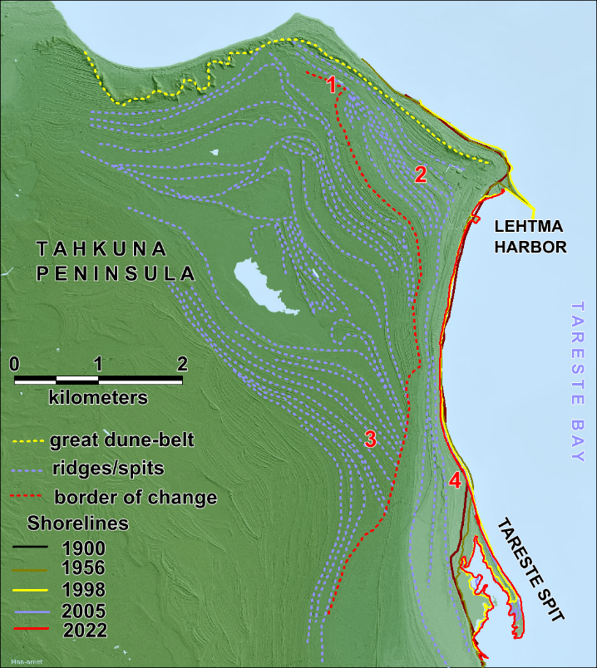
LiDAR topography for the western part of the Lehtma site, reveals several clear morphodynamic markers:
Marker 1: Natural paleo-cape situated ~5–6 m above sea level, ~400 m inland from the present shoreline. Formed as a result of a combination of land uplift and longshore sediment transport 1,500–1,800 years ago. This paleo-cape is similar to the Tareste Spit today (marker 4). Therefore, it is likely that this landform favored the formation of similar spits/segments behind it (marker 2).
When the sand started to accumulate into spits, it caused sediment deficit downdrift, especially on the eastern coast of Tahkuna Peninsula. It was likely similar to the current situation where Lehtma harbor is causing sediment deficit and erosion 3–4 km downdrift of the harbor.
Farther south, some of the older ridges with similar elevation (5–6 m above sea level, 400–900 m inland from shoreline) have been eroded and are truncated by newer shore-parallel ridges (marker 3).
When the spit-growth reached the point where coastal configuration favored longshore sediment transport again, a net accumulation regime resumed and new shore-parallel ridges began to form.
RESULTS
H
M
C
?
?

Slide 10
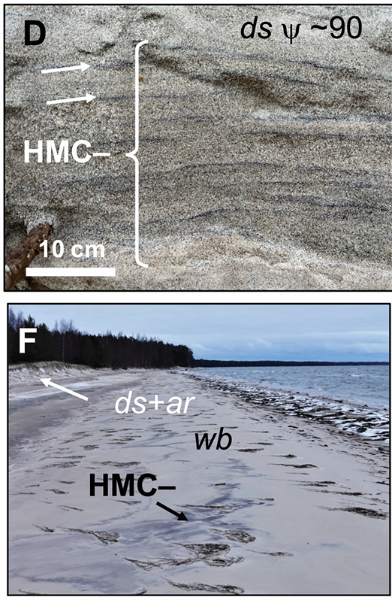
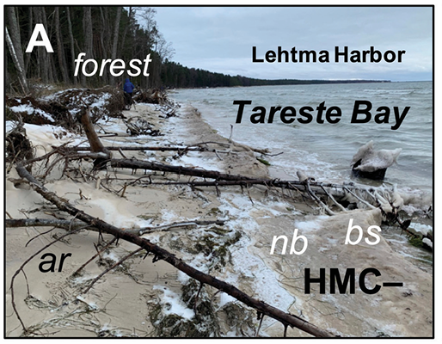
It is likely that along the boundary of truncated ridges, buried HMC layers are present, similar to the terminus of the Tareste spit. However, these anomalies are mostly caused by the natural changes in shoreline configuration that ended the regular longshore sediment flux.
There might also be signals of some intense storms, but it is not likely that these are the main factor behind the formation of HMC layers.

Slide 11
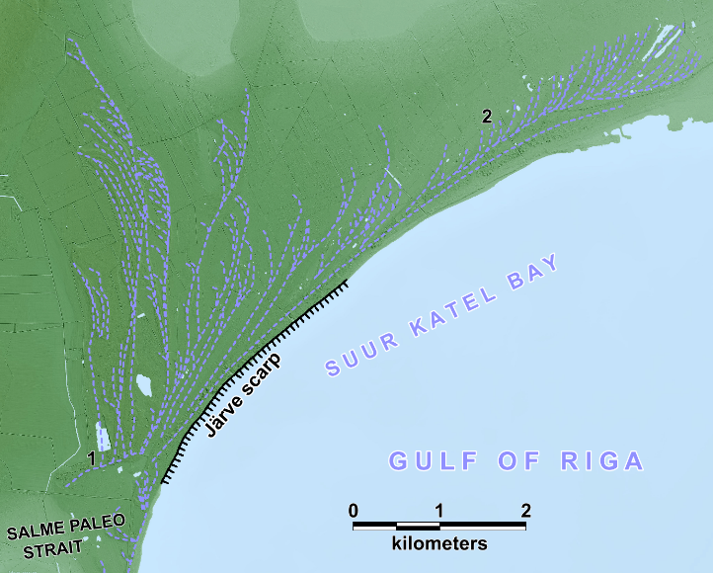
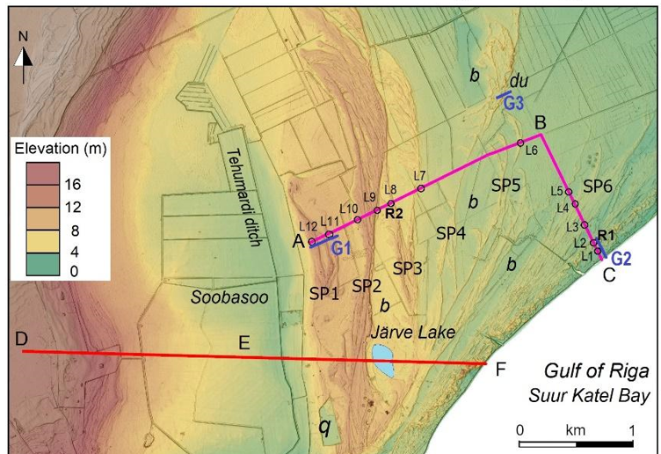
RESULTS
Progradation at Järve has occurred primarily due to the formation and uplift of spits, which subsequently merged into a barrier island.

Slide 12
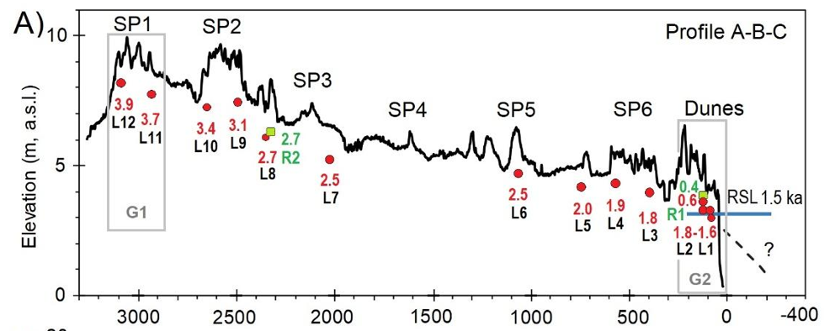
The formation of five or six different spits and their numerous segments occurred during the past 4 kyr.
It is likely that all four westernmost paleo-spits and their segments have formed during the period when the Sõrve Peninsula was still an island and waves accessed Järve site from W, SW, S, SE and E.

Slide 13
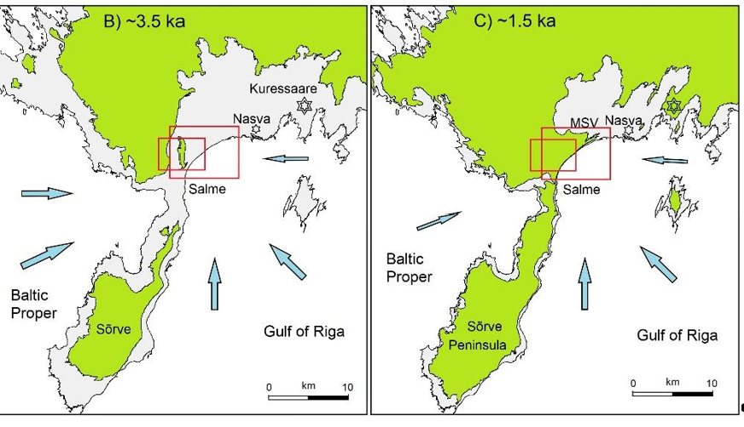
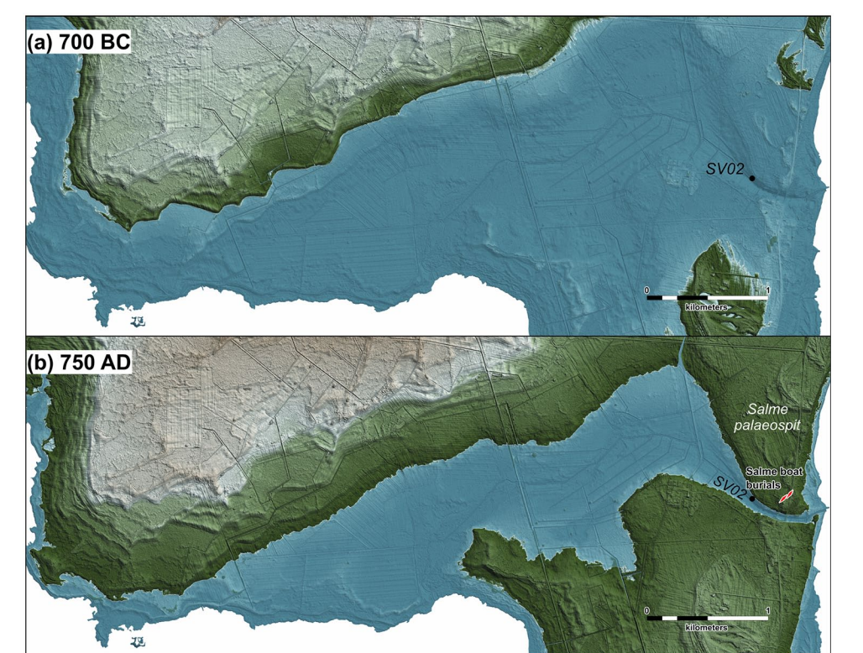
Southern boundary of this site is located at the isthmus of a much larger Sõrve Peninsula, which was still separated from the site by a strait that closed less than 1,500 years ago;
Luik et al., 2024
Nirgi et al., 2021

Slide 14
Marker 1 indicates the location of the paleo-cape from which all the currently visible paleo-spits started to grow.
This paleo-cape (currently >10 m above sea level) was likely one of the main sediment sources for paleo-spit growth.
Some sediment was likely eroded from the shallow seafloor, and waves approaching from the Baltic Sea proper played an important role in the development of the older paleo-spits.
The westernmost 4 paleo-spits are clearly larger than the two youngest ones – every next spit is smaller than previous.
An extra large decrease in size can be observed between the first four and the last two paleo-spits.
The paleo-strait south of the Järve site was gradually narrowing and shallowing, and was likely closed before the youngest spits formed.
This reduced the sediment supply, as can be clearly seen from very small elevation (mostly less than 0.5 m) of the youngest spit (marker 2) and its many recurved segments that continued to extend into a shallow embayment.
Notes:
Sediment supply from paleo-cape ceased and the wave climate turned much calmer, as there were no more westerly wave impact from the Baltic Sea proper.

Slide 15
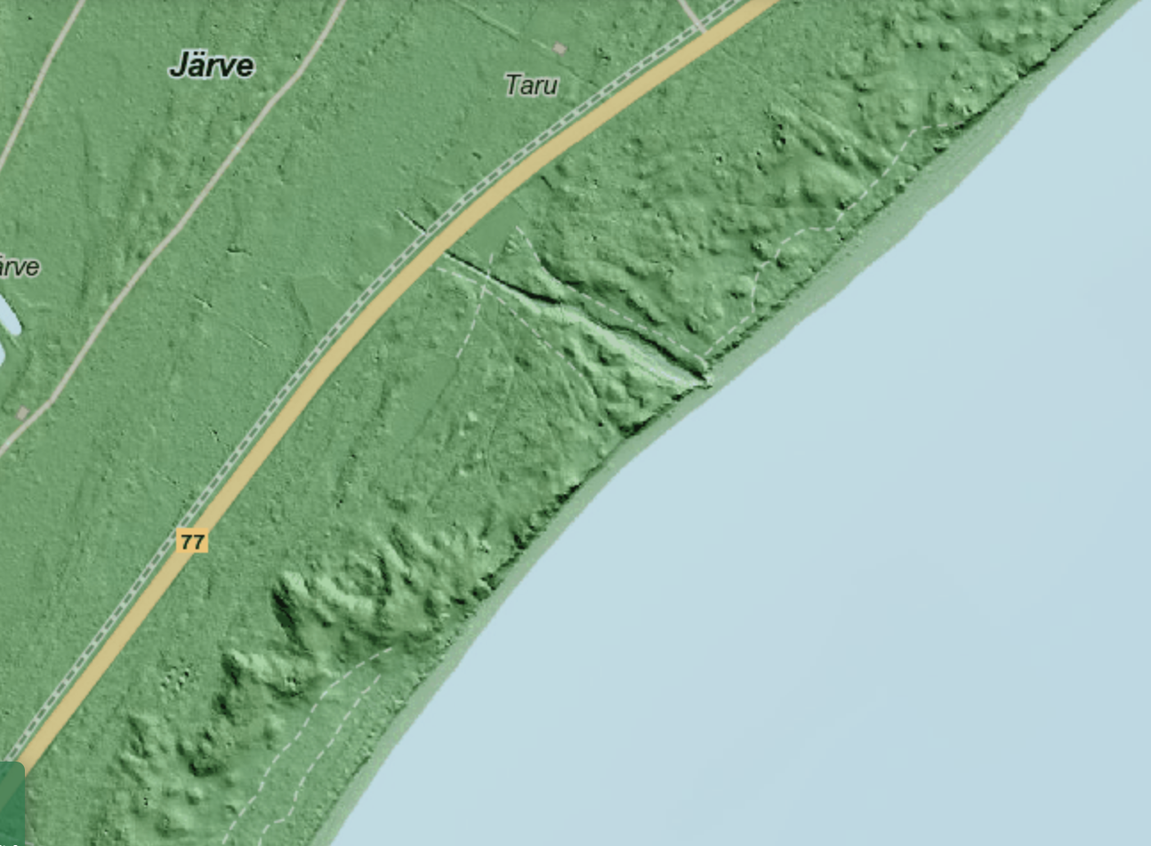
The longshore sediment transport dynamics during the LIA were likely diminished and eventually replaced by aeolian processes and formation of high dunes.
As a result, some sections of wave-built paleo-spits are capped by aeolian sands. After the end of the LIA (~1,850–1,900 CE), the coastal processes accelerated again.
D U N E S

Slide 16
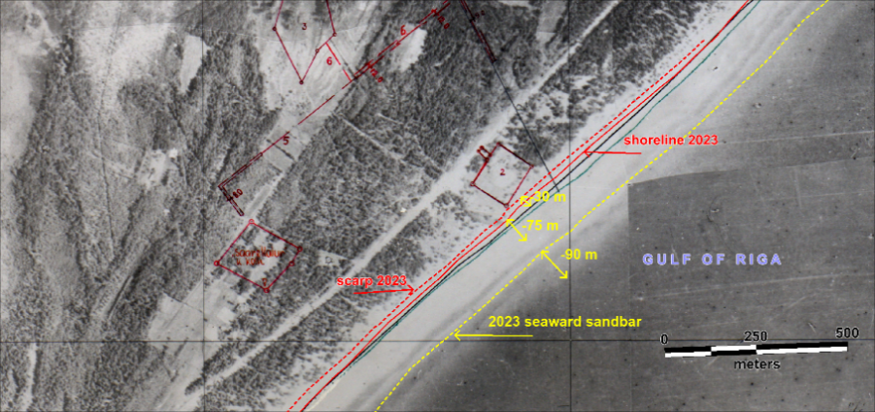
When sediment supply decreases and shoreline configuration changes, it is common that erosion begins from the proximal sections (necks) of the spits, especially when storminess increases.
In recent decades, the natural processes have reduced sediment supply and wave heights. At the same time, the shoreline configuration is still favouring erosion.
Also, as the regional climate warms up, the unfrozen sea allows higher sea level and waves, especially during powerful winter storms.
Recession of the scarp, shoreline, and sandbars at Järve. The 2023 lines are superimposed on the 1955 aerial photo.

Slide 17
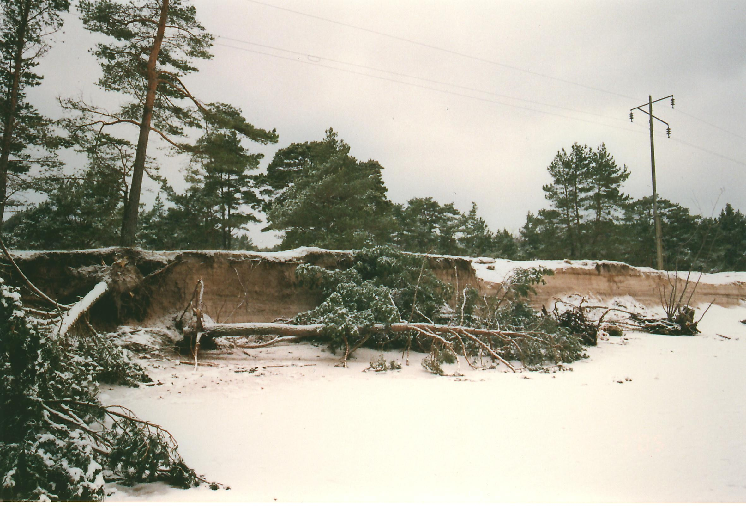
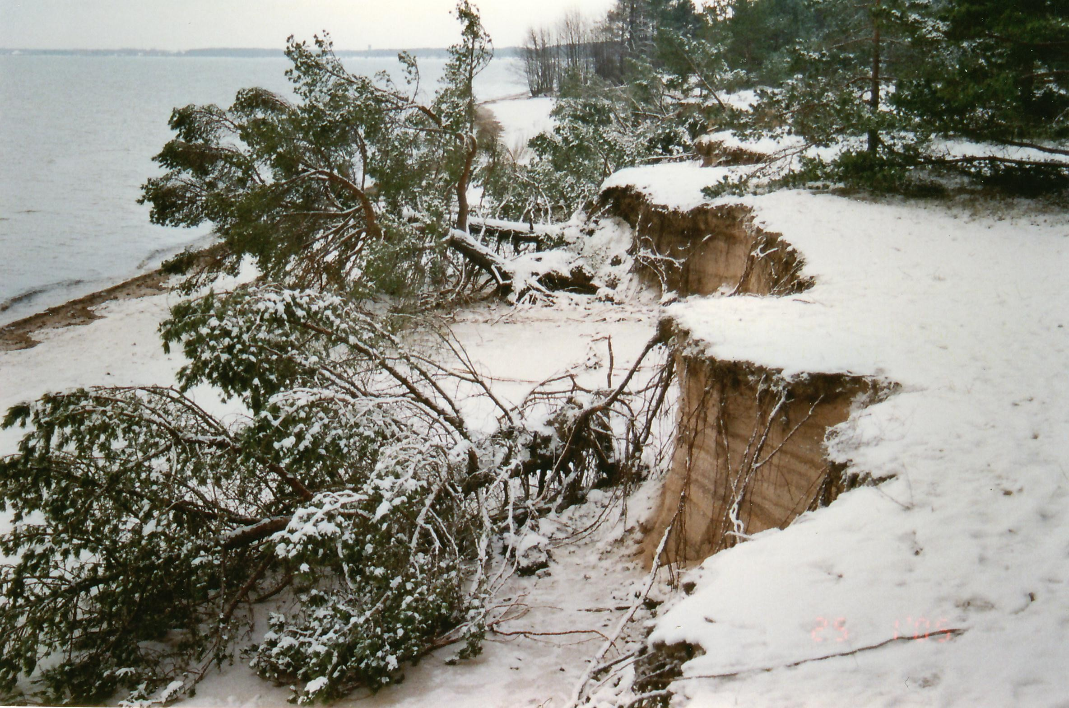
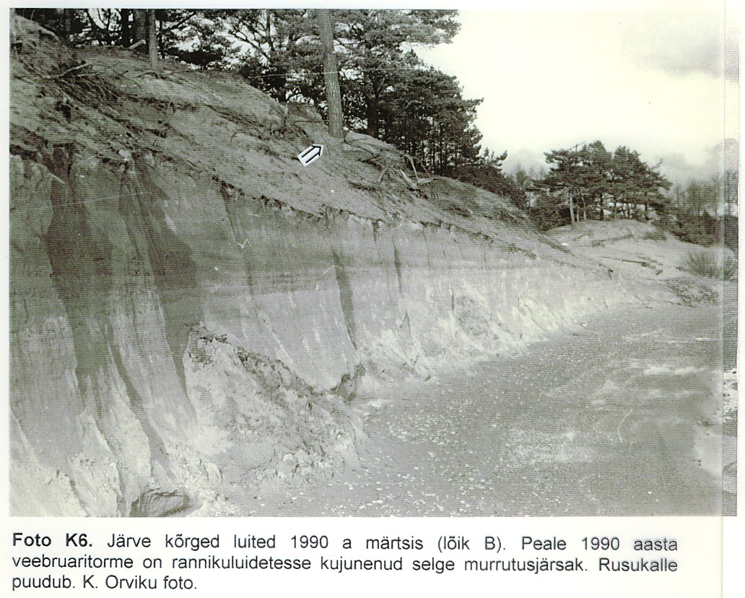
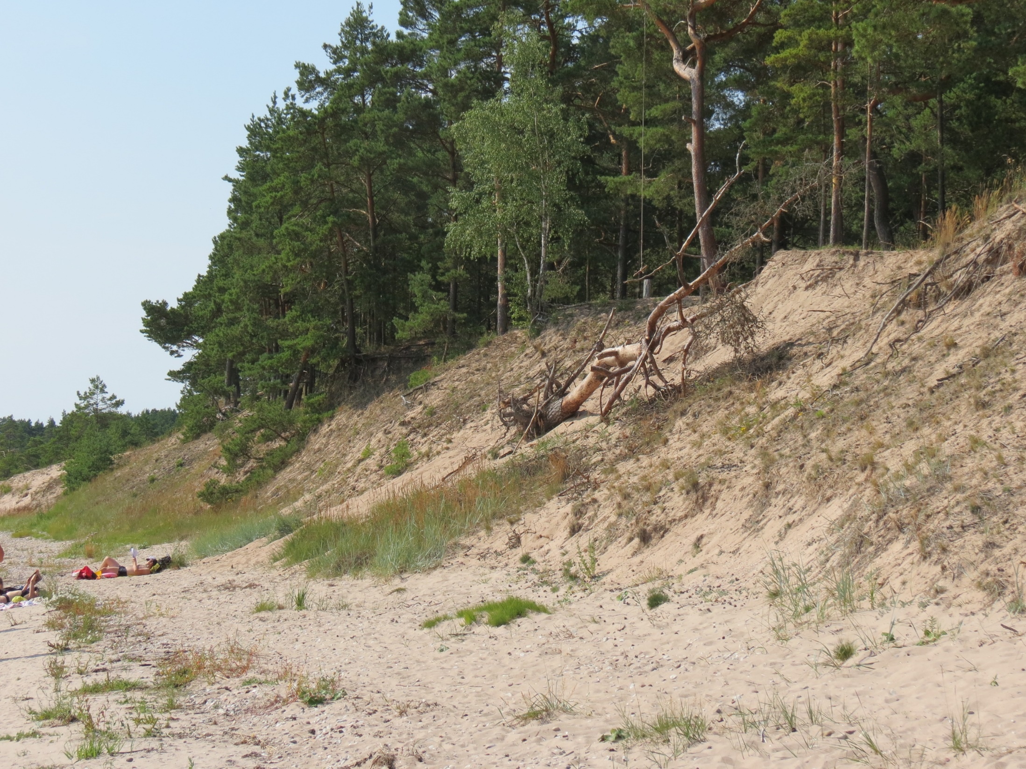
This all has results in more intense coastal erosion, with erosional indicators along the coast (berm and dune scarps, undercut and fallen trees, coarser sand horizons, and HMCs).
E R O S I O N

Slide 18
CONCLUSIONS
Our study indicates that the paleo-cape that formed approximately 1,500–1,800 years ago in the Tahkuna Peninsula triggered spit growth, which is analogous to the recent spit growth on Cape Tareste.
This spit growth temporarily inhibited the southerly longshore sediment flux and caused extensive erosion – similar to the effect where the Lehtma harbor jetties are now responsible for the erosion 3–4 km to the south.
Shoreline configuration change due to land uplift can alter the exposure of the site to the waves and cut off sediment supply, as documented along the Järve site. Sediment deficit, coastline configuration conducive to erosion, and hydroclimatic forcings may all contribute to coastal dynamics in the near future.
Ongoing erosion has exposed extensive paleo-HMC layers south of Lehtma harbor. During 1,500–1,800 years ago, erosion 400–800 m inland from the current shoreline of Tahkuna peninsula likely generated similar HMC anomalies that now lie buried within the prograding strandplain.
Thick HMC layers may indicate persistent shoreline erosion caused by technogenic (jetties, sediment dredging) or natural changes in the shoreline configuration.
In such cases, additional effects of storms cannot be ruled out. However, the HMCs and coarser grained anomalies in the internal architecture of paleo-beach lithosomes should not be attributed only to stormy periods, but rather a number of other aforementioned factors have to be considered.

Slide 19
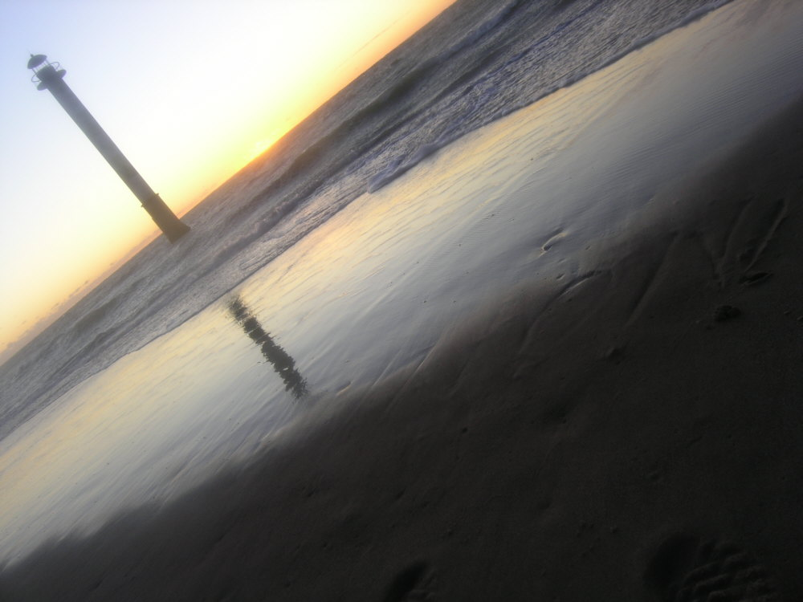

Acknowledgement: Estonian Research Council grant PRG1471.

