Slide 1
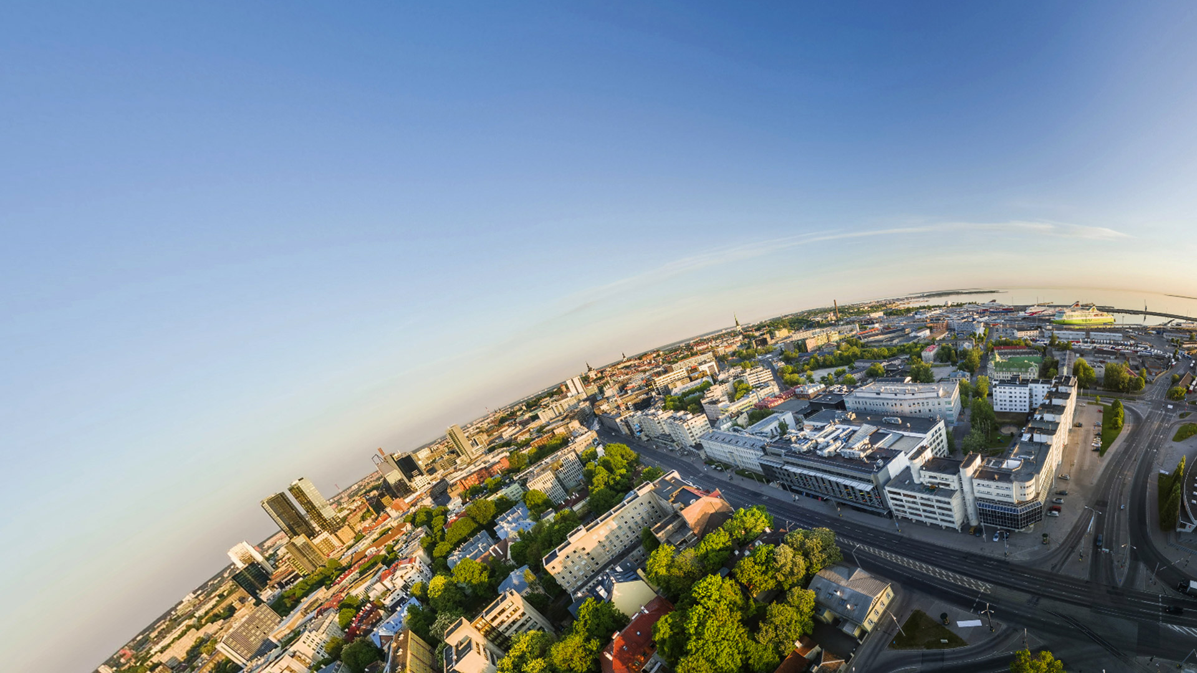
TALLINN
UNIVERSITY
Doris Piho
Senior Marketing Specialist doris.piho@tlu.ee

Slide 2
Tallinn University is the largest university of humanities and social sciences in Tallinn, and the third largest public university in Estonia.

Slide 3
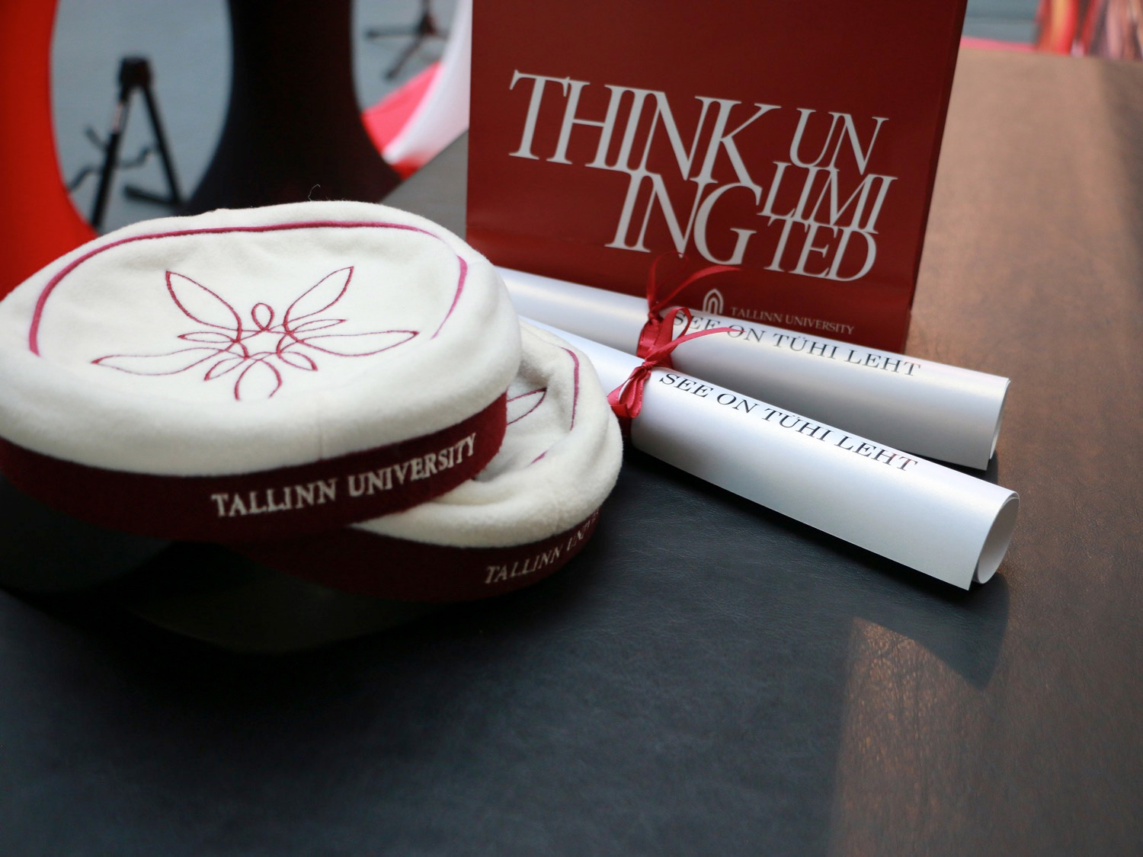
The university now known as Tallinn University came into existence on 18th March 2005.

Slide 4
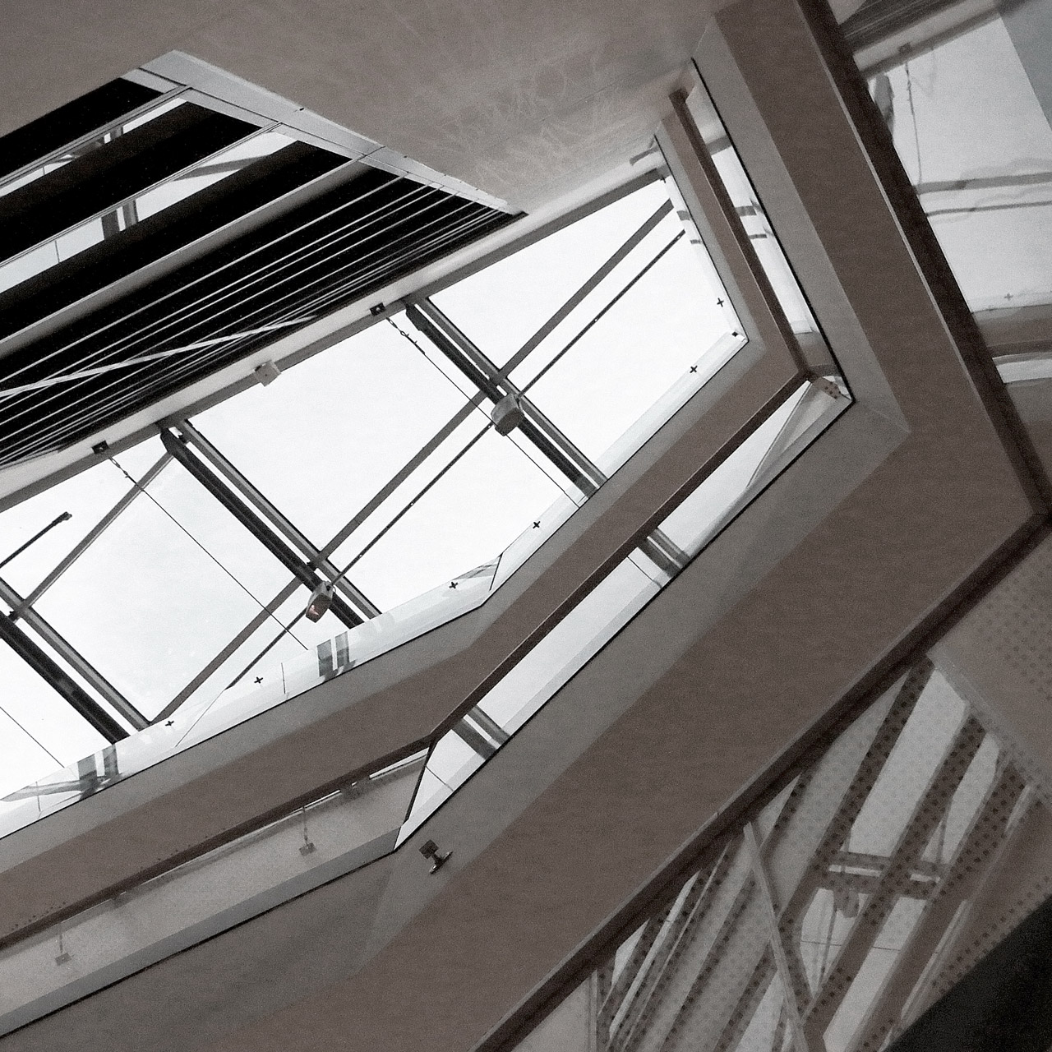
It developed as the result of the merger of several research and development institutions in Tallinn:
Academic Library
Tallinn Pedagogical University
Institute of History
Institute of International and Social Studies
Estonian Institute of Humanities
Institute of Ecology
Academy Nord
The Estonian Institute for Future Studies
Tallinn Pedagogical College

Slide 5
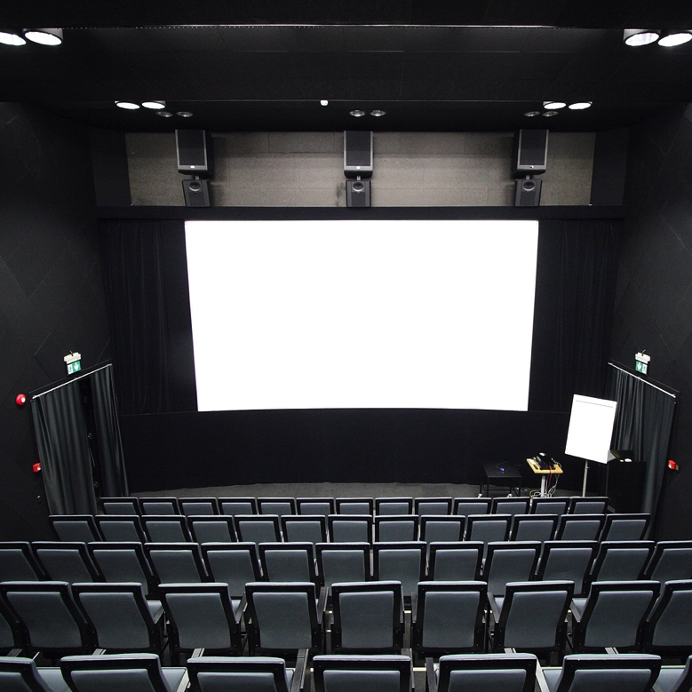
The university has longest traditions of teacher training in Estonia and the most modern film and media school in the Baltic countries exist side by side.

Slide 6
University has:
Unique, innovative and interdiciplinary programmes
New campus in the city centre and a branch in Helsinki
Prominent scientists and lecturers
Among 7% of the best universities
(QS World University Rankings)
Individual approach to students
Creative and free environment

Slide 7
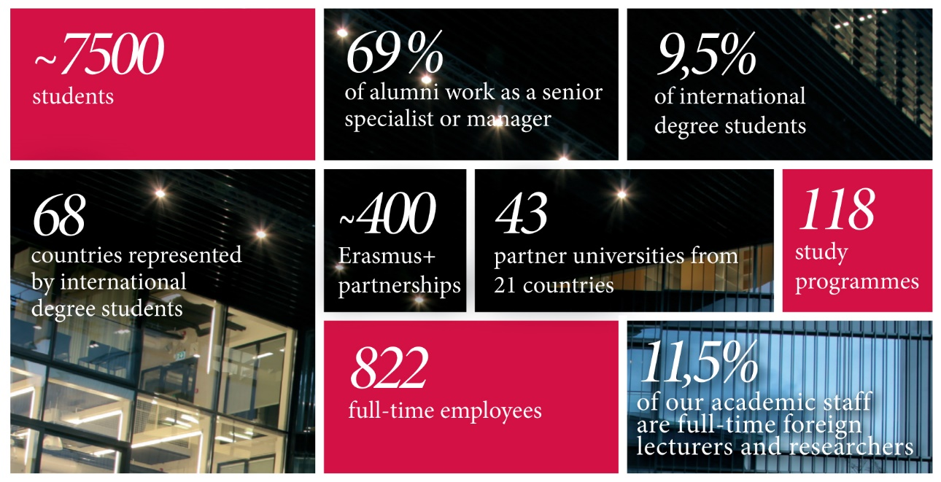

Slide 8


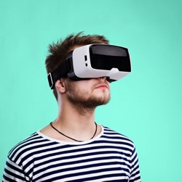

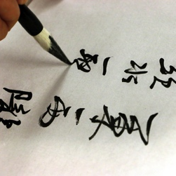
FIVE FOCUS FIELDS:
Healthy and
sustainable lifestyle
Society and open governance
Digital and media culture
Educational innovation
Cultural competences

Slide 9
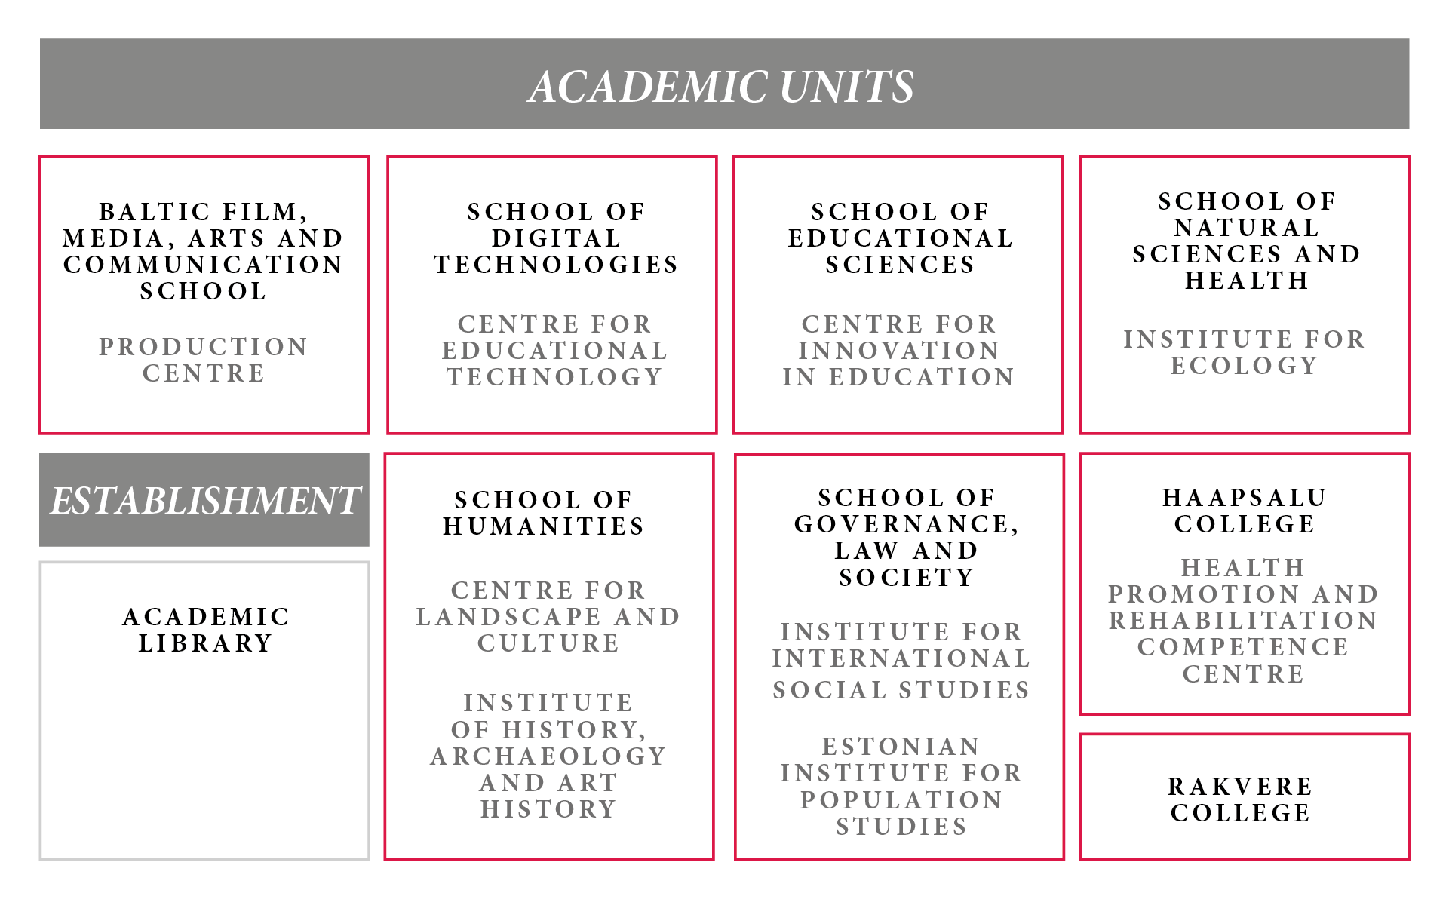

Slide 10
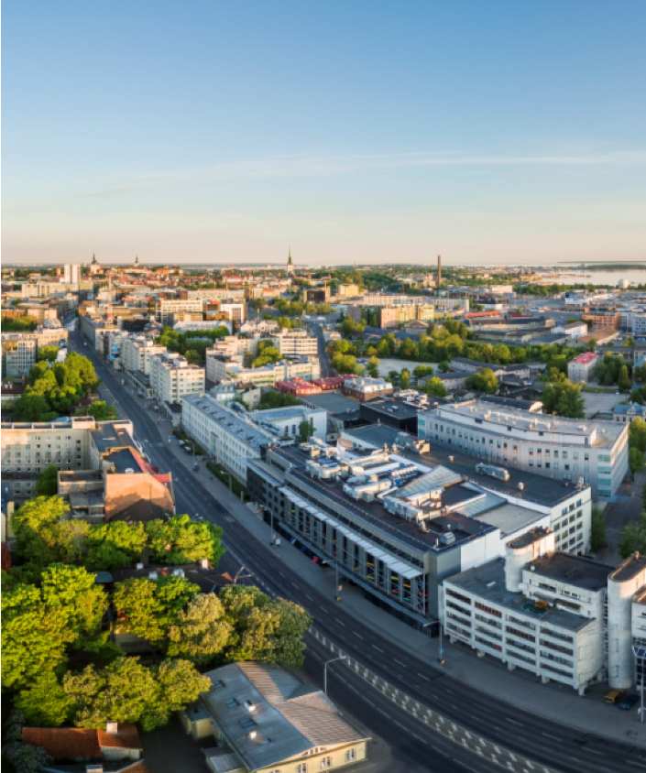
what DOES The tu
CAMPUS
LOOK LIKE?

Slide 11
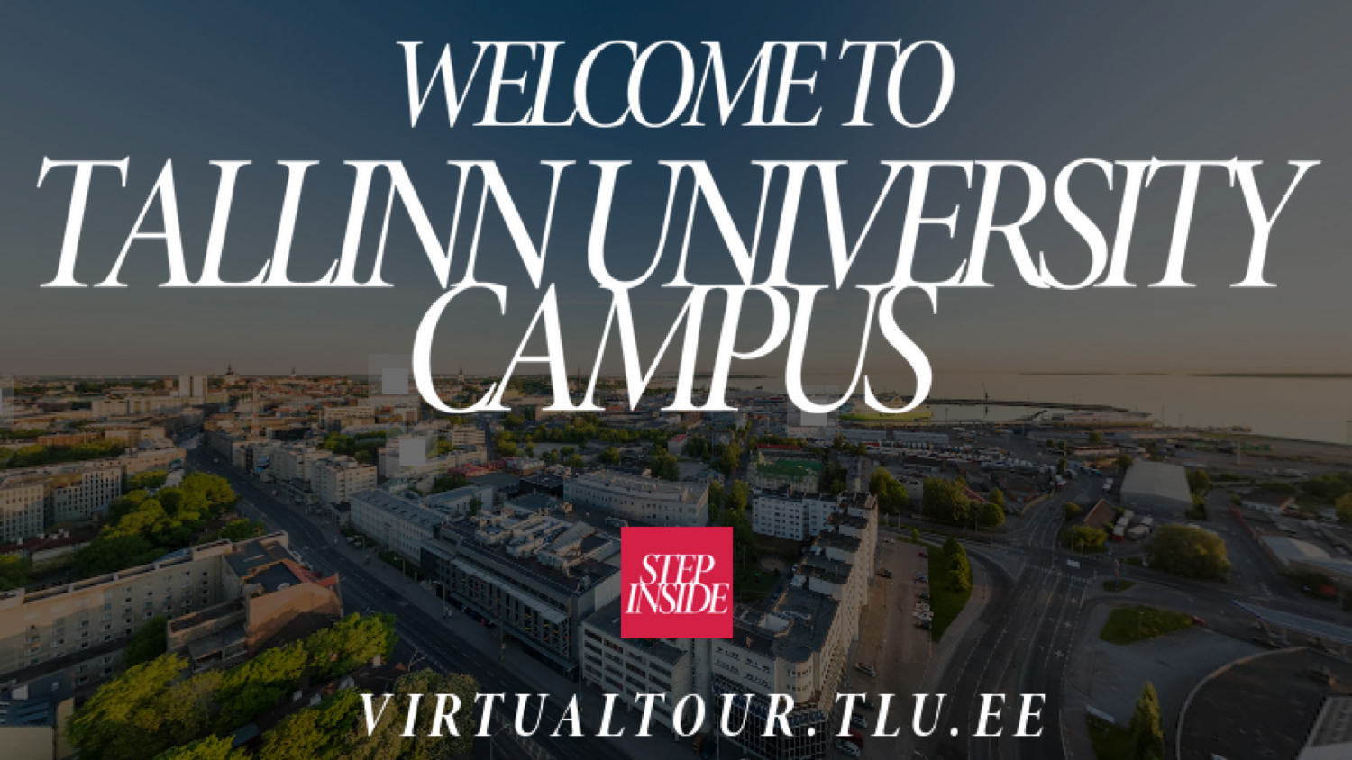

Slide 12
DEGREE PROGRAMMES

Slide 13
English-based degree programmeS:
6 bachelor’s,
16 master’s,
15 doctoral study programmes.

Slide 14
1
Bachelor’s Programmes

Slide 15
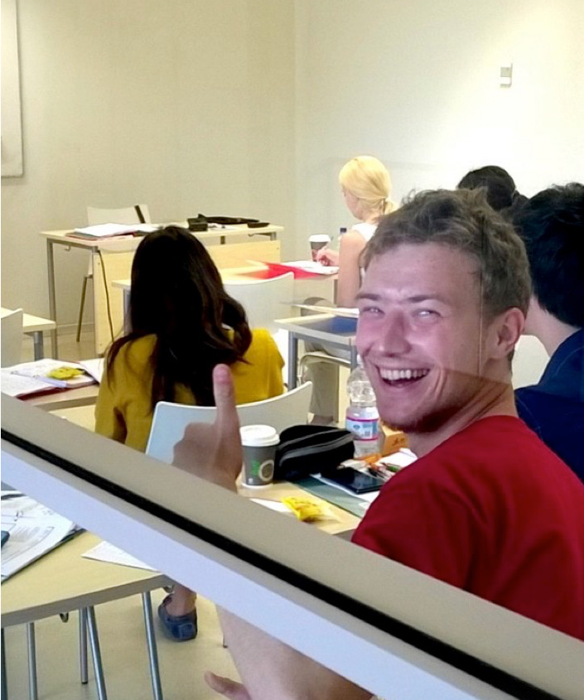
Audiovisual Media
Crossmedia in Film and Television
Liberal Arts in Humanities
Liberal Arts in Social Sciences
Law (in Tallinn and in Helsinki)
Politics and Governance

Slide 16
2
master’s Programmes

Slide 17
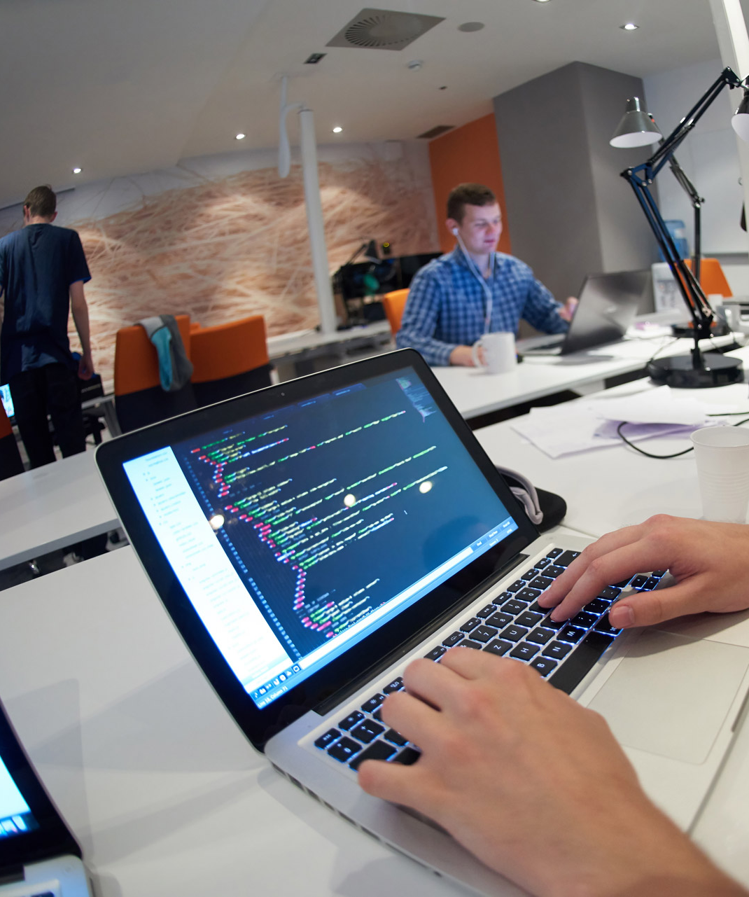
School of Digital Technologies
Digital Learning Games
Human - Computer Interaction
Open Society Technologies
Digital Library Learning*
*Joint master's programme

Slide 18

Baltic Film, Media, Arts and Communication School
Documentary Film
Communication Management
JMD Film Arts*
JMD Cinematographer*
*Joint master's programme

Slide 19

School of Humanities
Anthropology
Estonian Studies
Literature, Visual Culture and Film Studies

Slide 20
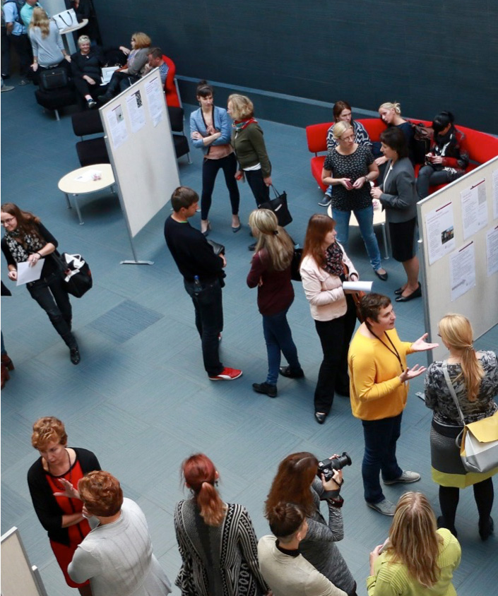
School of GovernAnce, Law and Society
International Relations
Social Entrepreneurship
Human Rights in the Digital Society

Slide 21
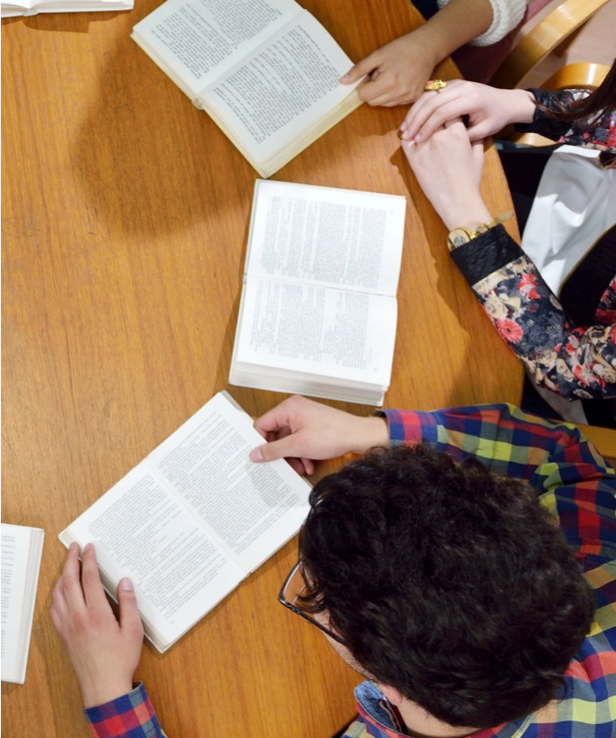
School of Educational Sciences
Educational Innovation and Leadership
Adult Education for Social Change*
*Joint master's programme

Slide 22
3
Doctorial Programmes

Slide 23
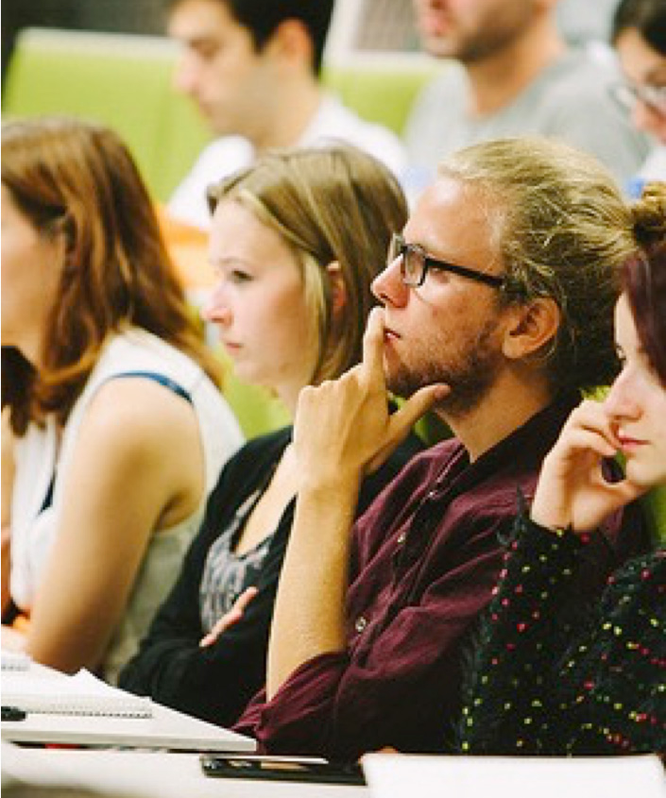
Information Society Technologies
Linguistics
Physics
Psychology
Social Work
Sociology
Studies of Cultures

Slide 24
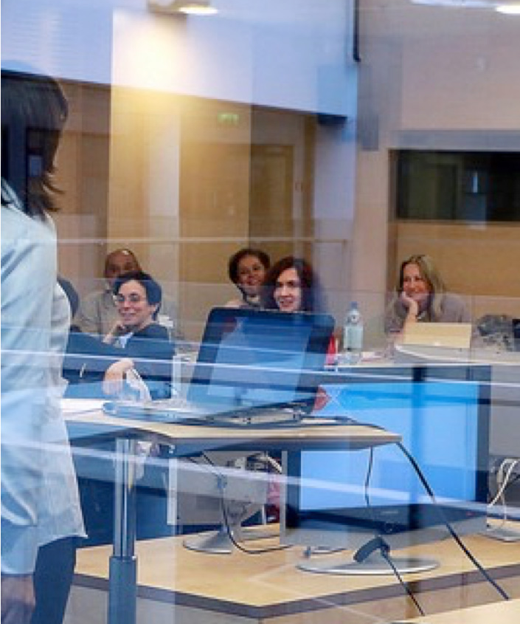
Analytical Biochemistry
Demography
Ecology
Educational Sciences
Government and Politics
Health Behaviour and
Wellbeing
History
Audiovisual Arts and Media Studies

Slide 25
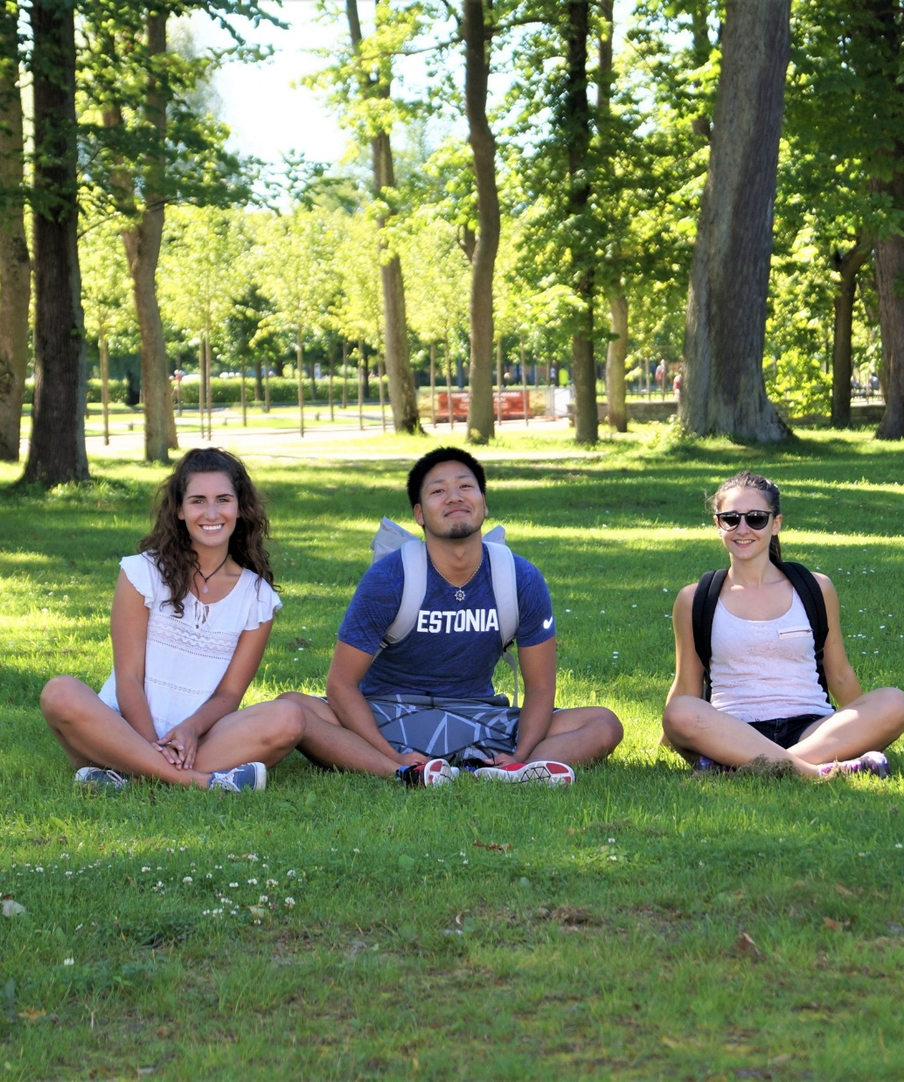
INTERNATIONAL SUMMER SCHOOL
July 15 – August 2, 2019
25 courses in various fields
More than 300 participants, ~85% international
Scholarships available
Exciting social and cultural programme
summerschool.tlu.ee

Slide 26
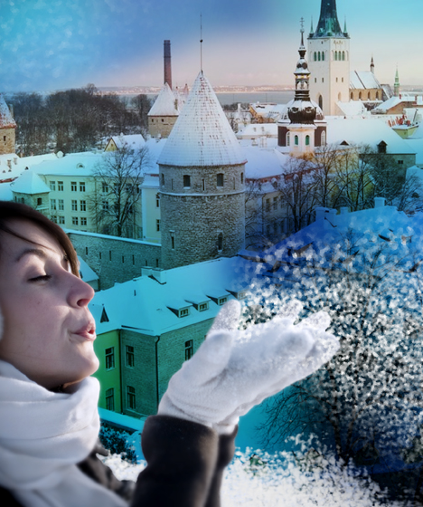
INTERNATIONAL WINTER SCHOOL
January
5 - 7 courses
Exciting social and cultural programme
winterchool.tlu.ee

Slide 27
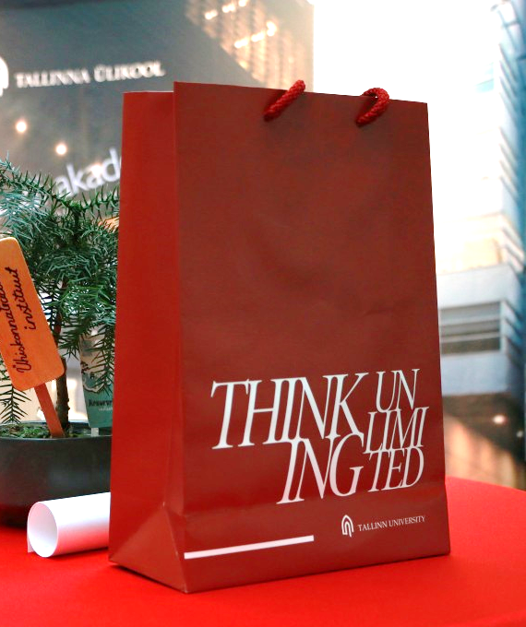
Souvenirs and Publications Centre
Astra building, 1st floor
Monday – Friday from 9.00 – 16.00
Tallinn University Press Bookshop
Souvenirs (T-shirts, pens, notebooks, key rings, memory sticks, DVDs, bags and many more)

Slide 28








DOWNLOAD TU STUDENT GUIDE!
Tallinn University
tallinnaulikool
tallinnuniversity
TallinnUniv
TallinnaYlikool
Tallinn University
media.tlu.ee

Slide 30
Thank you!

