Slide 1
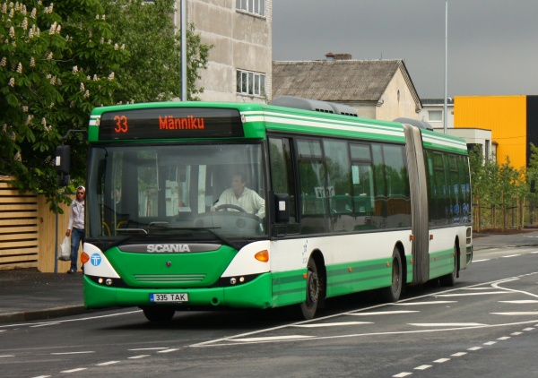
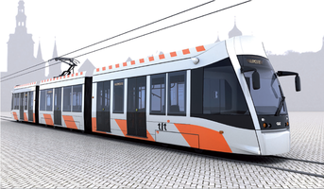
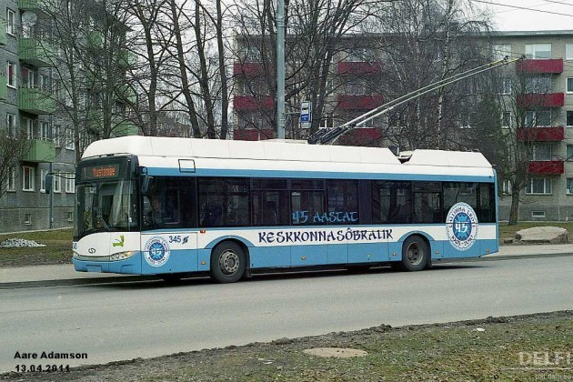
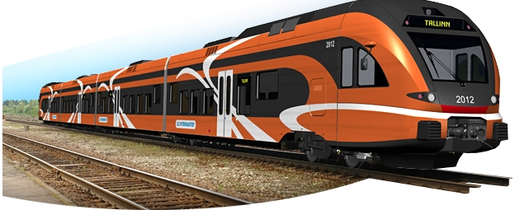
Transportation in Tallinn

Slide 2
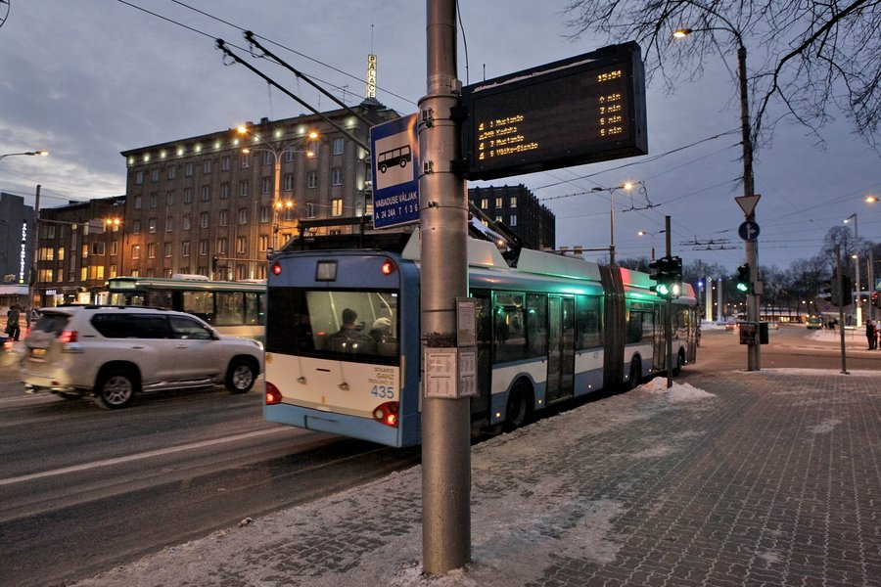
Working hours
Busses, trams and trolleys operate daily:
Working days: from 5 am until 12 am
Saturdays: from 6 am until 12 am
Sundays and public holidays: from 7 am until 12 am
There are some nigt buses
For routes and timetables, see transport.tallinn.ee
Due to roadworks, many changes in routes and timetables

Slide 3
Public Transport Card
The Public Transport Card is an electronic contactless personalised or non-personalised card which verifies its holder’s travelling rights. Personalised card is only valid with an identity document.
Personalise the card: it could be done at the point of sale or for free at tallinn.pilet.ee/personalise (if you have an ID-card)
Card nr.

Slide 4
Public Transport Card
The Public Transport Card can be purchased for 2€ from the public service office of Tallinn City Government (Vabaduse väljak 7) and:

Slide 5
Tickets with the Public Transport Card
Money can be loaded on the Card:
At sales points
Through internet bank at tallinn.pilet.ee
Mobile app Pilet.ee
https://www.tallinn.ee/eng/pilet/How-to-buy-ticket

Slide 6
ISIC Card as a transportation card
Has to be registered at tallinn.pilet.ee if you have an Estonian ID code
More information about purchasing tickets can be found at: https://www.tallinn.ee/eng/pilet/How-to-buy-ticket

Slide 7
Free public transport – for residents of Tallinn
Available once you have registered the place of residence in Tallinn and received the Estonian ID code
In service point need to show the ID document
At www.pilet.ee need to insert the Card number, personal code and Estonian ID card number
If you have personalised the card before and then become a resident of Tallinn, then the card needs to be personalised again
You need to write your name on the personalised card and have an ID document with you when you take public transport

Slide 8
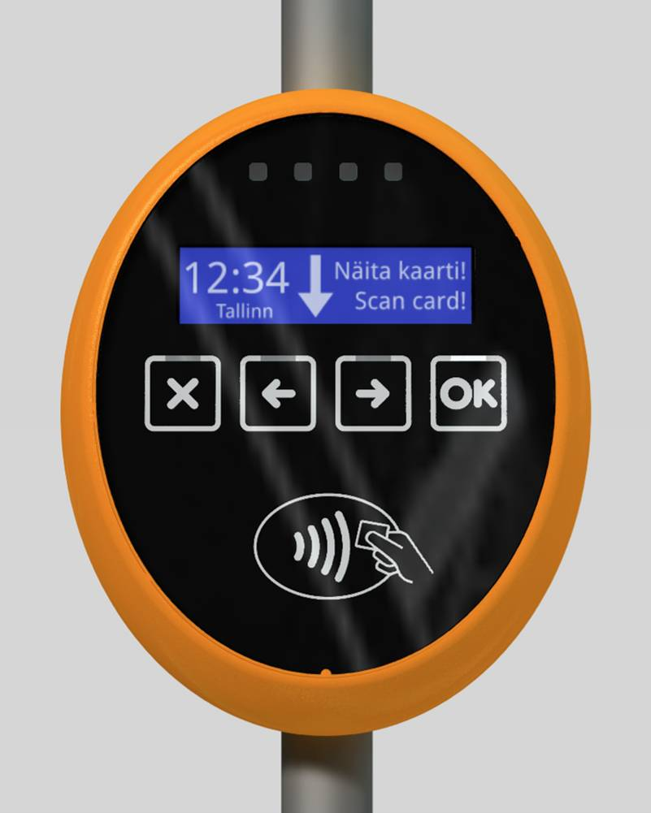
Validation
The card needs to be validated every time when entering public transport by placing the card in front of the orange validator
Hold your smartcard against the validator
Processing the information on your card.
Your ticket is activated/your travel card or discount are valid
You do not have the right to travel/you do not have sufficient funds on your card to purchase a ticket

Slide 9
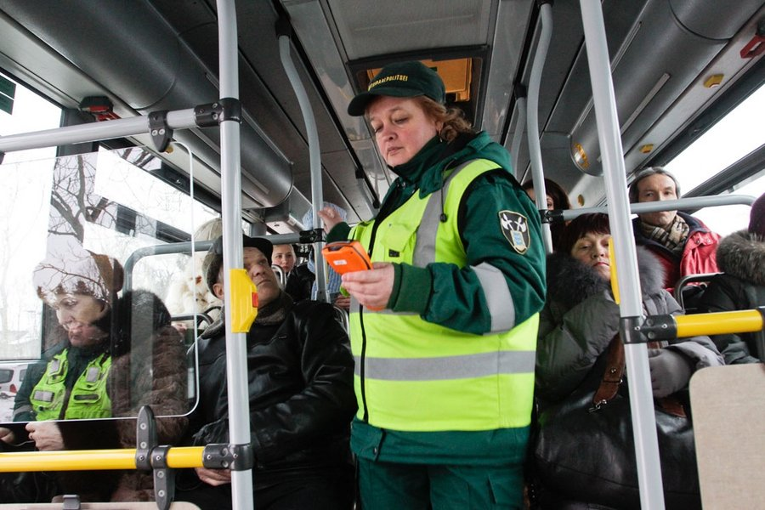
No ticket or document?
Passengers without a ticket or validation, and also those using the discount ticket without a document will be fined by imposing a fine.

Slide 10
More information
www.transport.tallinn.ee
www.pilet.ee
Plan your trip in Estonia:
www.peatus.ee

Slide 11
Taxis / scooters / bikes
Information about taking a taxi in Tallinn:
https://www.visittallinn.ee/eng/visitor/plan/transport/taxi
Scooters and bikes:
https://www.visittallinn.ee/eng/visitor/plan/transport/bike-rental

Slide 12
Transportation in Estonia
Buses – www.tpilet.ee
Trains – www.elron.ee

