Slide 1
TLU user account
Henni-Maria Johanson

Slide 2
TLU user account
Account will be active on the day of creation at 11:00, 14:00, 17:00 or 02:00
Forgot or want to change the password – contact me it@tlu.ee!
Password requirements:
minimum length is 6 characters
must contain both, numbers and letters (including at least one capital letter)
password can not contain the user´s name, part of the name, accented characters, symbols
password can not be a dictionary word
Period of validity of the user account: time of studying at TLU
Do not tie neccesary sites to your TLU account!
Notes:
Tallinn University user account joins a person’s personal data with their username in the University’s computer network and determines their rights in using University’s information systems and computer networks.

Slide 3
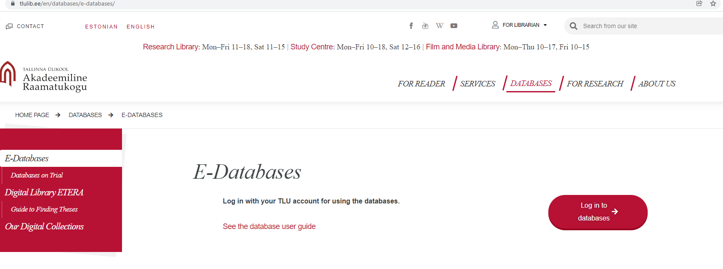
TLU user account
TLU user account gives access to:
University email and other Google services (Drive, Calendar). Logging in: username@tlu.ee
Every student has two email addresses (based on user name; and based on name), both have the same mailbox.
2. OIS (Studies Information System) – using the same user name and password as logging in to email@tlu.ee
3. Scientific databases at Academic Library of Tallinn University, require you to log in: https://www.tlulib.ee/en/databases/e-databases/

Slide 4
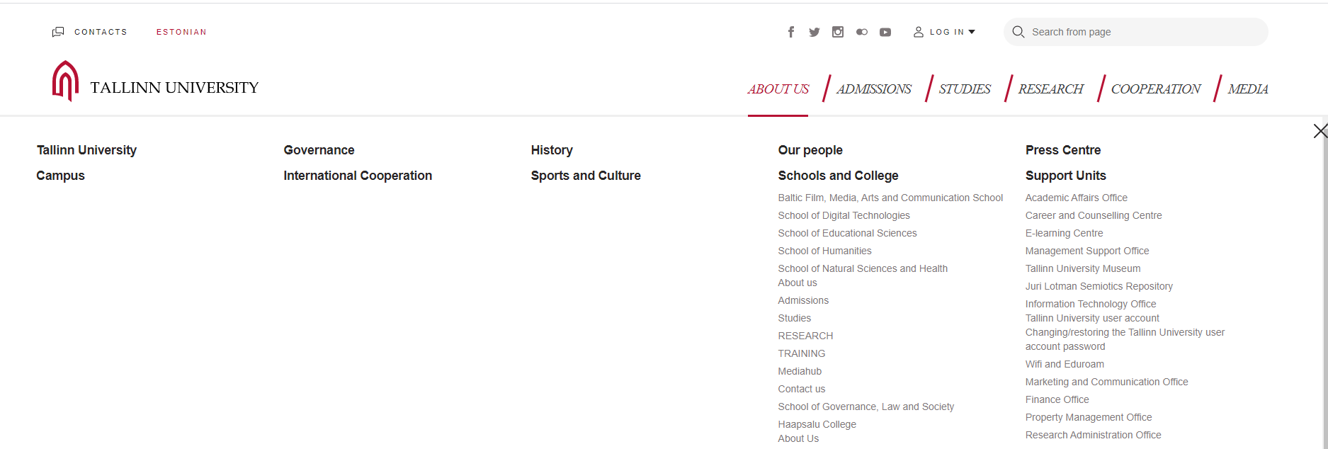
More info
More info: www.tlu.ee/en -> About us -> Information Technology Office
Welcome to Tallinn University!

Slide 5
Studies Information System (ÕIS)
Merli Laurson

Slide 6
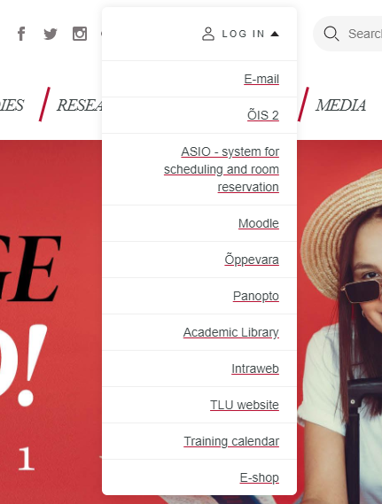
Users and Access
Who uses it?
Students
Lecturers
School´s Office
Academic Affairs Office
Where is it?
ois2.tlu.ee
www.tlu.ee/en

Slide 7
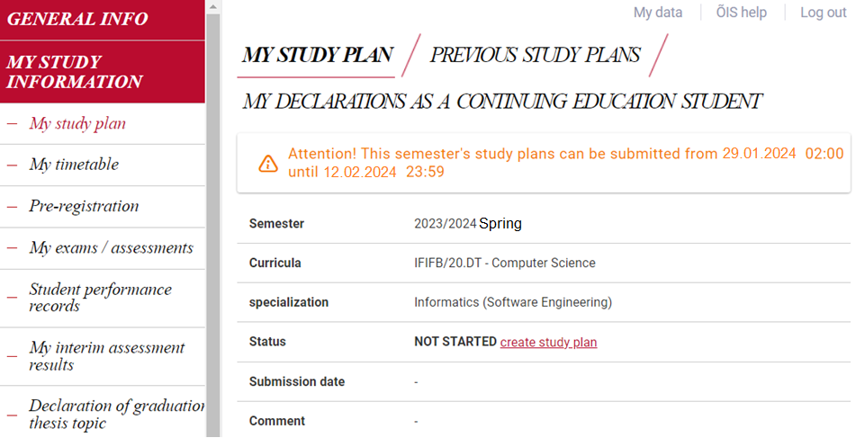

Slide 8
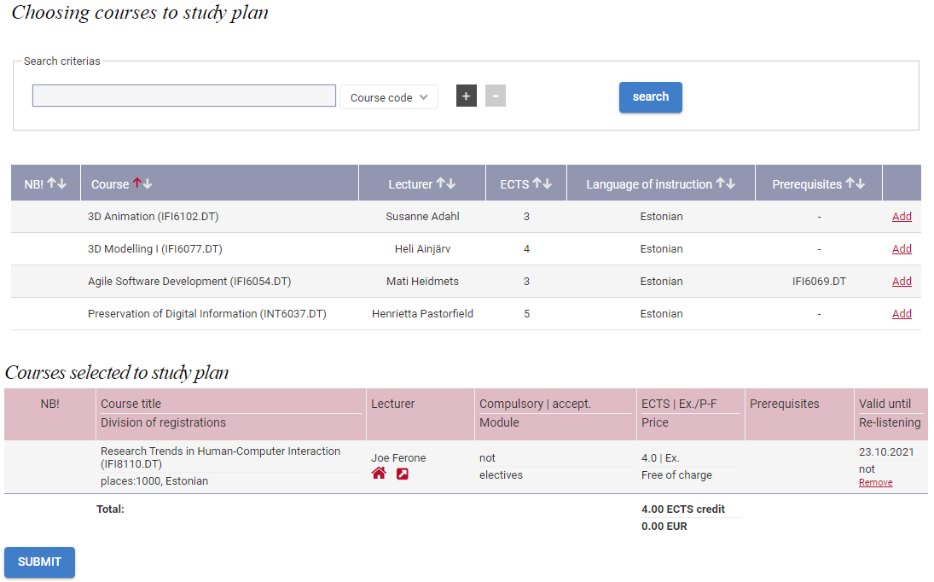

Slide 9
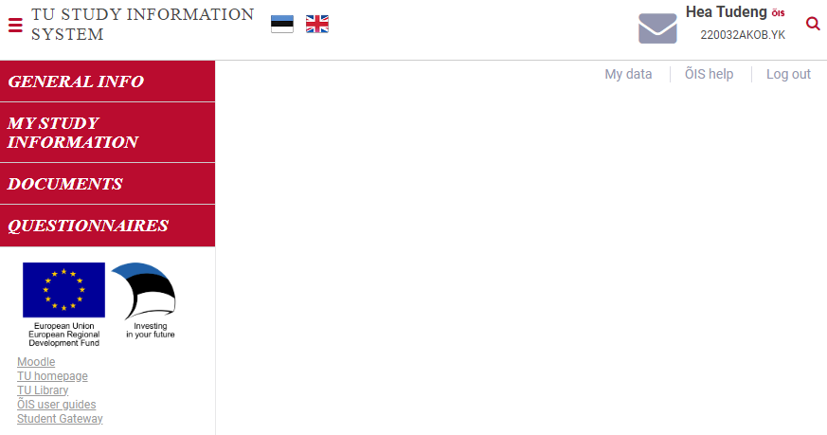
Support
Notes:
Manual
ÕIS support
OIS@TLU.EE
T-213

