Slide 1
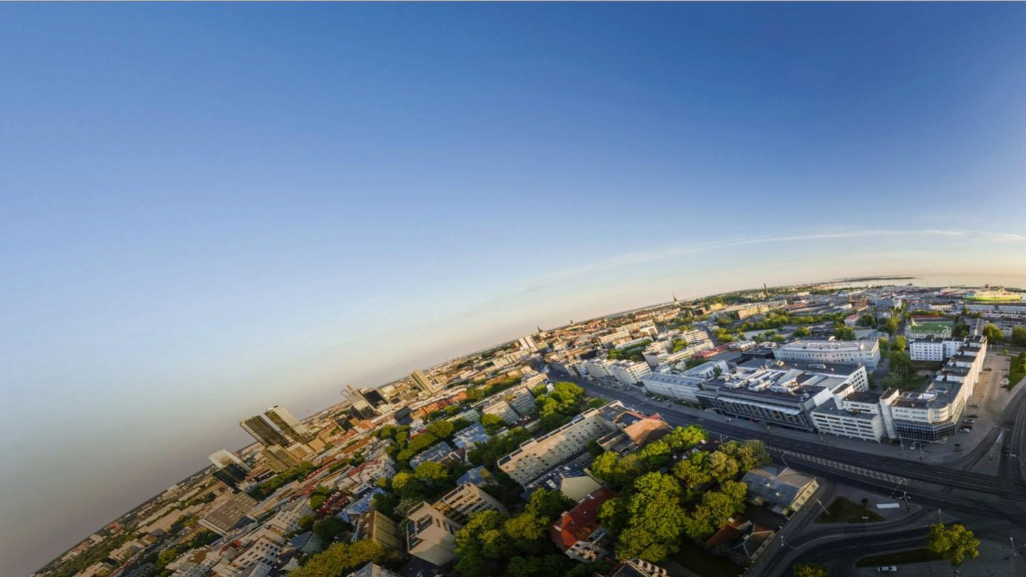
Student support in general
Kai Rannastu
Juny, 19-th 2025

Slide 2
Levels of support
Tutors
Incoming Mobility Senior Specialist (Ingrid.hinojosa@tlu.ee )
Counsellor for Students with special needs (kai.Rannastu@tlu.ee )
Student Support Centre
(S-140)
noustamiskeskus@tlu.ee
Study counceller in institutes

Slide 3
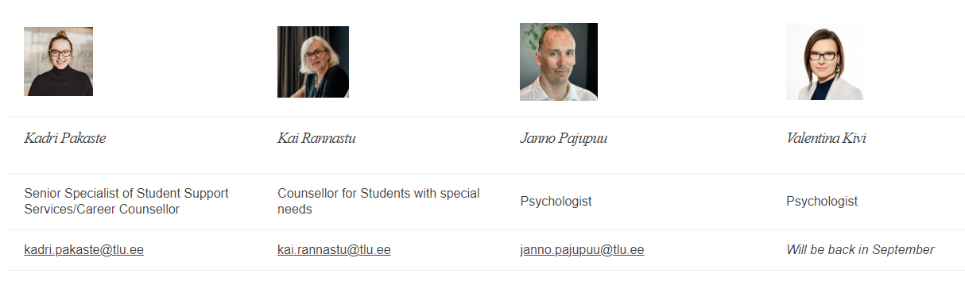
Student Support Centre

Slide 4
If you have a special need that affects your learning
If it doesn't affect you in any way, you simply don't have to report anything.
If you need adjustments for studies: proof from your country
  Recommendations provided by your Doctor or home University
It is important to prepare yourself for the possibility that your mental health/physical illness appears again (adaptation)
If a long-term illness/exacerbation occurs in Estonia, then...
    Specialist care might be chargeable.

Slide 5
The process to get adjustments
1.Certificate/document (doctor or from home university)
2. Meeting: adviser-student
Kohan
3.Agreed adjustments
in ÕIS (SIS)
4. Student: conversation with lecturer
5. Monitoring
Changes if needed
Notes:
SIS study inform system

Slide 6
Some examples
Accessible study rooms (physical difficulties)
Reduction of compulsory literature (reading difficulties)
Slides/materials before lecture (hearing/vision difficulties)
Sharing material in large print/letters (vision problems)
Different problems
  Extra time for taking the test
  Extension of the deadline
  Other adjustments alternative assessment methods
  aso

Slide 7
Thank you!
Kai Rannastu
Room S-140/ kai.Rannastu@tlu.ee

