Slide 1
Right of Residence for EU/EEA Citizens
Long-stay(D) visa for Non-EU Citizens

Slide 2
NON-EU students
Different legal bases to stay in Estonia
visa-free regime stay for up to 90 days (depends on your citizenship)
C-type visa for up to 90 days (can be applied for in embassies only)
D-type visa for up to 365 days (can be applied for in Estonian embassies or at the PBGB)
Other country temporary residence permit or visa based on study purpose.

Slide 3
Stay with another EU TRP or visa
TRP has to be issued according to EU directive 2016/801 and has to have marking „student“ on the residence card or visa.
It is allowed to stay on the basis of TRP or D-visa issued from another EU country for up to 360 days with the purpose of study in Estonia if a person is accepted to study in Estonian educational institution.
Can work

Slide 4
How to apply for a long-term (D) visa in Estonia?
Bring all the necessary documents with you.
Keepin mind that you have to apply for a long term (visa at least 10 business days before your legal basis to stay ends!
The PBGB shall review the submitted application within 10 business days of the acceptance of the application

Slide 5
Necessary documents
- completed and signed long
term visa application form pre application environment
- one digital colour photo
- a valid travel document
- a valid health insurance policy ensuring payment of treatment costs incurred through illness or injury of the applicant for the period of validity of the visa
- The documents evidencing the purpose and cause for stay
- a document evidencing the payment of a state fee (100 euros)

Slide 6
EU Students
Right to stay up to 3 months without any registrations.
For stays longer than 3 months, you should obtain the right of residence, which is issued for 5 years.
Register your place of residence at the Estonian population register to obtain the right of residence.
You have the right to work and study from the first day.
Notes:
A citizen of the European Union, a member state of the European Union Economic Area and Swiss Confederation (hereinafter an EU citizen) has a right to stay in Estonia on the basis of a valid travel document or an identity card for the period of up to three months without registration of the right of residence.

Slide 7
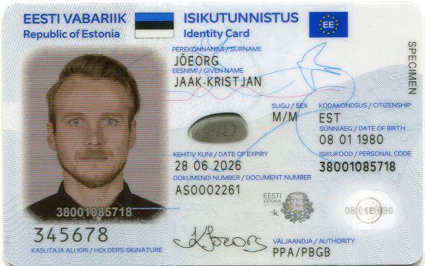
ID card for an adult
For applying for the document (ID card) which certifies the right of temporary residence, you need to address within the period of one month from the registration of your place of residence in person at the Service Office Please note that it is not required to book an appointment for this procedure, but we recommend booking an appointment (option nr 1 in the booking calender) in order to avoid the long queues

Slide 8
Thank you!

