Slide 1
STUDENT SUPPORT CENTRE
2024
Notes:
Hello!
I am Kadri from Student Support Centre.

Slide 2
COUNSELLING
STUDIES
WELL-BEING
ACADEMIC AFFAIRS OFFICE
(Admissions, studies abroad)
ACADEMIC UNITS
STUDENT SUPPORT CENTRE
STUDENT UNION
and its sub branches

Slide 3
THE STUDENT SUPPORT CENTRE
The aim of the centre is to support our students and offer different services to help them succeed in studies, labour market and personal life.
Notes:
Our aim is to support and help students with labour market as well as personal life topics.
https://www.mentimeter.com/app/presentation/alfa4eugbzjz7d3iwiat7s32eom1ivhs/5r8sfxo6cjb7/edit

Slide 4
1
PSYCHOLOGICAL COUNSELLING
Psychologists provide counselling in EST/ENG/RUS for all students facing psychological difficulties in their studies or in their personal life.
We offer short-term counselling, not psychotherapy or consultation of clinical psychologist. The counselling is limited to 5 consultations per semester.
Janno Pajupuu, Valentina Kivi,
psychologist psychologist
janno.pajupuu@tlu.ee valentina.kivi@tlu.ee
EST/ENG EST/RUS

Slide 5
Main concerns last year
Anxiety.
Depression.
Ukrainan war.
Finalizing studies.
Notes:
All of them are related to difficulties in studies.

Slide 6
2
CAREER COUNSELLING
The main purpose of Career counselling is to help to plan student’s future career. In addition to students, career counselling is provided to potential candidates and graduates as well.
Kadri Pakaste, Senior Specialist of Student Support Services/Career Counsellor
kadri.pakaste@tlu.ee
Notes:
The circle is wider.

Slide 7
Main concerns from last year
Choice of major.
Job search.
Change of study programme.
NOTE!
30% of career counselling clients were non-students (potential candidates and graduates).
Notes:
Students of humanities and education were the most eager ones to explore options to change their current study programme to smth new.

Slide 8
3
SPECIAL NEEDS
University can provide adjustments in courses, offering everyone equal opportunities to achieve maximum academic potential.
For that we have a Counsellor for students with special needs. It is necessary to inform her regarding special needs, so the university is able to make any necessary changes in time to allow the student to fully participate in their studies. The proof of special needs is required through documentation.
Kai Rannastu, Counsellor for students with special needs
kai.rannastu@tlu.ee
Notes:
Special needs can be proven with a disability certificate from the Social Insurance Board, with the Estonian Unemployment Insurance Fund's reduced working capacity certificate, a specialist doctor's certificate or with your host university disability assessment certificate.

Slide 9
Reasonable adjustments we offer:
Use of an aid or support services in lectures.
Ensuring physically accessible learning spaces.
Sharing of lecture presentations (before class).
Ensuring learning materials in a form accessible to the learner.
Distributing worksheets to the learner digitally (if it is more convenient to the learner).
If the recording of lectures is necessary, the learner informs the lecturer in advance and can make a copyright agreement to protect the intellectual property of the lecturer.
Extension of deadlines, if the learner has notified the teacher in time before the original deadline.
Flexible attendance when alternative assessment is pre-agreed with the lecturer to achieve the learning outcomes.
Providing extra time for exams and tests to compensate for obstacles arising from special needs, allowing the learner to express the learned content on an equal basis with peers.
Offering an alternative assessment that takes into account the specific needs of the learner when achieving learning outcomes.

Slide 10
OUR MAIN ACTIVITES
Individual counselling,
Support groups gatherings,
Workshops, seminars, lectures,
Information and prevention activities,
Co-operation with academic units,
Co-operation with Academic Library.

Slide 11
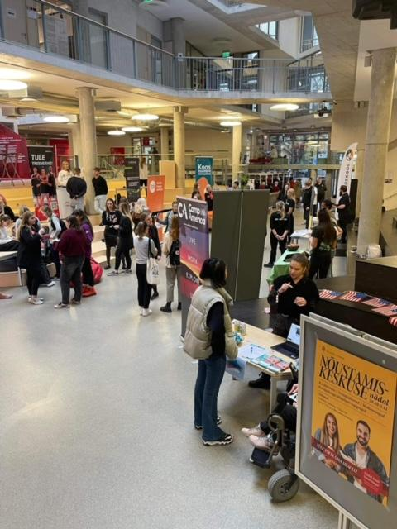
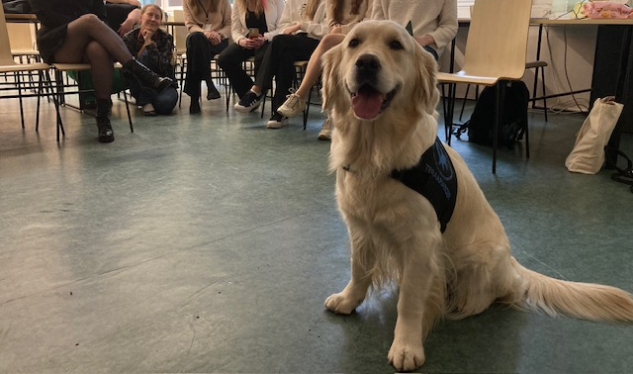
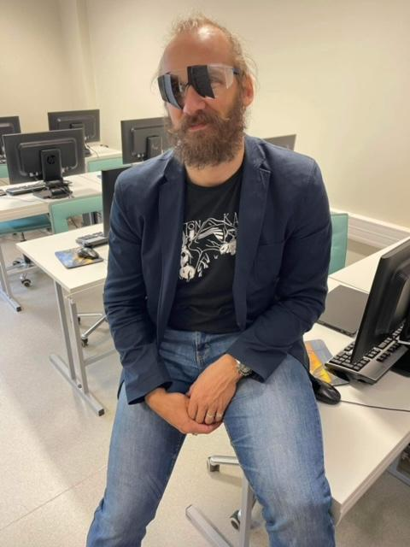
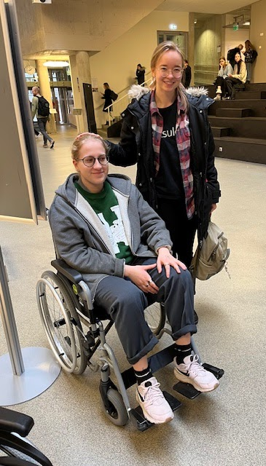
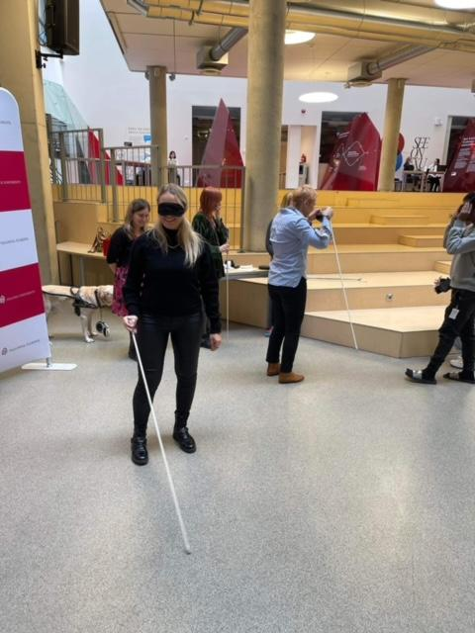
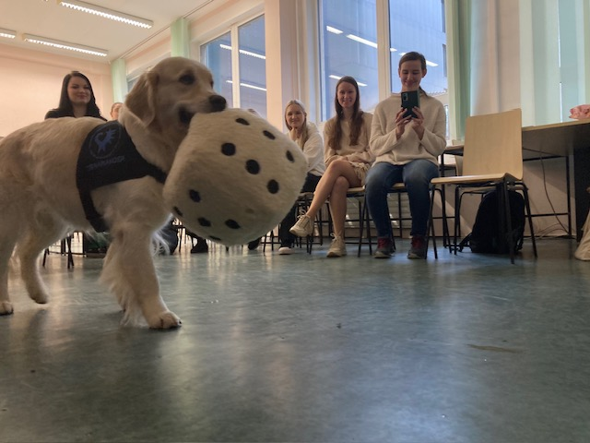
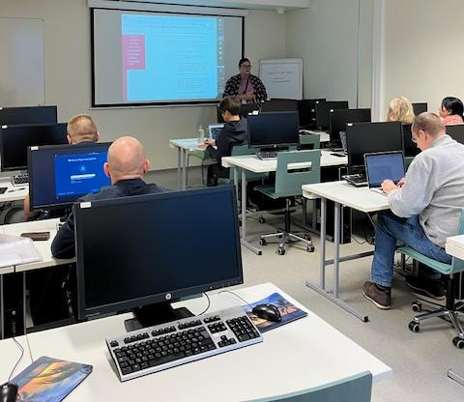
Student support centre week
Notes:
Activities to acknowledge disabilities – imitation games (with wheelchair/glasses).
Workshops in co-operation with Academic Library to support students finding scientific materials for schoolwork.
Therapy dogs.
Career Fair.

Slide 12
ALL OUR SERVICES ARE:

Slide 13
OUR CONTACTS
Generic e-mail: noustamiskeskus@tlu.ee
Location: office S140, counselling S103 & S117
Web: https://www.tlu.ee/en/student-support-centre
Facebook: https://www.facebook.com/tallinnaylikool.ynk
Instragram: https://www.instagram.com/tlu_ynk/

Slide 14
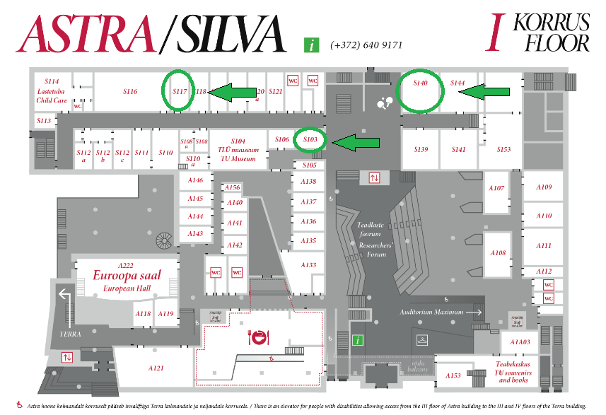

Slide 15
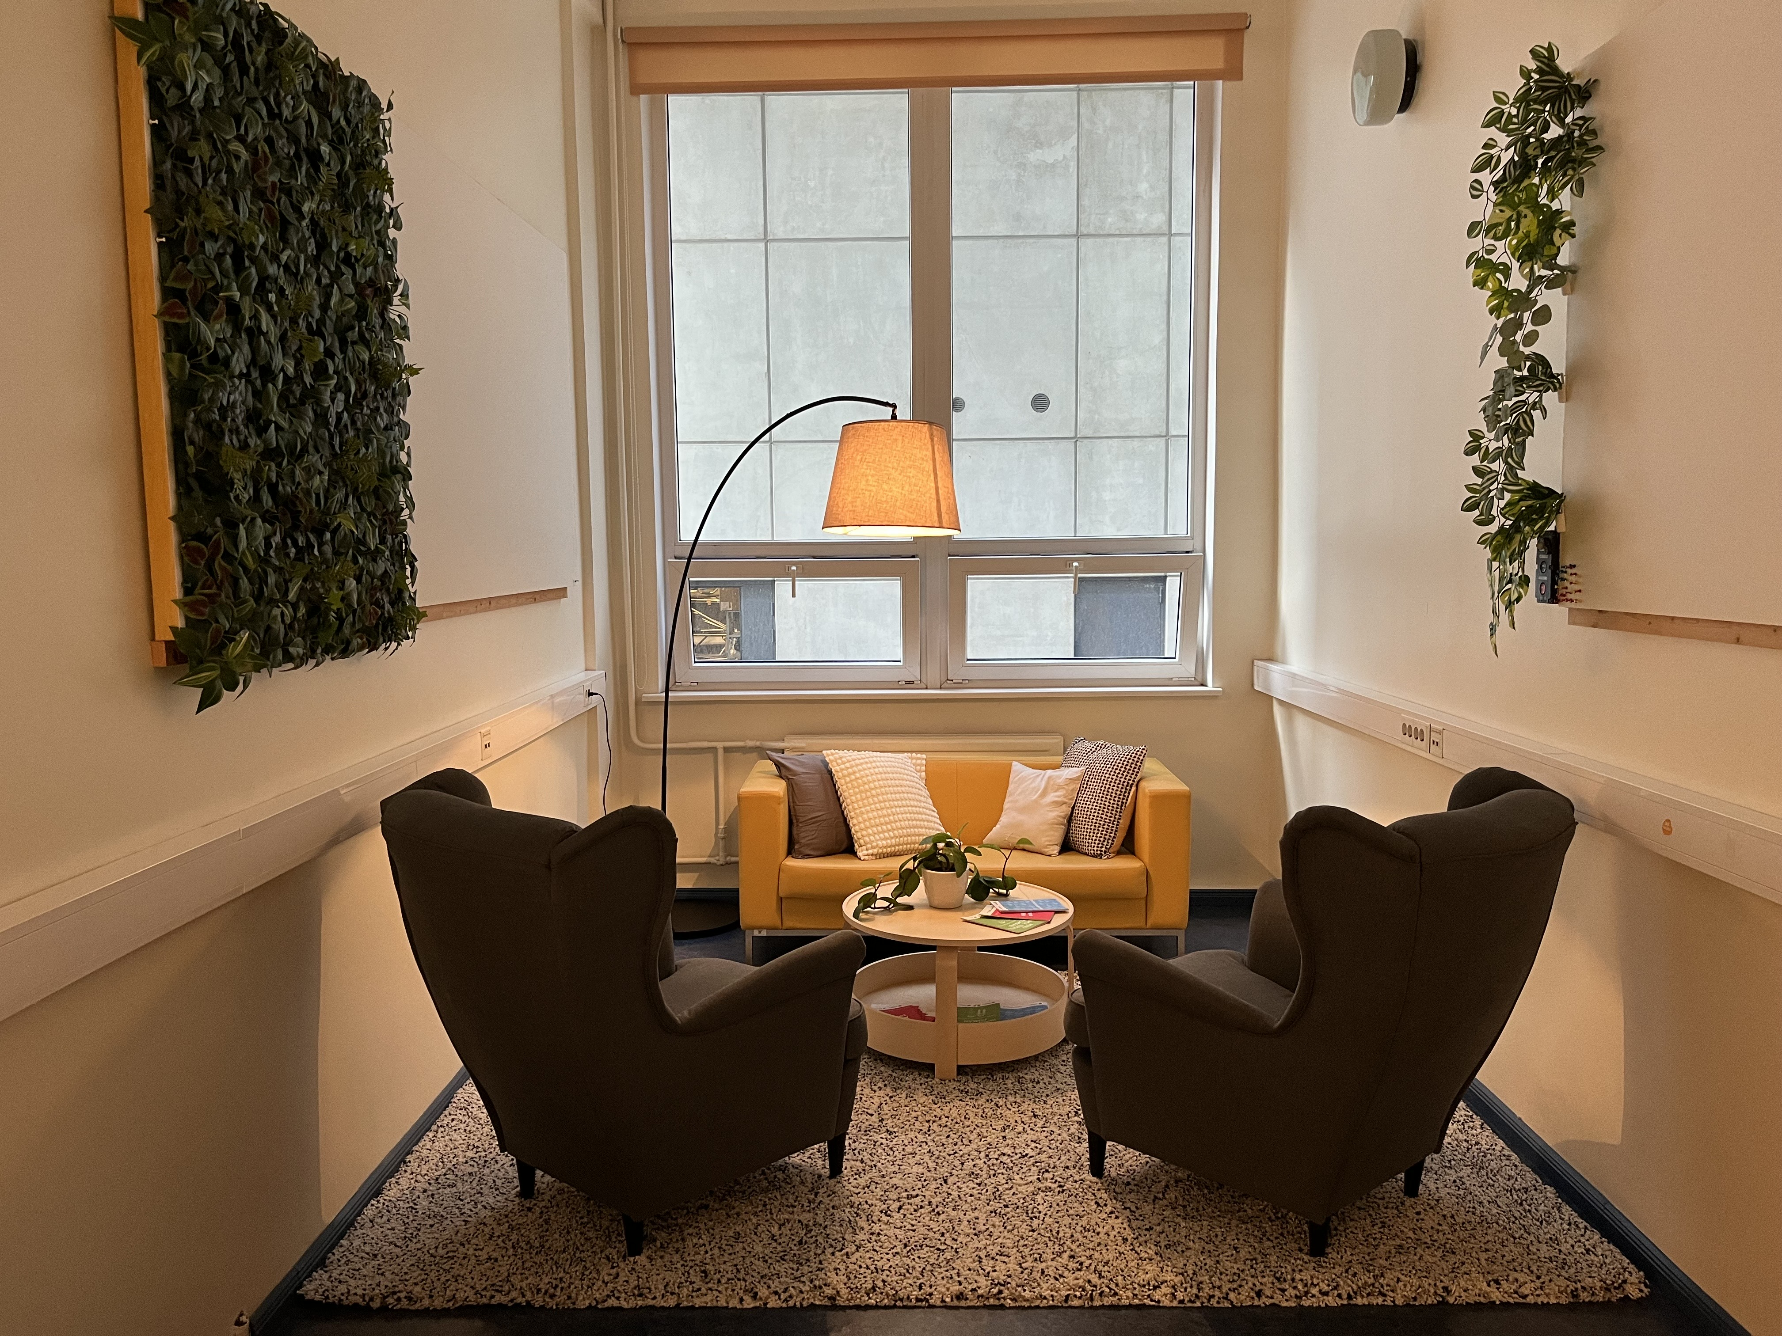
Our counselling room

Slide 16
OUR TEAM

Slide 17
Booking an appointment

Slide 18
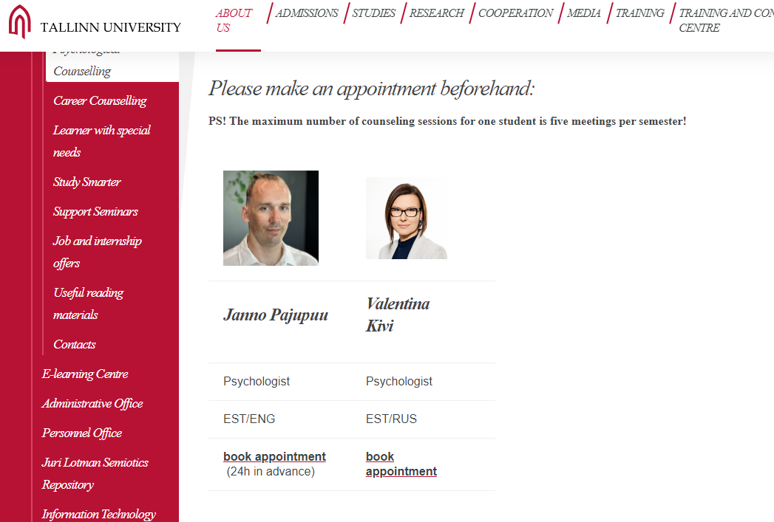
Booking an appointment

Slide 19
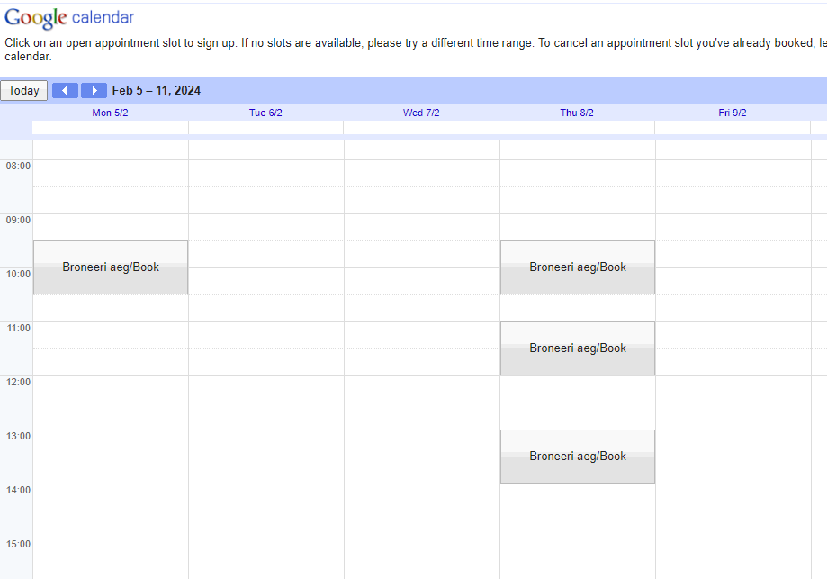

Slide 20
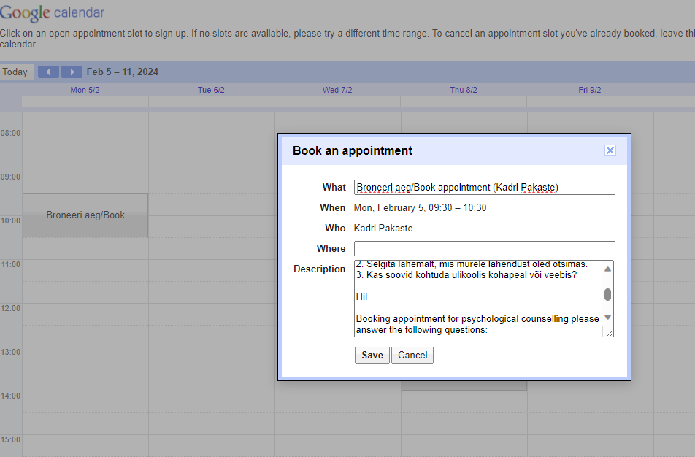

Slide 21
THANK YOU!

