Slide 1
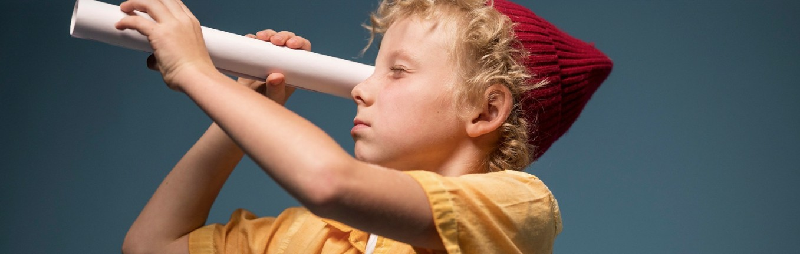

Slide 2
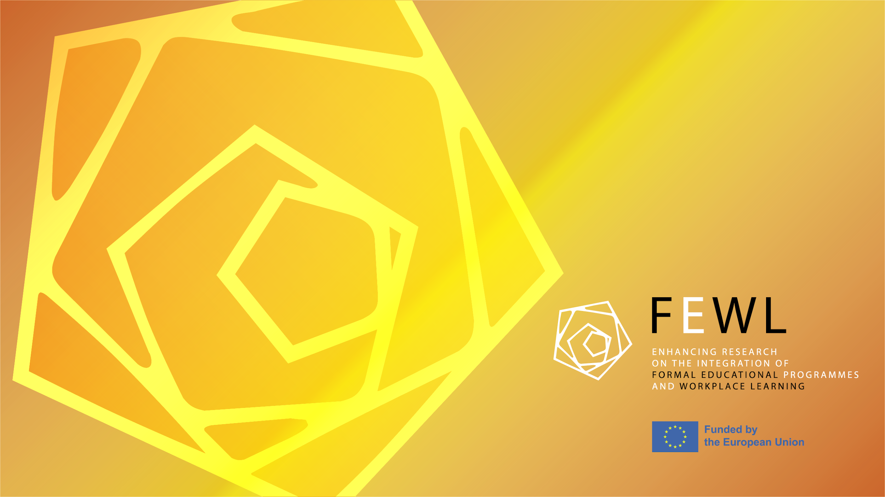

FEWL 2025 Conference: The World of Work in Schools – Opportunities and Contradictions
April 25, 2025

Slide 3
Date: April 25, 2025
Location: Tallinn University
Title: The World of Work in Schools – Opportunities and Contradictions
Agenda:
10:30–12:10 Opening and presentations
12:10–12:30 Networking break
12:30–13:30 Presentations continue
13:30–14:30 Lunch (Mare Atrium)
14:30–15:30 Roundtables
15:30–16:00 Wrap-up

Slide 4
Conceptualizing Work in School
Inge Timoštšuk
Professor of primary education

Slide 5
FEWL - Formal Education and Workplace Learning Integration Research (Horizon Europe Twinning Project)
FEWL Project: Partners: Tallinn University (Estonia), University of Paderborn (Germany), University of Jyväskylä (Finland)
Focus: Integration of work-life themes in general education (basic and upper secondary schools)
Starting point: Work is a natural part of children’s lives

Slide 6
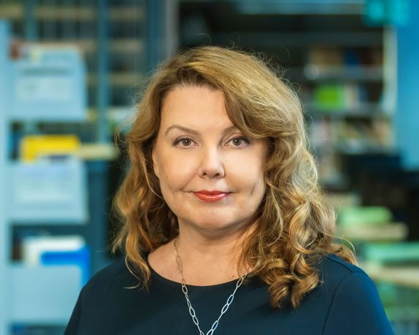
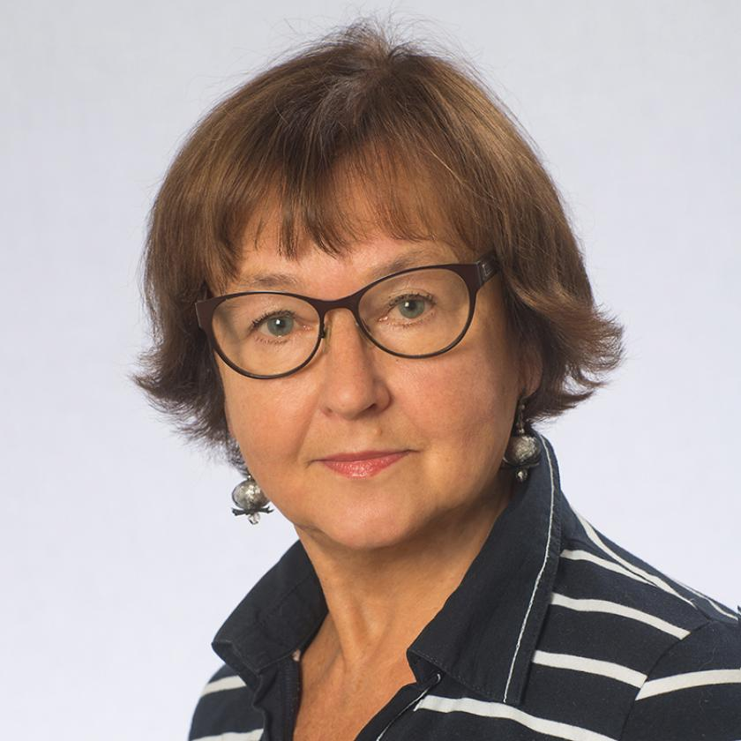
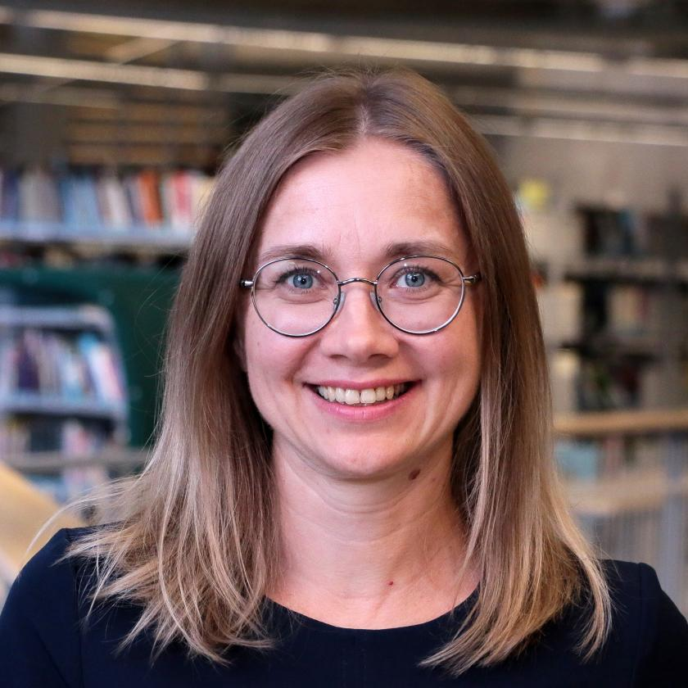
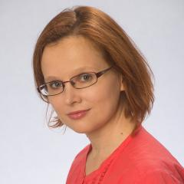
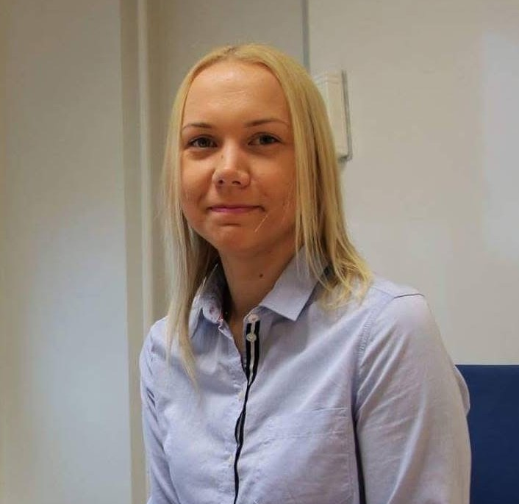
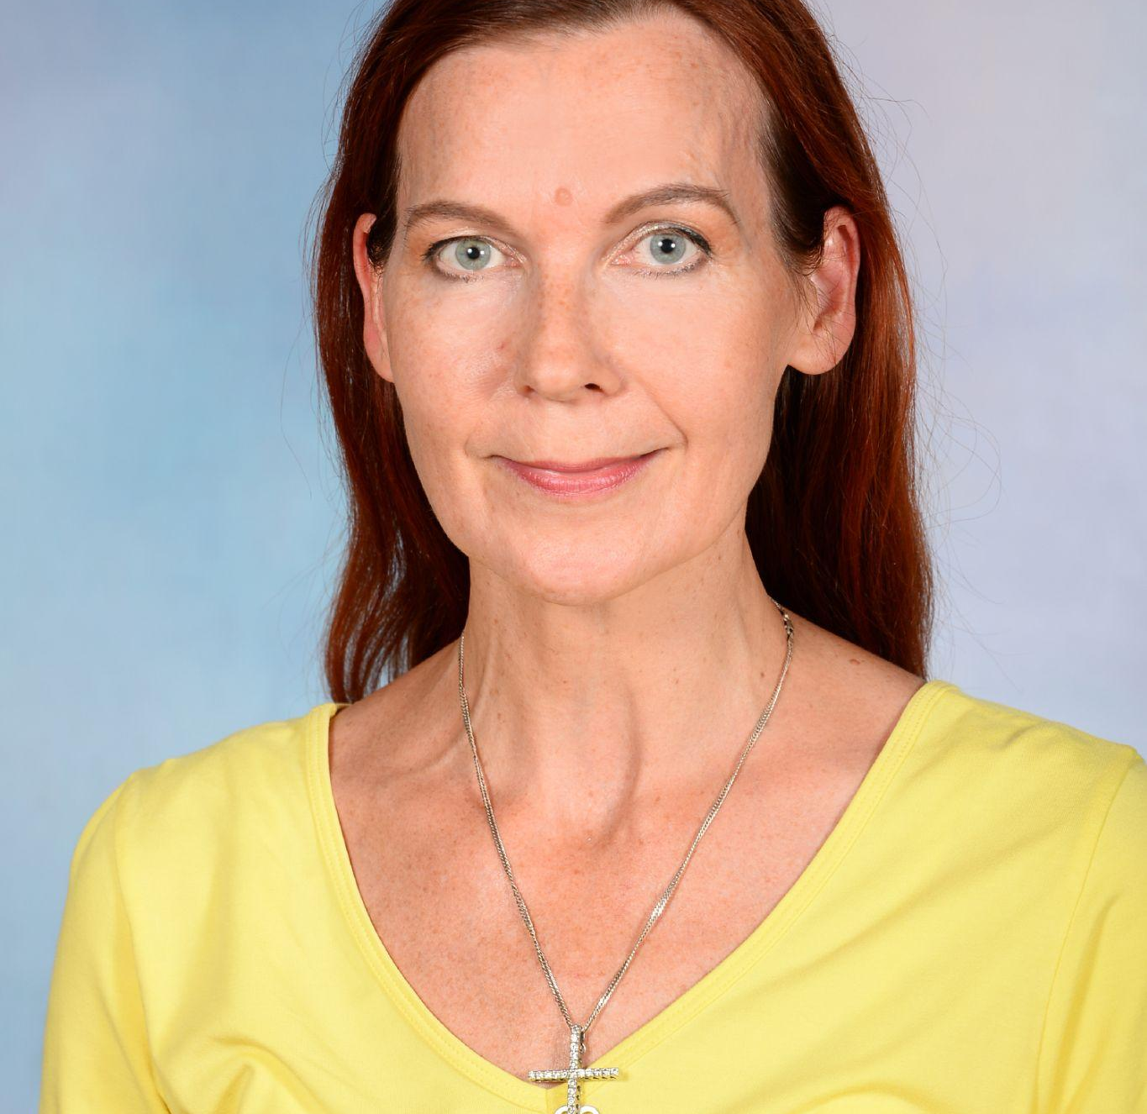
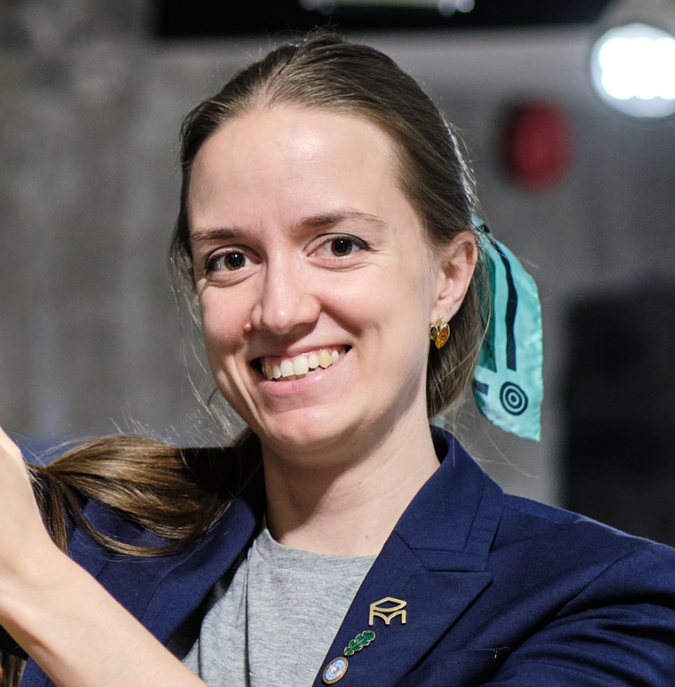
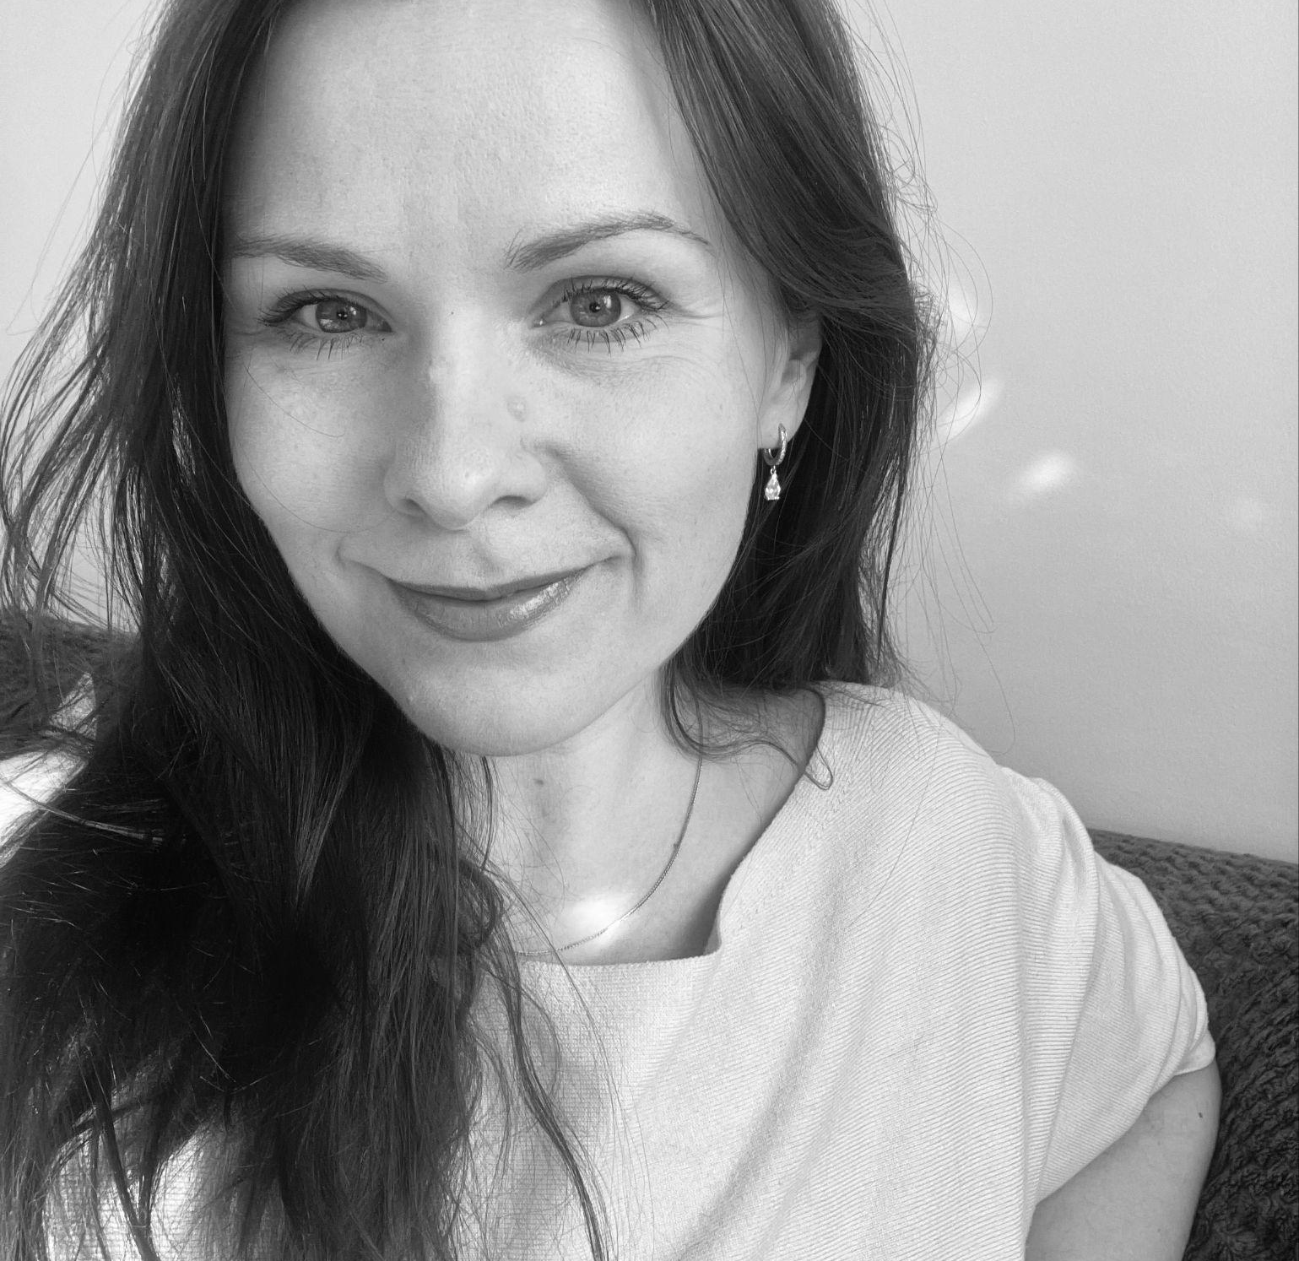
FEWL - Formal Education and Workplace Learning Integration Research (Horizon Europe Twinning Project)
(Principal investigator and the Estonian research team)
Inge Timoštšuk
Krista Loogma
Merle Pajus
Maria Erss
Kaidi
Nurmik
Maret
Aasa
Birgit Peterson
Helene
Uppin

Slide 7
KEY POINTS
Work is a natural part of students' lives: parents’ work, earning pocket money/doing paid work, community initiatives, family work projects.
Skills for play, learning, and work often overlap: goal setting, keeping focus, problem-solving, feedback, social skills, self-regulation.
Real-life examples are rarely used in classrooms.
Data Collected From: Students, parents, employers, teachers, museum educators

Slide 8
Student Work Experience & Agency
Maria Erss
associate professor of curriculum theory

Slide 9
KEY POINTS: What is the work experience of students and how is it connected to agency?
80% of high school students have some kind of work experience
Work experience correlates with higher student agency in school
Recent work (summer jobs, volunteering) impacts agency more than past jobs
Students in Estonian medium schools have more work experience than students in Russian medium schools.
Boys have more work experience and higher agency than girls.
Data Collection:
Survey (2022), 9060 students in grades 6–12, Estonian and Russian language schools

Slide 10
Work as a Bridge Between Real Life and Classroom Teaching. The Perspective of Primary Teachers on Integrating the World of Work into School Learning
Kaidi Nurmik, junior researcher

Slide 11
KEY FINDINGS: the world of work in school and at home
Primary teachers invite the parents to introduce their professions, orginise field trips to parents’ workplaces and career orientation days in school.
  Learning becomes more meaningful and better connected with real life.
  An opportunity to widen the horizon of students shape students’ attitudes towards different professions disregarding of their socio-economic or cultural background.
Good cooperation with parents is important but sometimes teachers lack knowledge of parents’ professions and children cannot explain what their parents do.
Data protection rules make it difficult to get relevant information.
Children’s work at school is keeping their workplace and classroom in order. They rarely have any leadership roles.
At home most children don’t have many chores but those who do are more independent and better organised.
Data collection: 20 semi-structured interviews with primary teachers in 2023

Slide 12
Out-of-school Learning Environments as Supporters of Career Choice: The Role of Educational Programmes in Museums and Environmental Education Centres
Helene Uppin, doctoral student and guest lecturer of natural sciences

Slide 13
KEY FINDINGS: How do museum educators perceive career awareness and how do they support it?
Most museum educators believe that their programmes support the career awareness of students by:
supporting lifelong learning;
sharing professional knowledge;
supporting individual interests and self-awareness
Problems:
The readiness of educators to deal with career awareness varies. Some see it as “propaganda”.
Museum educators and teachers do not cooperate much.
Some associate career awareness primarily with older students.
Self-awareness is not perceived as part of career awareness.
Benefits:
Work and different professions are introduced in multifaceted ways: through role plays, practical work, discussions, introduction of study opportunities etc.
Data collection: stage I: interviews with experienced museum educators (27) in 2020; stage II: a survey addressed to programme educators (43)

Slide 14
Working is Learning: Work Experience of Upper Secondary School Students
Krista Loogma
Professor of vocational education

Slide 15
KEY FINDINGS: the work experience of upper secondary students
Students find work through contacts, school programmes, youth work camps and volunteering usually in summer.
The initial motives to earn pocket money can change with time: student focus more on reflecting on their future career
Students are aware of how important it is to have work experience in one’s resume
They develop many specific and generic skills and competences (e.g. social skills, problem-solving, conflict management, language skills, leadership), overcome their anxieties and laziness, learn to plan their time and develop self-regulation skills.
Usually, students are not mentored or coached at work but are thrown in the deep end.
Learning at school and work are two separate worlds although some overlap exists.
Negative experiences shape career awareness: what to avoid in the future.
Data collection: 12 qualitative interviews with 18+ year-old students.

Slide 16
Collaboration Between Schools and Companies in Supporting Students’ Work Experience
Birgit Peterson, doctoral student

Slide 17
Key findings: how is work integrated into upper secondary education? What are the experiences and needs of employers?
Employers believe that work experience develops generic competences and career awareness, responsibility and self-confidence and creates the link between real life and school learning.
Some schools analyse work experience and bring work topics into lessons in the form of school exams, practical projects, electives or mentor lessons.
In cooperation with companies schools organise practical learning experiences: short-time internships, volunteer work, work shadowing, electives taught by professionals
Employers expect schools to develop better career awareness and knowledge about the labour market.
Suggestion: internships in businesses for teachers; addressing work-related topics in younger age groups; making cooperation between businesses and schools sustainable.
Data collection: focus group interviews with 15 employers from 8 fields; individual interviews with teachers (5) and assistant principals (3)

Slide 18
Lunch 13.30-14:30 (Mare Aatrium)
Roundtables 14:30-15:30 (Mare building)
Wrap-up 15:30-16:00 (Mare Aatrium)

Slide 19
Roundtable Discussions
How can parents enrich learning through their work experience? M-421
How to enhance cooperation between upper secondary schools and the world of work? M-439
How does work experience affect students' initiative in school and society? M-446
What are the untapped opportunities of museum education as a way to explore the world of work? M-430
What connects hobby education and working? M-408

