Slide 1
Tallinn University
Haapsalu College

Slide 2
Promotor of intelligent lifestyle

Slide 3
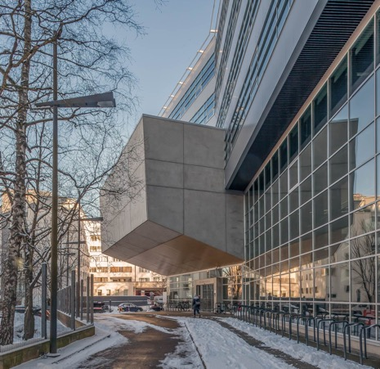
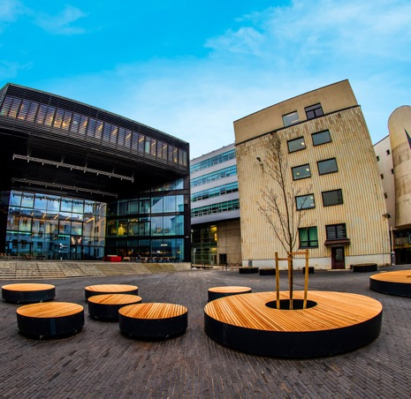
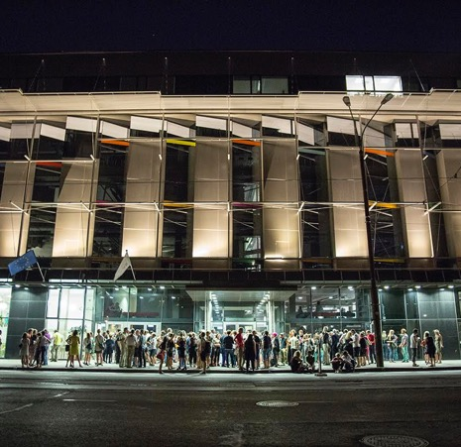
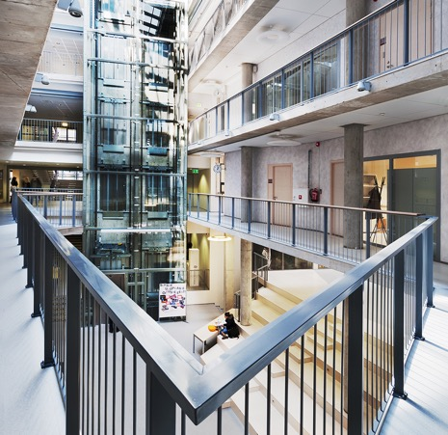
Our campus
Our central campus is located in the heart of Estonia’s capital. Close to the sea and a big Kadriorg park

Slide 4

We take pride for our innovations in education,
e-governance, digital society and entrepreneurship.
Did you know that Estonia is the first e-government in the world?

Slide 5
Tallinn University’s mission
Support the sustainable development of Estonia through high-quality research, studies and creative work, public discussion, entrepreneurship, co-operation with the public and third sector, and promotion of academic partnership.

Slide 6
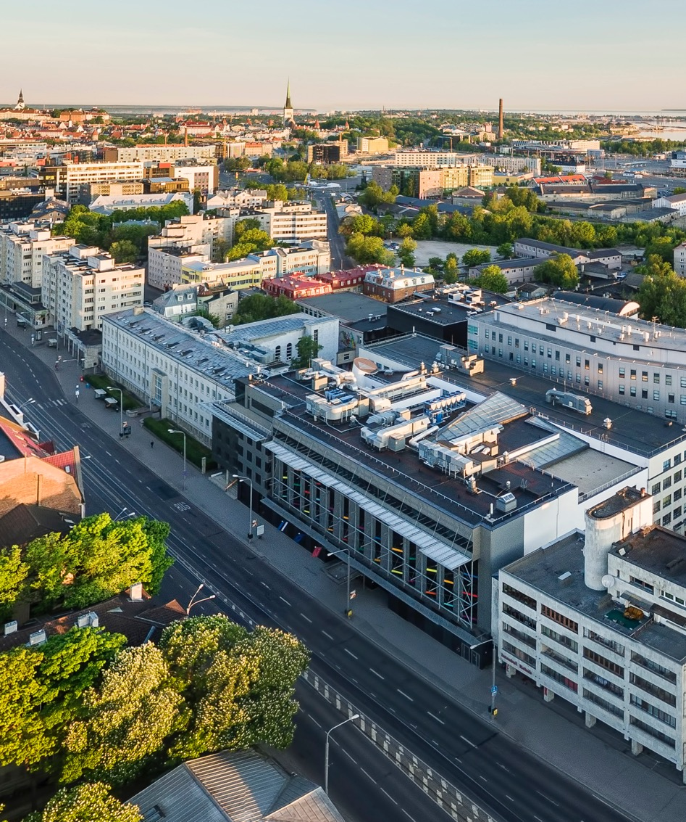
Tallinn University in its present form was founded on
18th March 2005

Slide 7
TLU was established as the result of a merger of several research and development institutions in Tallinn:
Tallinn Pedagogical University
Estonian Institute of Humanities
Institute of History
Academic Library
Institute of International and Social Studies
Institute of Ecology
Academy Nord
The Estonian Institute for Future Studies
Tallinn Pedagogical College

Slide 8

TLU is part of the european universities alliance for film and media arts (filmeu)

Slide 9

Among
5%
of the best universities
in the world
 | Sociology # 251-300
 | Education #301-400
 | Arts and Humanities #401-500
 | Social Sciences #401-500

Slide 10





Our focus fields:
Educational innovation
Digital and media culture
Cultural competences
Healthy and sustainable lifestyle
Society and open governance

Slide 11
Academic units
Baltic Film, Media and Arts School
School of Digital Technologies
School of Educational Science
Academic
Library
School of Natural Sciences and Health
School of Humanities
School of Governance, Law and Society
Haapsalu
College

Slide 12
Support units
Academic Affairs Office
Administrative Office
Archaeological Research Collection
Conference Centre
Confucius Institute
Estonian Pedagogical Archives and Museum
Finance Office
Information Technology Office
Juri Lotman Semiotics Repository
Knowledge Transfer and Project Support Office
Marketing and Communication Office
Open Academy
Personnel Office
Property Management Office
Procurement Department
Research Administration Office
Strategy Office
Tallinn University Press

Slide 13

122 study programmes
38 Bachelor’s
59 Master’s
14 Doctoral programmes
5 Professional higher
education studies
36 Programmes in English
7 Joint study programmes

Slide 14

BA programmes in English
Audiovisual Media
Crossmedia
Law
Law studies in Helsinki
Liberal Arts in Humanities
Liberal Arts in Social Sciences
Politics and Governance

Slide 15
MA programmes in English
Anthropology
Communication Management
Digital Learning Games
Documentary Film
Educational Innovation and Leadership
Estonian Studies
Human Rights in the Digital Society
Human-Computer Interaction
Interaction Design
International Relations
Literature, Visual Culture and
Film Studies
Open Society Technologies
Screen Media and Innovation
Social Entrepreneurship
Well-Being and Health Behaviour

Slide 16
PhD programmes in English
Audiovisual Arts and
Media Studies
Complex Systems in
Natural Sciences
Demography
Educational Sciences
Government and Politics
Health Behaviour and Wellbeing
History
Information Society Technologies
Linguistics
Psychology
Social Work
Sociology
Studies of Cultures

Slide 17

Joint Master’s programmes
JMD Film Arts
Interaction Design
100% online
Adult Education for
Social Change

Slide 18
University-wide interdisciplinary project-based course
Compulsory for every BA and MA curriculum
The objective is to enhance interdisciplinary competences and teamworking skills

Slide 19

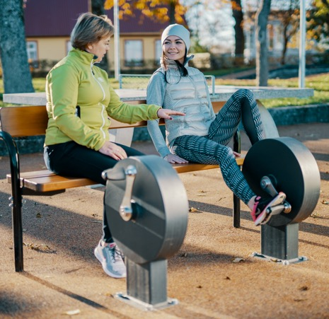
Haapsalu College
Based on the traditions and quality of Tallinn University, the college consciously contributes to health promotion and rehabilitation and regional development through teaching, development and research.

Slide 20










Handycraft Technology and Design

Slide 21










Traffic Safety

Slide 22










Applied Computer Science

Slide 23









Health Promotion Specialist

Slide 24
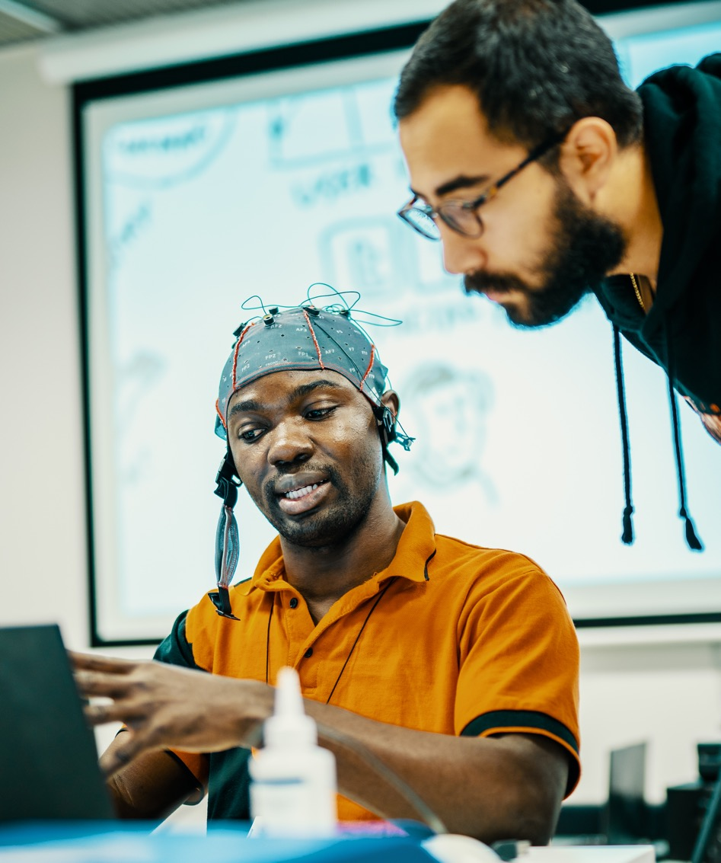
Research
From six OECD Frascat manual research fields, five are prominently represented in Tallinn University.
In 2021, Tallinn University’s
financed projects were in:
Social sciences – 58%
Humanities and Arts - 29%
Natural sciences – 7%
Engineering and Technology – 4%
Medical and Health sciences– 2%

Slide 25
Recent research projects we are especially proud of:
Translating Memories:
The Eastern European Past in the Global Arena (H2020 ERC Starting Grant)
„Between the Times“: Embattled Temporalities and Political Imagination in Interwar Europe (H2020 ERC Grant)
CUDAN Cultural Data Analytics (H2020 ERA Chair)
AdaptEst - Implementation of national climate change adaptation activities in Estonia (LIFE2021)
DEMOCRAT - Education for Responsible Democratic Citizenship (HORIZON)
CresCine – Increasing the International Competitiveness of the Film Industry in Small European Markets (HORIZON)

Slide 26






Follow us
tlu.ee/en
Tallinn University
Tallinn University
TallinnaYlikool
TallinnUniversity
Tallinn University
Tallinn University

Slide 27
Thank you!

