Slide 1
Migration from the population development perspective
Population on the Move. Migrants, Refugees and Citizenship Rights
Conference in Tallinn University, February 7-8, 2019 , Tallinn
Luule Sakkeus
Notes:
‹#›

Slide 2
Outline
Definition. What do we study when we study migration?
What can demographic theories offer?
Revisiting mobility transition theory –what have we missed?
Mobility transition theory – how to advance?
Critique of mobility transition theory and possible answers
Setting of the definitions and some examples

Slide 3
Definition of migration
People on the move – are all of them migrants?
Migration is a relocation of oneself in time and space
For how long? – regular migration: for over 12 months
visits, tourists, business trips, education for short-term courses, irregular (like asylum seekers, refugees- assumed to stay less) not to say about illegal are excluded OR
Permanent and temproray (US, CAN – OECD 2018)
For how far? –regular migration: over administrative borders
internal, international
In which direction? Out of the borders (from which population), into the borders (from which populations)
e-(out-)migration, im-(in-) migrationwhich borders
urban-rural, rural-rural, rural-urban
Why to define?
in order to measure the process adequately and understand underlying mechanisms

Slide 4
What do we study when studying migration?
Migration processes in the societal development from the long-term perspective
Economic approaches are usually been static and applicable to short-run phenomena in the process development (see critique Massey et al 1993; de Haas 2009)
Spatial approaches relatively less related to other social processes
World systems theories (migration systems) and (human) development theories embrace in themselves counteractions between different systems and often lose the perspective
Complex system theories – a future challenge in non-linear non-equilibrial dynamical systems modelling?

Slide 5
What can demographic theories offer?
Bring in the historical perspective (memory and based on that organization of collective conciousness driving generational shifts in demographic processes)
Enable to have the macro-level perspective and not to lose individual behaviour patterns within them (Billari 2015)
Offer migration processes the demographic perspective, i.e. related to the population development from which it originates and thus better understanding how (the collective and historical) memory organizes itself, mechanisms of adaptation and rejection and non-linear interoperability
Offer systematic approach into self-organization of new structures, possibly better inclusion into complex system theories
And last but not least, people are carrying all these behaviour patterns, so there is no way we can break away from their collective conciousness building which determine the macro-level trends

Slide 6
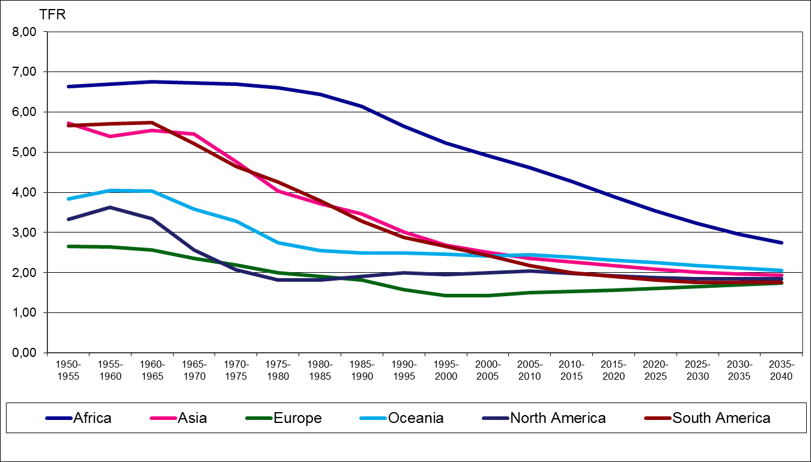
Trends in demographic processes: fertility

Slide 7
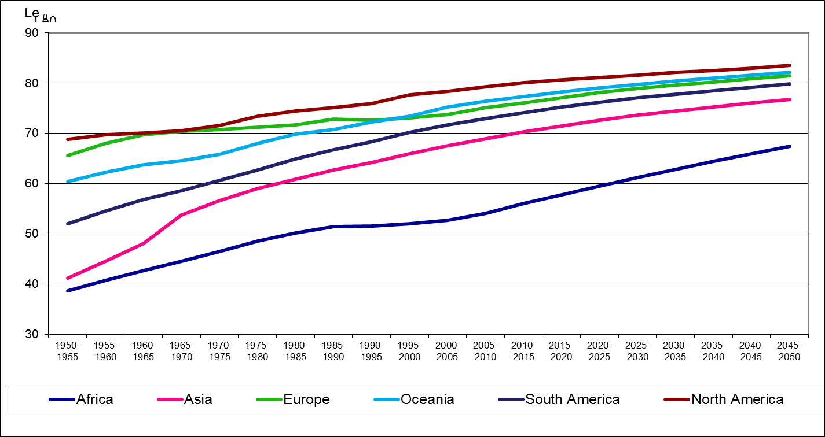
Trends in demographic processes: life expectancy

Slide 8
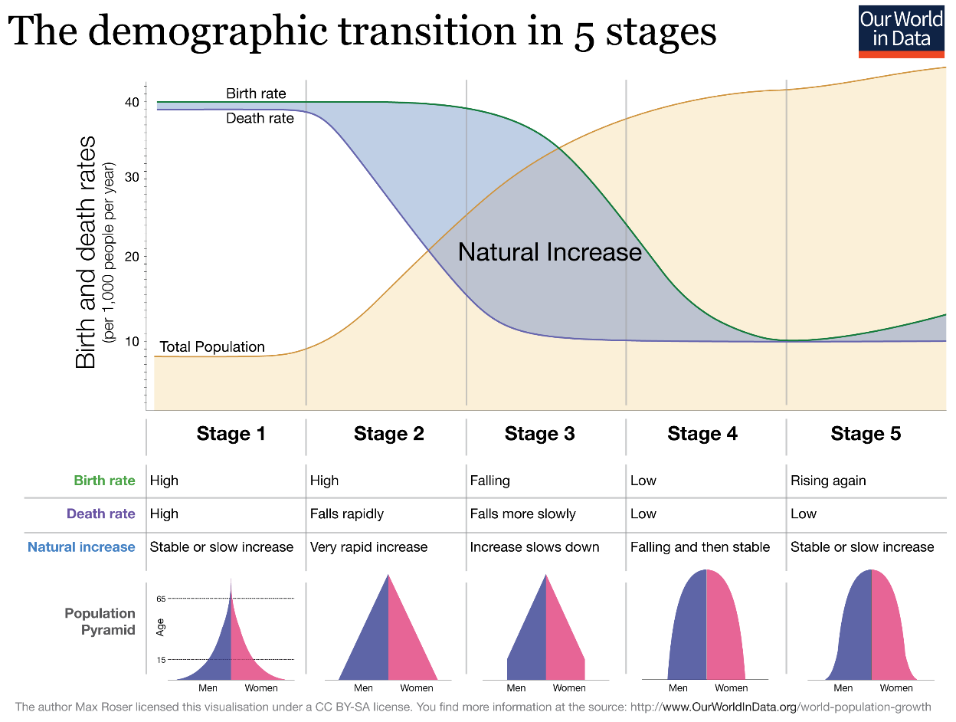
Demographic transition: where in a population development the migration potential is lying?

Slide 9
Revisiting mobility transition theory – what have we missed?
Zelinsky (1971) relates spatio-temporal systems to demographic systems and postulates that there are
definite, patterned regularities in the growth of personal mobility through space-time during recent history,
and these regularities comprise an essential component of the modernization process
Offers a view on the irreversible progression of stages in the development of the process

Slide 10
Revisiting mobility transition theory – what have we missed?
But also that modernization process
brings about widening range of options for locating and patterning one’s life
genuine migration means usually shift both in spatial and SOCIAL locus (i.e occupations, social class, religious affiliation, variety of political affiliations (including citizenship))
Mobility of mind (access to information, spread of knowledge, educational transition)

Slide 11
Revisiting mobility transition theory – what have we missed?
But also ‘shallower local attachment’, ‘rootlessness’? Or from ‘increasing trend of formation of political, civic and community oriented networks’ (Lesthaeghe, Neels 2002) and ‘state-formation process’ (Skeldon 1997) to ‘weakening social cohesion and social capital shifts towards expressive and affective types’ (Lesthaeghe, Neels 2002)? Or rather ‘the short-run and long-run’ view on the issue of diversity (Putnam 2007) Or the Third Demographic Transition (Coleman 2006)?
Zelinsky(1971) warns that despite a lot of research related to migration
The intrinsic nature of the phenomenon might not have been captured due to definitional problems
and thus, availability of relevant data and analysis remains a problem
STILL TRUE TODAY!

Slide 12
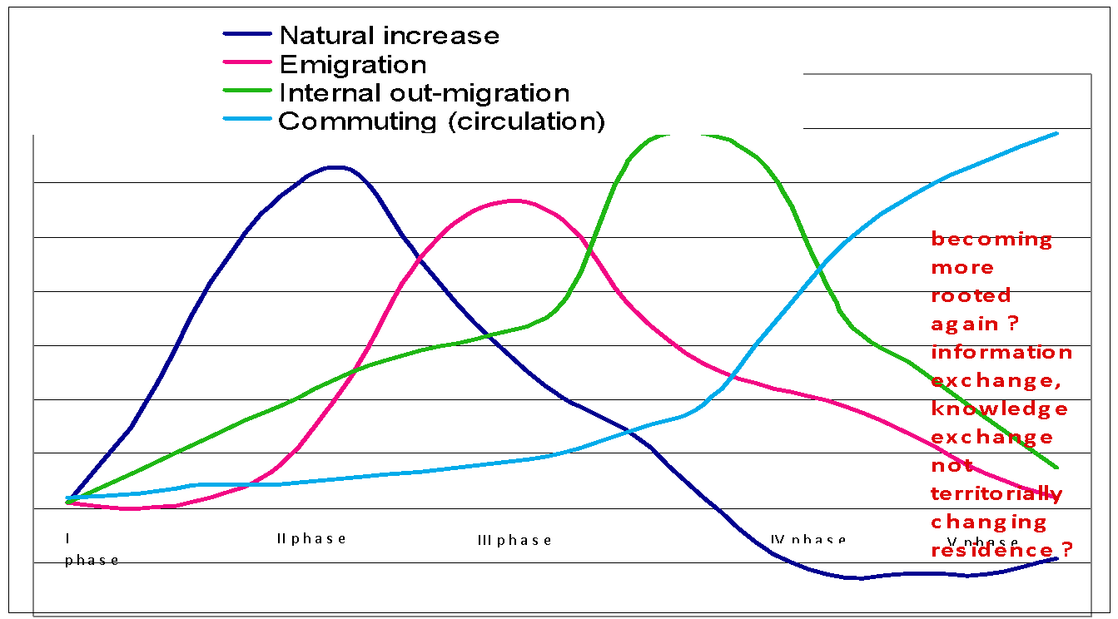
Mobility transition theory – how to advance?

Slide 13
Definition setting
Do not apply colonial thinking
With colonial thinking European marriage type and Hajnal line (1956) would have never come into existence, vice versa, explore the state formation process in relation to demographic development (Skeldon 1997), i.e. what is the definition of place of birth? (current problems in Kyrgyztan (Fergana is historical Uzbekistan territory), countries and regions in FSU, Yugoslav )
Construct valid population entities
It is for scientific community to influence their NSOs and administrative databases to serve the populations in their best interest – start collecting data on diversity aspects and to each populations apply what is relevant to them (not political constructs)(see Haug 2000, Haug, Compton, Courbage 2000, 2003),
i.e. self-identification, mother tongue, usual language, other languages, religious affiliation, place of birth of oneself (first generation), parents (second generation), grandparents (third generation, think of Paris, Tallinn, Malmö, Stockholm), new concept of citizenship because of its dual, triple or even quadraple nature

Slide 14
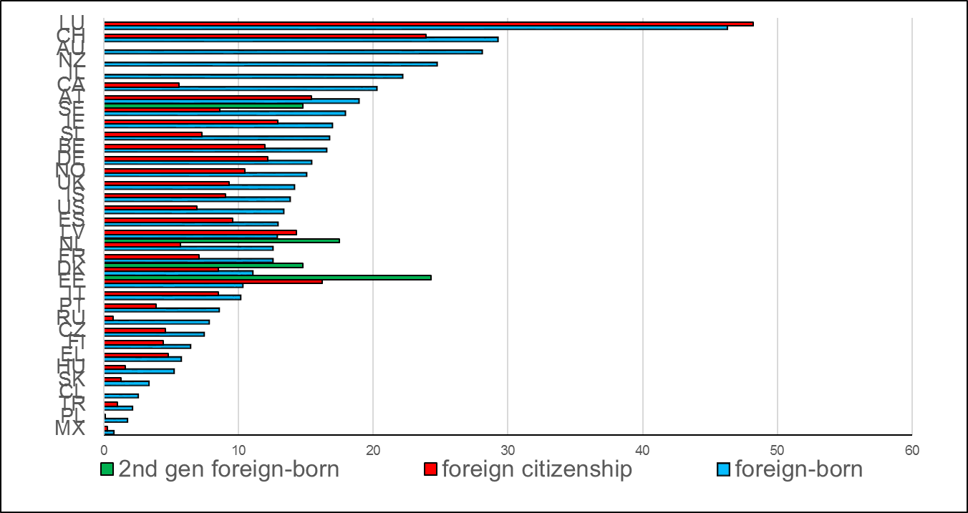
Examples on definition of who is foreign?
Source: OECD, 2018, Statistics Estonia 2011

Slide 15
Definition setting
Measure migrations to relevant population,
i.e. go to the beginning where it all started
Emigration is tied to the certain structure of population
Immigration a certain stage during population’s development
Consider pool of return migration

Slide 16
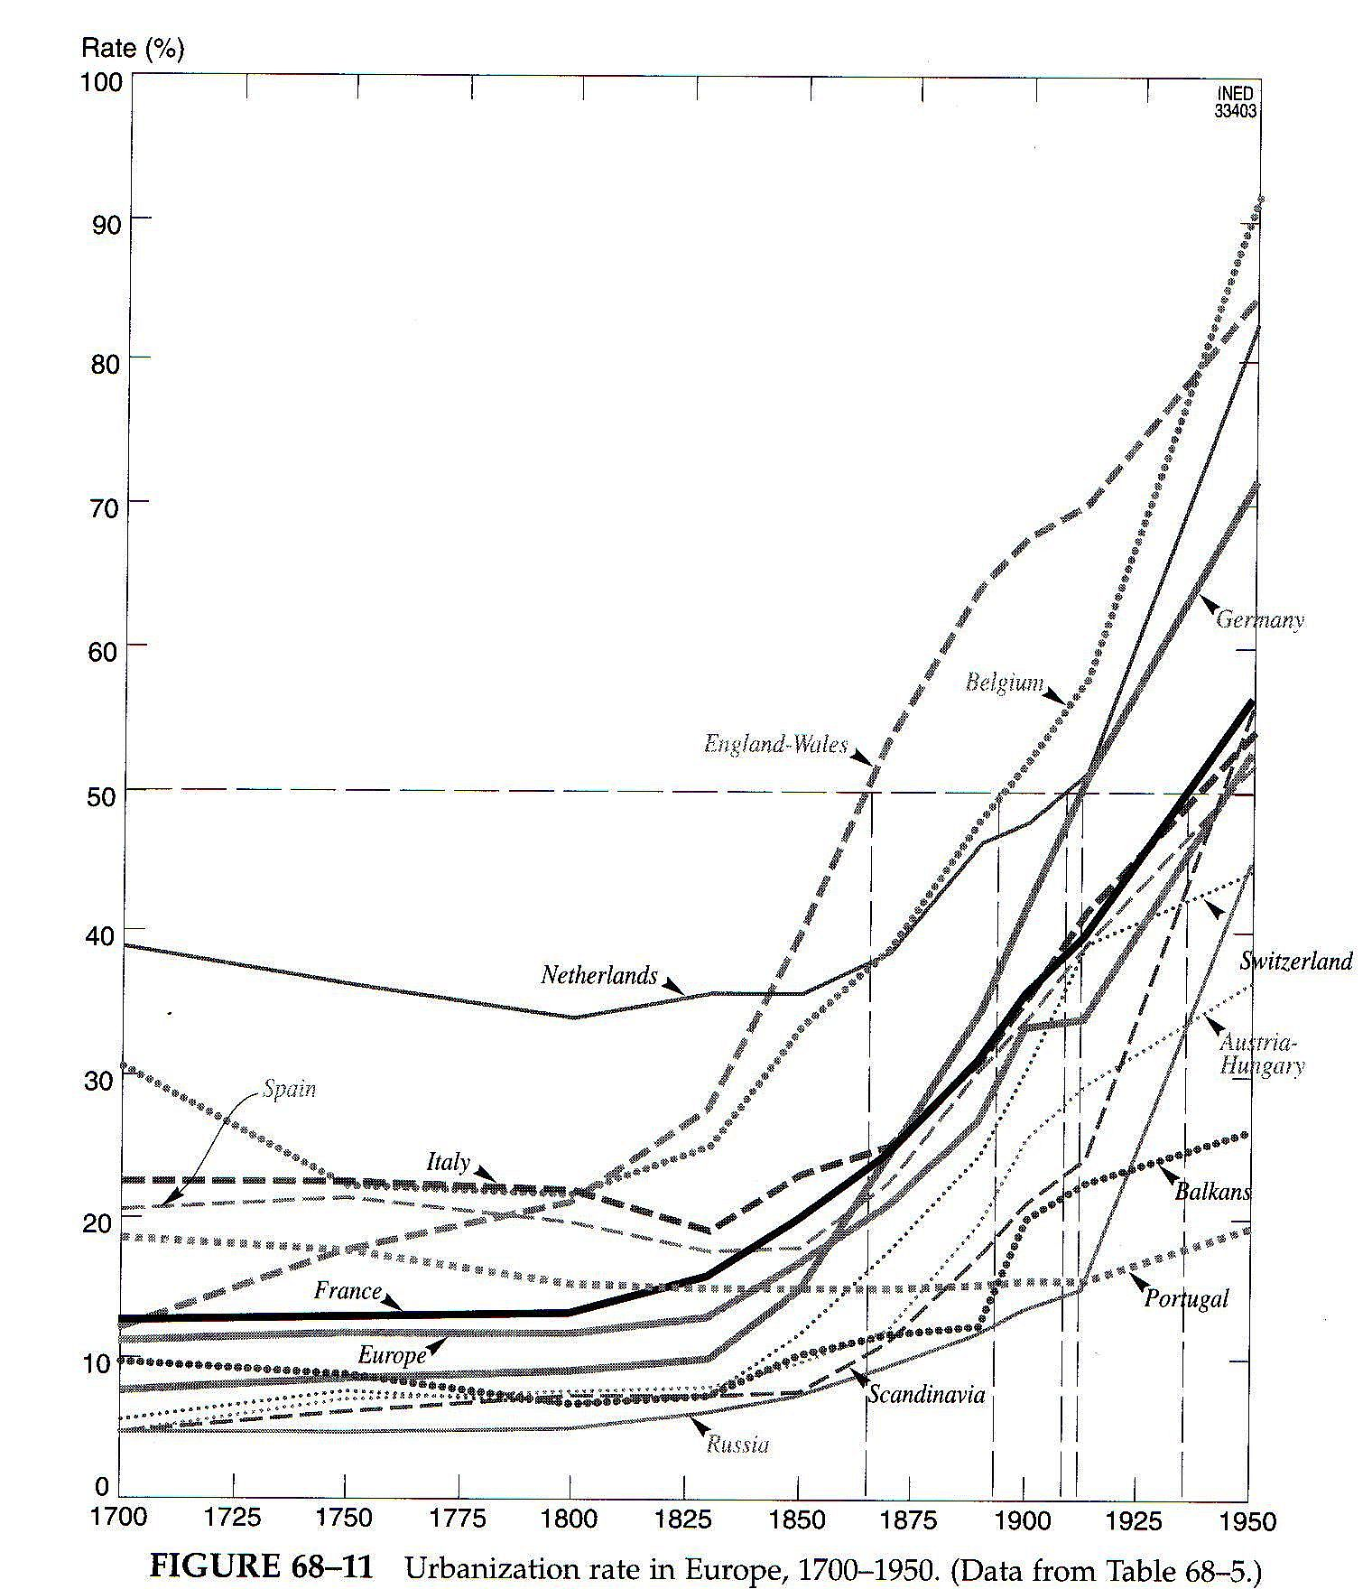
Start of mobility increase – at a certain point in each population’s development?
Source: Rogers, 1982

Slide 17
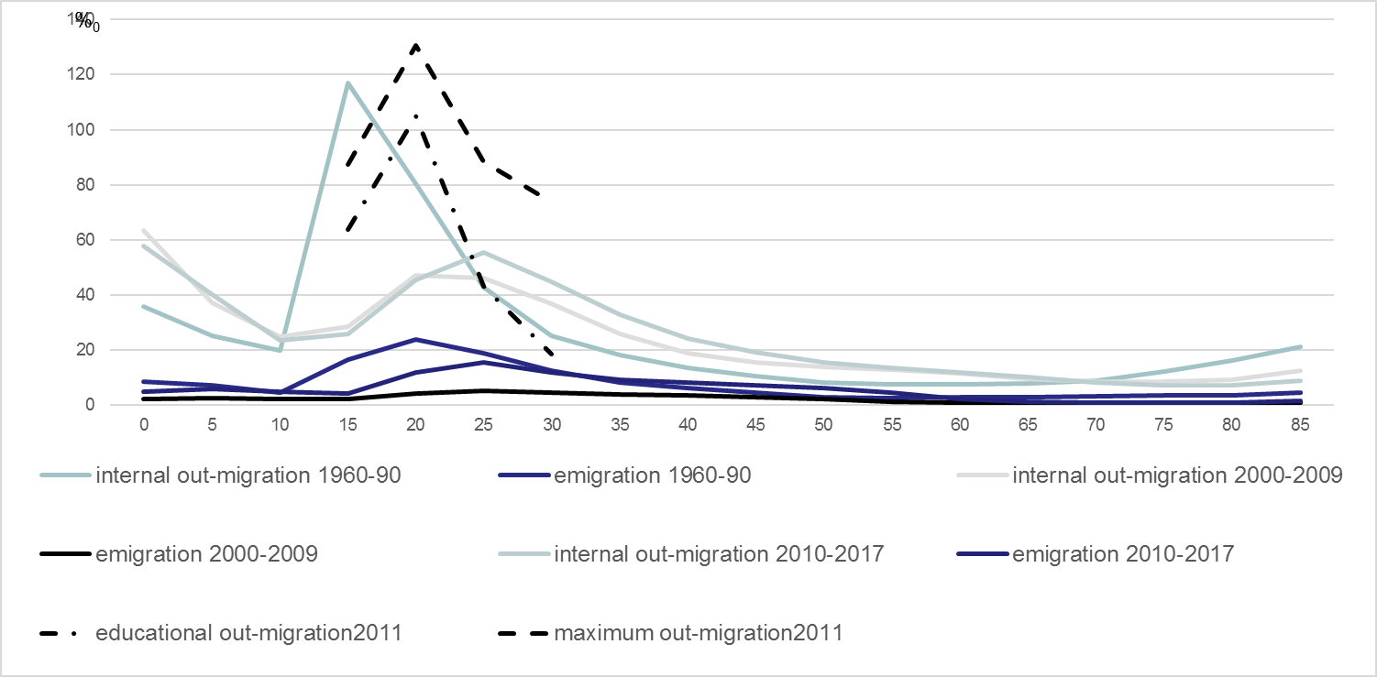
Out-migration into two main directions 2010s , Estonia
Source: Statistics Estonia 2011, 2018, EstPOPDatabank

Slide 18
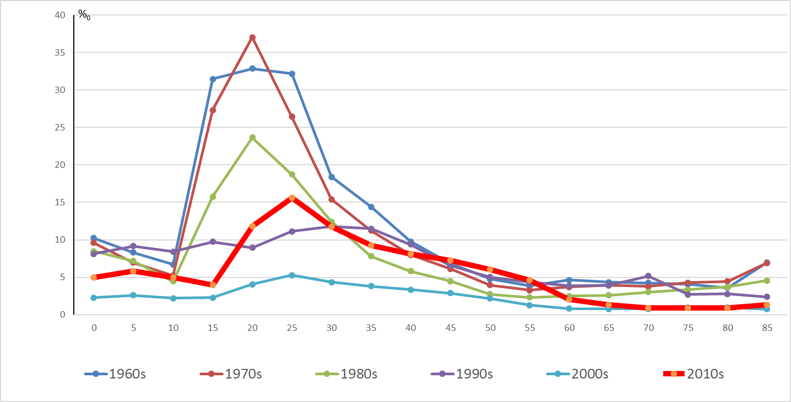
Age-specific emigration rates, Estonia, 1960s-2010s
Source: Statistics Estonia 2018, EstPOPDatabank, authors own calculations

Slide 19
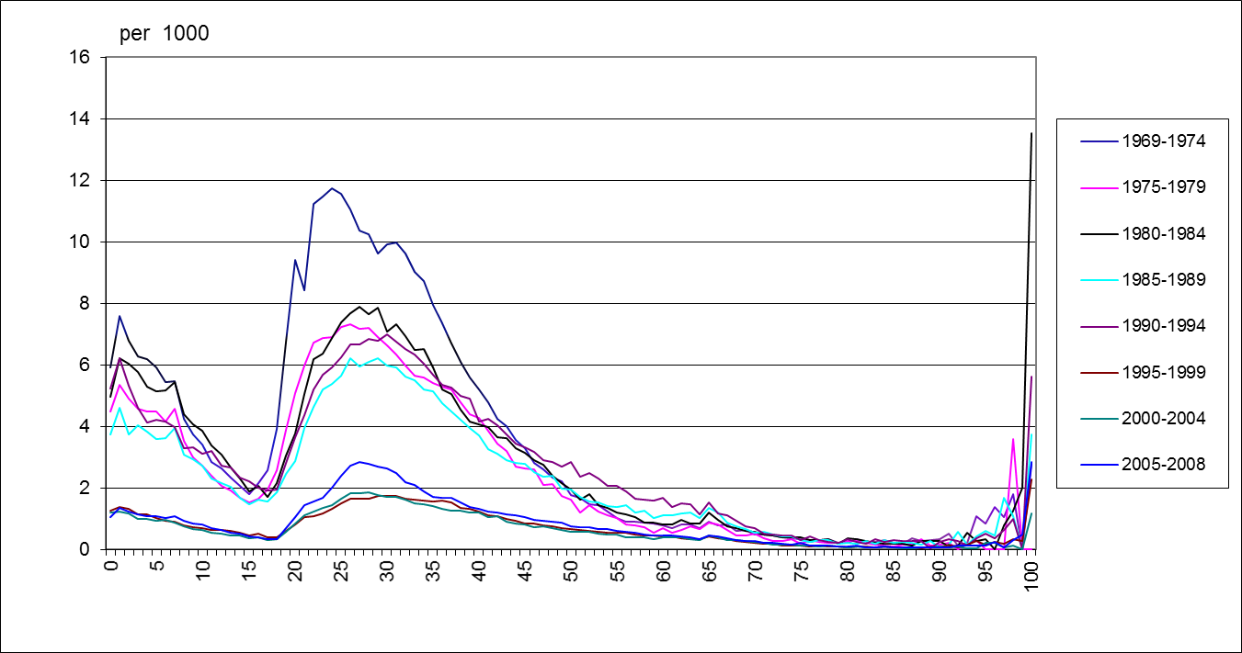
Age-specific emigration rates, Sweden, 1969-2008
Source: Statistics Sweden, 2010

Slide 20
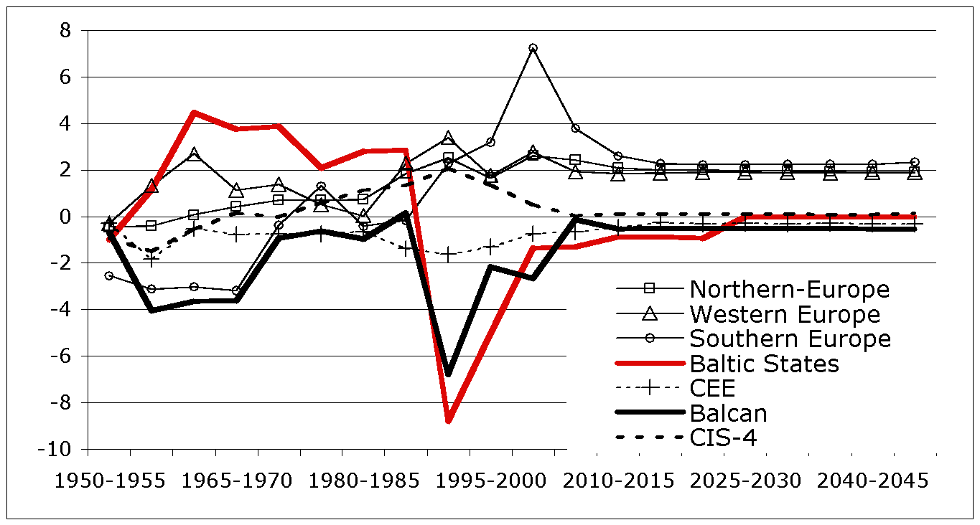
Net migration rates, regions of Europe, 1950-2050
Source: UN Population Prospects database, rel.2008

Slide 21
Definition setting
Do not apply your system to the part of immigrant population
they are in another phase, i.e. measure in accordance with that stage in demographic development as well as their population’s social structure

Slide 22
No effect of economic transition, but effect of imposed colonial structures Crude emigration rates (per 1000) by self-identification, Estonia 1990s, 2010s
 | 1989 | 1992 | 2011
Ukrainians | 2,9 | 105,9
Tatars | 1,6 | 97,8
Germans | 111,3 | 91,5
Bielorussians | 0,7 | 89
Jews | 58,5 | 72,9
Russians | 0,8 | 54,5 | 1,7
Polish | 106,3 | 53,9
Finns (Ingrians) | 1,9 | 19
Estonians | 0,3 | 0,9 | 5,1
Source: Statistics Estonia 2011, Est POP Databank, author’s own calculations

Slide 23
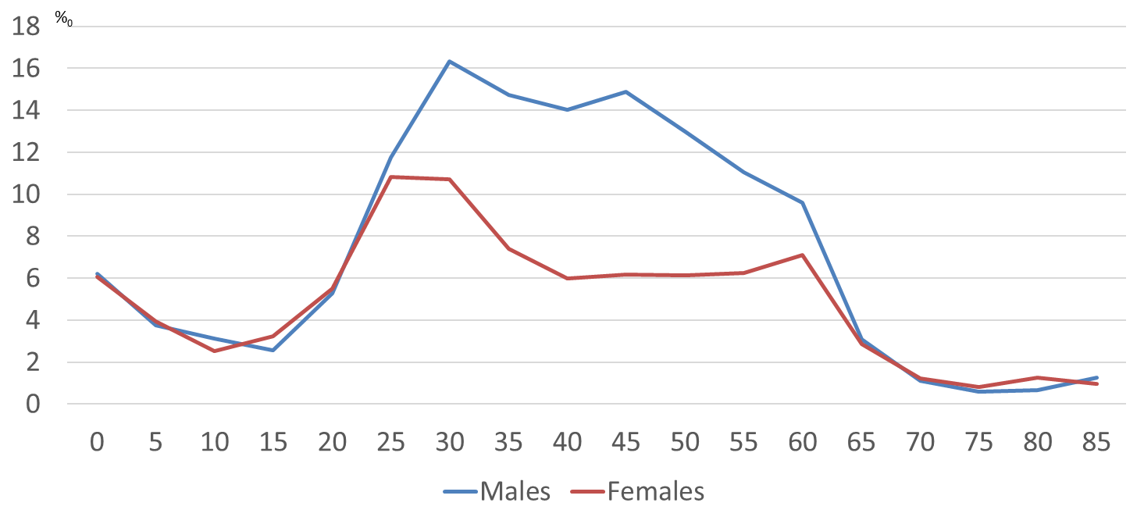
Return migration of those of Estonian citizenship, Estonia 2017
Source: Statistics Estonia 2019, own calculations

Slide 24
Definition setting
Development of new forms of migration are
intrinsic to the population in accordance with the developmental stage of demographic transition of this population, we need to start measuring them

Slide 25
Modern phases of migration- urban to rural (urban sprawl)?
By age |  | 1924 | 1929 | 1934 | 1939 | 1944 | 1949 | 1954 | 1959 | 1964 | 1969 | 1974
Native population
30 | 13.0 |  | 8.9 | 7.3 | 11.0 | 10.2 | 14.2 | 17.4 | 17.2 | 15.0 | 14.7 | 14.5
35 | 8.7 |  | 8.4 | 7.9 | 9.8 | 10.5 | 14.0 | 16.1 | 18.5 | 17.9 | 16.2
Foreign origin population
30 | 4.3 |  | 7.8 | 4.2 | 4.7 | 3.8 | 5.1 | 4.5 | 4.7 | 3.1 | 4.0 | 4.5
35 | 4.3 |  | 5.6 | 3.2 | 2.3 | 1.1 | 2.9 | 4.0 | 4.7 | 4.2 | 10.5
Source: Est GGS 2004, birthplace in urban environment, by that age in rural environment

Slide 26
In order to understand new forms of migration.......
Additional definitions – who is in emigration waves and who is not?
EU wide movements in case of free movement – countries with excellent register systems can have the opportunity to distinguish ( in 2006 14% formed own nationals, another similar amount other EU MS (Herm , 2009)) – at what time in their lifetime they come back?
Do not count residence permits, but real residence
Education attainment abroad - to which extent is it registered in our population’s data?
Commuting between household in own country and work in the neighbouring country (the same in internal migration)
Residing half a year in own country, half a year in another country

Slide 27
In order to understand new forms of migration.......
DATA; DATA; DATA:
Nordic countries can have advantage to monitor different movements and distinguish new forms through linking different datasets (residence permits,asylum applications, tax payments, border-crossing, benefit reception, study loans and education registers etc)
Tackle the movements of native population, in particular through linking on personal data emigration dates with return dates, understanding who is going away for how long, what new characteristics have acquired (higher educational level, for some professionals professional advancement can be monitored through relevant registers (health care staff))
Distinguish population groups (foreign origin population evaluated separately from native population) and their migration rates in accordance with their population structure in the residence country
Cooperation between countries with registers to exchange personal level data in order to tackle their movements in neighbouring countries and back –LET US START A BALTO-SCANDIC COOPERATION

Slide 28
START THEORIZING BIG....
Encompass the social mobility transition as a whole
On the basis of understanding better emergence of new forms of mobility adjust the mobility concept (like health transition or union formation transition)
Systematic approach to processes under study will help to model them in the frame of complex system approach but you cannot start at the complex level without understanding the development process of sub-systems you put into the complex system
Link to social mechanisms (i.e. micro-level behaviours) (Billari 2015)
1) situational mechanisms through which the macro level affects individual outcomes (e.g., how mortality decline in a society affects individual fertility choices).
2) action-formation mechanisms through which inter-individual processes (over time) affect individual outcomes (e.g., how past fertility choices affect current fertility choices).
3) transformational mechanisms through which, via the aggregation of individual outcomes or the interaction among individuals, macro-level outcomes are generated.

Slide 29
THANK YOU FOR ATTENTION!
e-mail: luule.sakkeus@tlu.ee

Slide 30
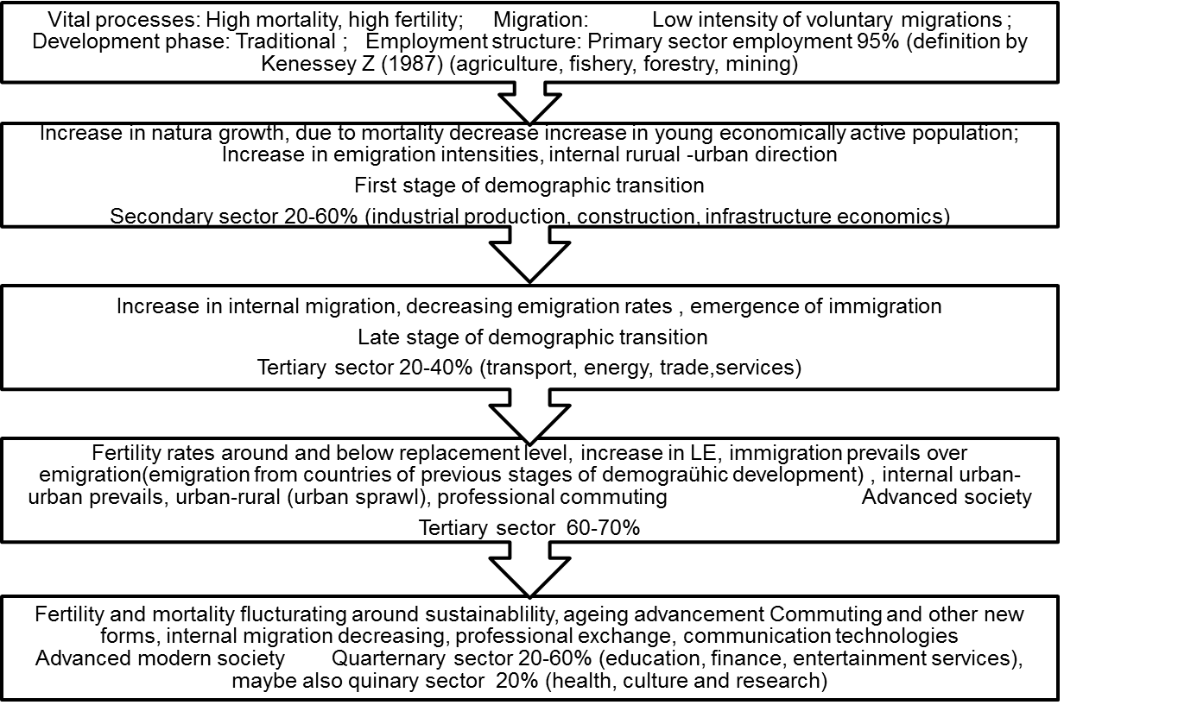
Five stages in migration transition (Zelinsky 1971)

