Slide 1

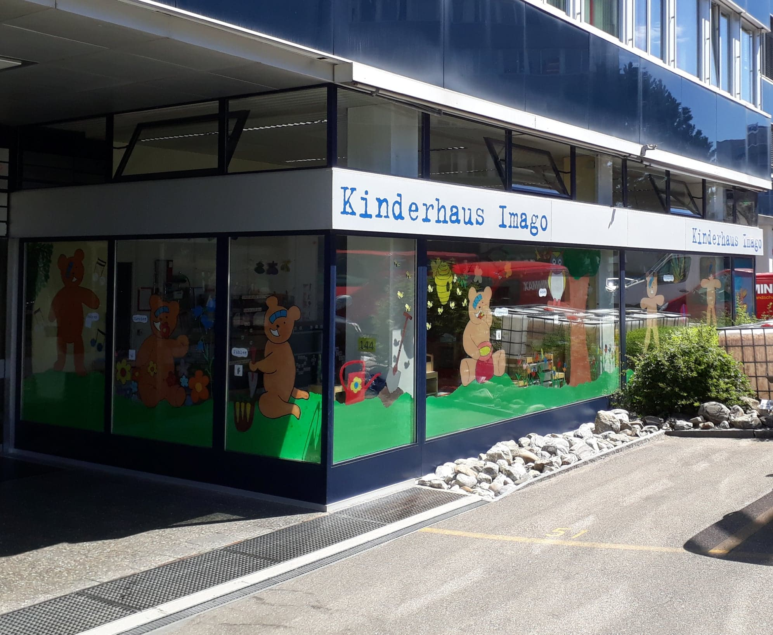
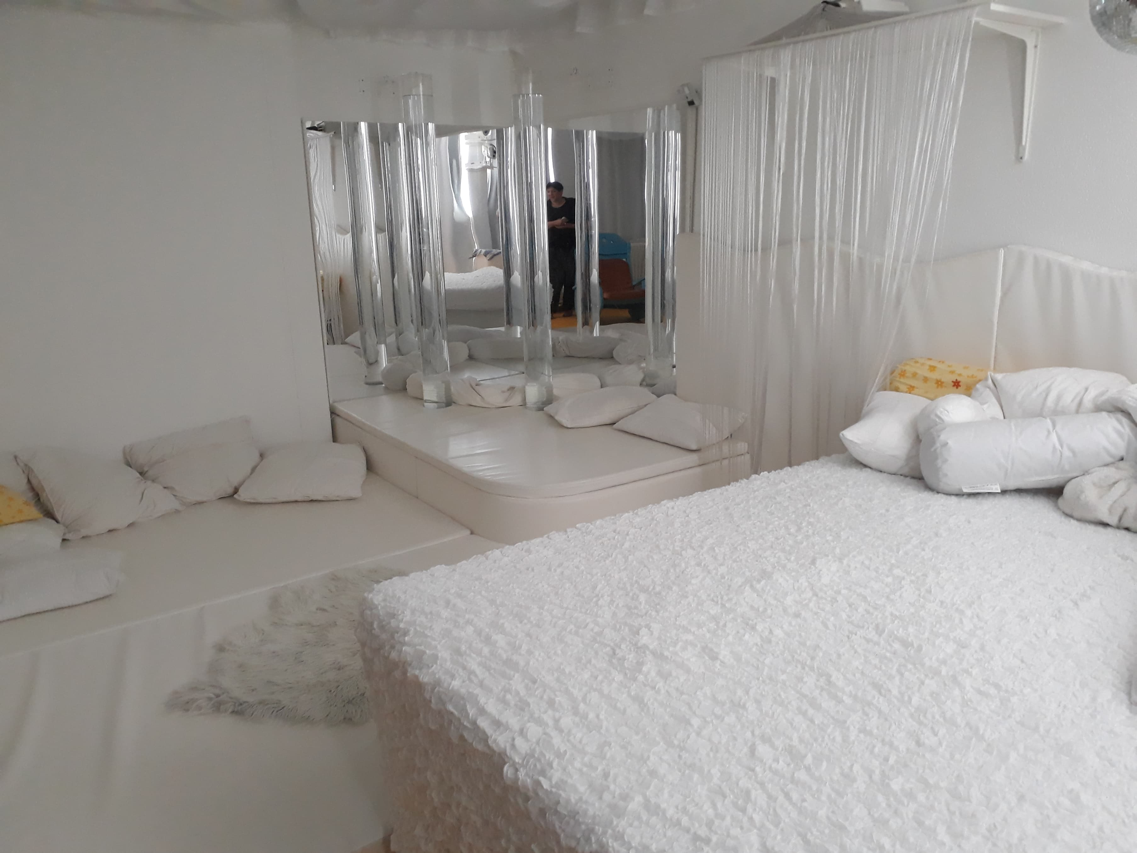



Early years education who’s responsibility is it?
Summer School
Special Needs and
Inclusive Education
in Switzerland
Antonia Shevlin Manchester Metropolitan University, England, UK
Ashley Weaver Bellarmine University, Kentucky, USA
Merilin Oidjärv, Tallinn University, Estonia
2018
Abstract
A poster report reflecting on our visit to Viso parents and discussion into the different attitudes across cultures on early years education. Incorporating information from a variety of countries and from the director of Viso Parents Carmelina Castellino.
Introduction
Conclusions
We all came into the programme to expand our knowledge of working with children across different cultures with special educational needs. Over the week we have had the opportunity to discuss with peers the similarities and differences of our own education system and share knowledge into different types of practices. We also had the opportunity to visit local educational organisations, in the city of Zurich, we went to Viso parents which offers places for children with and without special educational needs before they start compulsary education. What was surprising is that early years education in Zurich is not funded by the government.
This poster aims to discuss the visit to Viso parents, information from Carmelina Castellino to compare early years education across a variety of countries; in particular parental, goverment and teacher attitudes to early years education.
How much does early years education cost and who‘s responsiblity is it to pay for it?
From our visit to viso parents and hearing from guest lecturer Peter Wheli we were surprised to hear that in switzerland the responsibility of early years education regardless of whether the child has special needs or not is considered the responsibility of the parents and only as a last resort will the government intervene.
When we visted Viso Parent and spoke with the director, Carmelina Castellino, about how the program started and what her role was with the program. She spoke to us about the lack of funding from the government and the different fundraising they have to do to support their daycare. She spoke on the idea of how they are an inclusive day care instead of segregated. She spoke to us on how they considered themsevles inclusive instead of integrated because they have about fifty percent of students instead of having a regualr education daycare and bringing students with disabilites into it.
After this she took us on a tour of the day care and we spoke with different teachers and apprenticeships. They spoke to us on the ideas they have brought to the day care such as, starting a program called Relief. This program is 1 day a week, 1 weekend per month, and 4 weeks per year where children with disabilites and their siblings can stay overnight so the parents have relief. One of the biggest fundraising proects she focused on was the Snoozelen Room. This room included a water bed for children that couldnt hear so they could feel the music but the wave and motions in the bed. In this room everything was white and they had the ability to turn on different lights that helped with children with disabilities with senosry motor.
In 1970, Freire argued that education is never neutral – it is a political act that is informed by individuals and collective vaules. Inclusive education therefore involves embrassing human diversity, valuing and supporting the beloging and full participation of all people together (Cologon, 2013).
Viso parents are a fully inclusive organisation with half of their children that have some sort of Special Educational Needs, whether it be visible or not. As long the staff can learn new skills by the parents to support the child and that they have the staff to be able care for the child then they will be accepted into the school.
In the UK every child with Special Educational Needs from aged 0-25 are entitled to receive up to £6,000 funding for their school, under the SEND code of practice (paragraph 6.2). Resources for these schools and the schools SEN budget is monitored by the schools governing body e.g. Ofsted. (Childlawadvice.org.uk, 2018).
In Estonia, children aged 17 and under with profound and severe disability who have a great need for care are offered childcare, support person and transport service as support services. The need for support services has to be assessed beforehand at a local government by a specialist of child protection or social work and it has to be included in the case plan (it may be based on the assessment of the need for services in the child’s rehabilitation plan)(eesti.ee, 2018).
An increasing number of parents and teachers in the UK are seeking a diagnosis for their children due to the pressures of the raising standards in schools to compete nationally. Teachers can not cope with the rising number of children with SEN on the limited resources they currently have. ( Allan and Youdell, 2017). Yet, in Singapore for example parents are against their children having a diagnosis of Special Educational Needs due to fear of stigmatisation.
Viso parents is an organisation that relies heavily on fundraising and charity support. It is inclusive not only in it’s students but also has staff and committee members who have a Special Educational Needs or Disability for example their president is Blind and 3 members of the committee has a SEN.
I really enjoyed the visit to Viso Parents and the way this program was run. I liked how much the parents were involved and the parent organization always worked together for fundraising and keeping the programs running. I think the thing that I will take back to the United States is having the perspective that the directors do at Viso Parents that there is no disability they cant take because if the parents can handle it they can. I think this is really important to understand that all children deserve the respect and care to live the best life possible.
I really liked the visit to the day care because it showed that children don't care about differences and they don't see them. Thanks to integrating special education children with regular ones makes them more tolerant. I was really happy to see the opportunities that the day care provided for the children, the possibility to move around and use all the space that they have in their rooms. What really impressed me was the snoozelen.
Picture 2: Snoozelen
It was amazing to see how much they try to make the special education children feel the world The most important thing that I will take back to Estonia would be that no matter what disability the child has, I can include them in every day life and let them explore life.
It was great to have the opportunity to have a tour of the facility, to see first hand the amazing work that they do. I really like the relief programme that they offer, it is great that they fully support not only the child but the entire family. The relief programme offers the children with SEND and their siblings an over night stay once a week, 1 weekend a month and 4 weeks a year to give parents a break. It is a shame that the government does not help fund this organisation as they do great work, but I appreciate it is hard to change people’s mind sets.
UK | >2yrs 25 hours = £122.46 2-4yrs = £11.9.47 | All 3-4 year old and 40% of the most disadvantaged 2 year olds in England are eligible for free 15 hrs per week, 38 weeks a year.
USA | >5 yrs = $140 pw 5-21 years free | Government funding is only available at the age of 5.
Estonia | €61 per month | Parents pay monthly fee. Government helps to pay for the fee when families don’t earn the minimum wage.
Singapore | $160 per month as of 2019 | 80% of fees are paid for by the Government for poor families. However, pre-school is not compulsory.
Switzerland | 1 day: Child - 125 chf Baby – 130 chf: Server disability 400 chf | Government do not fund any school under the age of 4 as it is seen to the be the responsibility of the family.
Sweden | 1-3yrs 15hrs pw -free 3-6yrs 525hrs are required to offer those hours | After that amount the payment is split between parents and the government 3% from parents wages and €16,000 per child.
Picture 1: Viso parent.
Figure 1: Cost of early years education across countries and who is responsible to pay.
Bibliography
Visit
Ainscow, M., Dyson, A., Goldrick, S. and West, M. (2016). Using collaborative inquiry to foster equity within school systems: opportunities and barriers1. School Effectiveness and School Improvement, 27(1), pp.7-23.
Allan, J. and Youdell, D. (2015). Ghostings, materialisations and flows in Britain's special educational needs and disability assemblage. Discourse: Studies in the Cultural Politics of Education, 38(1), pp.70-82.
Amet, R. (2018). Eesti riigi infoportaal | Eesti.ee. [online] Eesti.ee. Available at: http://eesti.ee/ [Accessed 29 Jun. 2018].
Childlawadvice.org.uk. (2018). Special Educational Needs. [online] Available at: https://childlawadvice.org.uk/information-pages/special-educational-needs/ [Accessed 27 Jun. 2018].
Nurseryworld.co.uk. (2018). The cost of a nursery place rises above inflation | Nursery World. [online] Available at: https://www.nurseryworld.co.uk/nursery-world/news/1163692/the-cost-of-a-nursery-place-rises-above-inflation [Accessed 29 Jun. 2018].

